Slide 1
“得救”意味着什么？
What Does It Mean to Be “Saved”?
A Brief Study of Gal 加拉太书 1:3-5 简析
3 Grace and peace to you from God our Father and the Lord Jesus Christ, 4 who gave himself for our sins to rescue us from the present evil age, according to the will of our God and Father, 5 to whom be glory for ever and ever. Amen.
It means 它意味着—
I. We are at peace with God! (v. 3)
我们与神和好，从神得平安！
“I never knew we argued!
我不知道我们吵过架！”
Notes:
加拉太书 1:1做使徒的保罗——不是由于人，也不是借着人，乃是借着耶稣基督，与叫他从死里复活的父神—— 2 和一切与我同在的众弟兄，写信给加拉太的各教会。 3 愿恩惠、平安从父神与我们的主耶稣基督归于你们！ 4 基督照我们父神的旨意，为我们的罪舍己，要救我们脱离这罪恶的世代。 5 但愿荣耀归于神，直到永永远远！阿门。我们与神和好，从神得平安！
我们已被买赎！
我们已被拯救！
神想要我们!
我们有一个永恒目标!

Slide 2
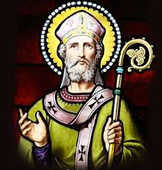
"得救"意味着什么
What Does It Mean to Be “Saved”?
A Brief Study of Gal 加拉太书 1:3-5 简析
3 Grace and peace to you from God our Father and the Lord Jesus Christ, 4 who gave himself for our sins to rescue us from the present evil age, according to the will of our God and Father, 5 to whom be glory for ever and ever. Amen.
It means 它意味着 —
II. We have been paid for! (v. 4)
罪债全偿清！
The 11th Century scholar Anselm’s Why the God-Man?
Notes:
我们与神和好，从神得平安！
我们已被买赎！
我们已被拯救！
神想要我们!我们有一个永恒目标!

Slide 3
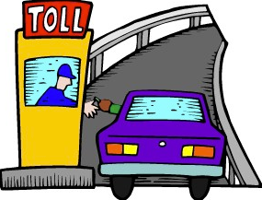
"得救"意味着什么
What Does It Mean to Be “Saved”?
A Brief Study of Gal 加拉太书 1:3-5 简析
3 Grace and peace to you from God our Father and the Lord Jesus Christ, 4 who gave himself for our sins to rescue us from the present evil age, according to the will of our God and Father, 5 to whom be glory for ever and ever. Amen.
It means 它意味着 —
II. We have been paid for! (v. 4)
我们已被买赎！
The debt has been paid!
罪债全偿清！

Slide 4
"得救"意味着什么
What Does It Mean to Be “Saved”?
A Brief Study of Gal 加拉太书 1:3-5 简析
3 Grace and peace to you from God our Father and the Lord Jesus Christ, 4 who gave himself for our sins to rescue us from the present evil age, according to the will of our God and Father, 5 to whom be glory for ever and ever. Amen.
It means 它意味着 —
III. We have been rescued! (v. 4)
我们已被拯救！
Life-saving class 救命课程. . .

Slide 5
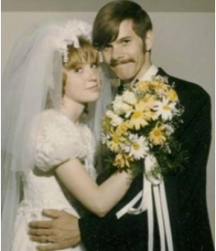
"得救"意味着什么
What Does It Mean to Be “Saved”?
A Brief Study of Gal 加拉太书 1:3-5 简析
3 Grace and peace to you from God our Father and the Lord Jesus Christ, 4 who gave himself for our sins to rescue us from the present evil age, according to the will of our God and Father, 5 to whom be glory for ever and ever. Amen.
It means 它意味着 —
IV. We are wanted by God! (v. 4)
神想要我们！

Slide 6
"得救"意味着什么
What Does It Mean to Be “Saved”?
A Brief Study of Gal 加拉太书 1:3-5 简析
西番雅书 Zeph. 3:17
The Lord your God is with you,
the Mighty Warrior who saves.
He will take great delight in you;
in his love he will no longer rebuke you,
but will rejoice over you with singing. 耶和华你的神是施行拯救、大有能力的主，他在你中间必因你欢欣喜乐，默然爱你，且因你喜乐而欢呼

Slide 7
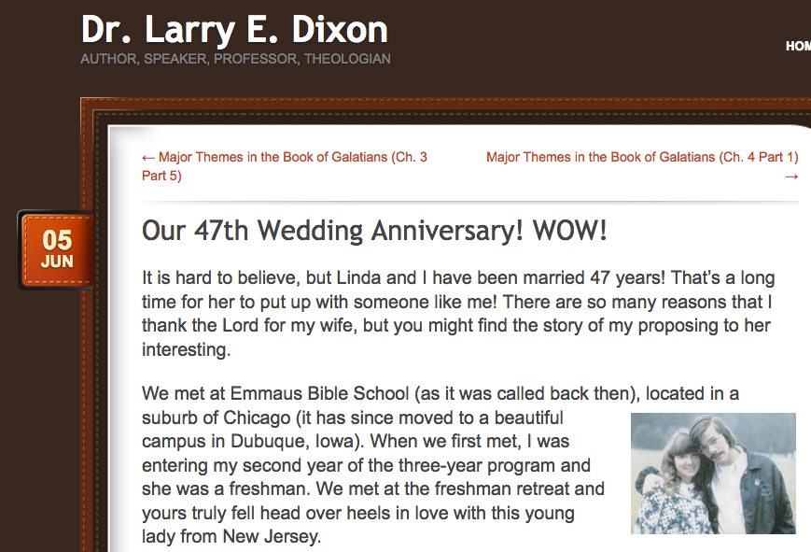
"得救"意味着什么
What Does It Mean to Be “Saved”?
A Brief Study of Gal 加拉太书 1:3-5 简析
larrydixon.wordpress.com

Slide 8
"得救"意味着什么
What Does It Mean to Be “Saved”?
A Brief Study of Gal 加拉太书 1:3-5 简析
3 Grace and peace to you from God our Father and the Lord Jesus Christ, 4 who gave himself for our sins to rescue us from the present evil age, according to the will of our God and Father, 5 to whom be glory for ever and ever. Amen.
It means 它意味着 —
IV. We are wanted by God神想要我们! (v. 4)
V. We have an eternal purpose
我们有一个永恒目标! (v. 5)
“to whom be glory for ever and ever. Amen.
但愿荣耀归于神，直到永永远远！阿门”

Slide 9
What Does It Mean to Be “Saved”?
A Brief Study of Gal 加拉太书 1:3-5 简析
"If it is right for man to have the glory of God as
his goal, can it be wrong for God to aim at the
same goal? If man can have no higher end and
motive than God’s glory, how can God? And if it is
wrong for man to seek a lesser end than this, then it would be wrong for God too. The reason why it cannot be right for man to live for himself, as if he were God, is simply the fact that he is not God; and the reason why it cannot be wrong for God to seek His own glory is simply the fact that He is God. Those who would not have God seek His glory in all things are really asking that He should cease to be God. And there is no greater blasphemy than to will God out of existence." (J.I. Packer in The Plan of God)
Notes:
他们的推论合理吗？让我们再说一遍：其实他们完全错误。既然人应以神的荣耀为目标，神岂不可以有同一目标吗？既然人除了神的荣耀以外，不可能有更高目标，神又怎能有比此更高的目标呢？既然人不应追求次等的目标，神也不应如此了。人之所以不应为自己而活，好象自己就是神一样，是因为人根本不是神。但是，神寻求祂自己的荣耀并无不妥，理由很简单，因为祂是神。谁坚持神不应追求个人荣耀实际上就是不以神为神。再没有什么比这样凭意志否定神更加亵渎神了。

Slide 10
“得救”意味着什么?
加拉太书 1:3-5 简析
"既然人应以神的荣耀为目标，神岂不可以
有同一目标吗？既然人除了神的荣耀以外，
不可能有更高目标，神又怎能有比此更高的
目标呢？既然人不应追求次等的目标，神也不应如此了。人之所以不应为自己而活，好象自己就是神一样，是因为人根本不是神。但是，神寻求祂自己的荣耀并无不妥，理由很简单，因为祂是神。谁坚持神不应追求个人荣耀实际上就是不以神为神。再没有什么比这样凭意志否定神更加亵渎神了。“ (巴刻在其著作《神的計畫》中写道)

Slide 11
"得救"意味着什么
What Does It Mean to Be “Saved”?
A Brief Study of Gal 加拉太书 1:3-5 简析
3 Grace and peace to you from God our Father and the Lord Jesus Christ, 4 who gave himself for our sins to rescue us from the present evil age, according to the will of our God and Father, 5 to whom be glory for ever and ever. Amen.
It means 它意味着 —
I. We are at peace with God我们与神和好! (v. 3)
II. We have been paid for我们已被买赎! (v. 4)
III. We have been rescued我们已被拯救! (v. 4)
IV. We are wanted by God神想要我们! (v. 4)
V. We have an eternal purpose我们有永恒目标(v. 5)
Notes:
我们与神和好，从神得平安！
我们已被买赎！
我们已被拯救！
神想要我们!我们有一个永恒目标!

