Slide 1
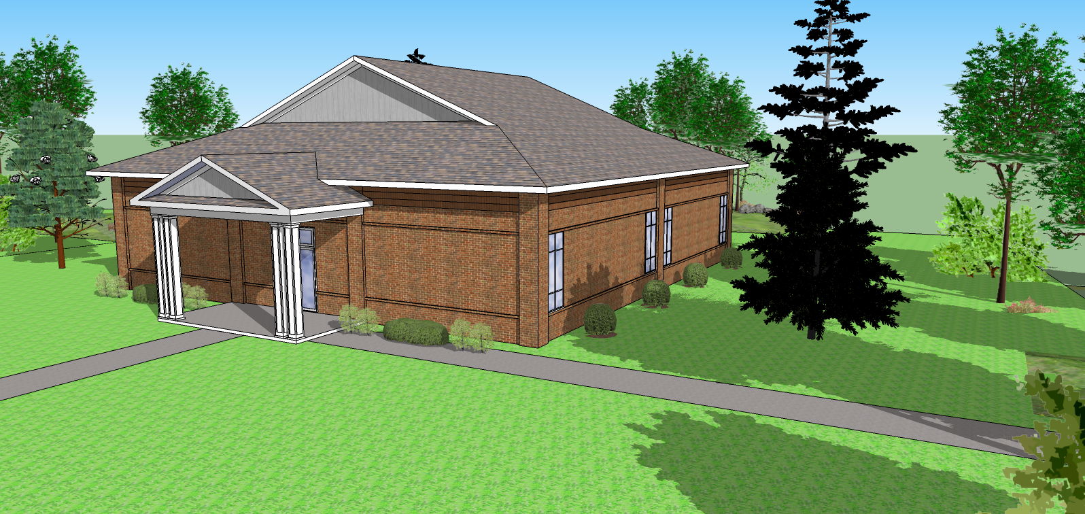

Slide 2
Current fund
$358,000

Slide 3
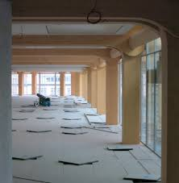
Shell
$300,000
Rough-in
$150,000
Total: $450,000

Slide 4
Needed fund $450,000
Current fund $358,000
2013 gen. fund contribution $25,000
2013 fundraising Goal: $65,000

Slide 5
Oct ’13 Dec’13 June’14
Shell $300K
Rough-in $150K
Completion of revised Phase 1
+ or - $150K

