Slide 1
神的呼召
C4 2015.3.15

Slide 2
The call

Slide 3
What is calling?
When God calls us, what does this mean? Os Guinness in his book The Call writes, "Calling is the truth that God calls us to himself so decisively that everything we are, everything we do, and everything we have is invested with a special devotion, dynamism, and direction lived out as a respond to his summons and service.” (The Call p.29)

Slide 4
Primary calling and secondary calling
The primary calling is that all should follow Christ, that we should love God with everything we have and everything we do.
The secondary calling is. how we live in our lives in response to this primary calling

Slide 5
What is your calling?
There's a distinct difference between calling and vocation.
Every Christian is called by God. We must never forget that we are not called to a specific activity, rather, we are called to obedience to Christ.
The response to God's calling upon our life is our service. Whatever our vocation--whatever we do in life, should be a direct response to the call of God.

Slide 6
finding and fulfilling the central purpose of your life (Subtitle)

Slide 7
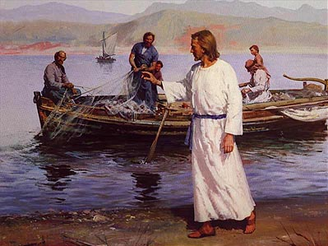
上帝呼召你了吗？

Slide 8
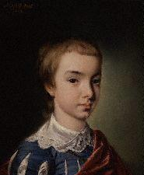
William Wilberforce (1759-1833)
His famous mission statement：the Lord is set before me two great objects, the suppression of the slave trade, and the reformation of manners for moral standards

Slide 9
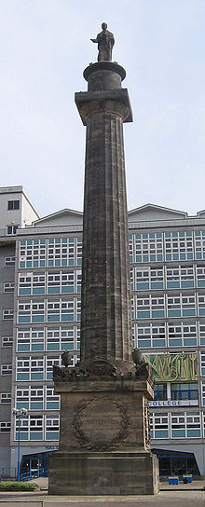
Wilberforce 废止奴隶贸易

Slide 10
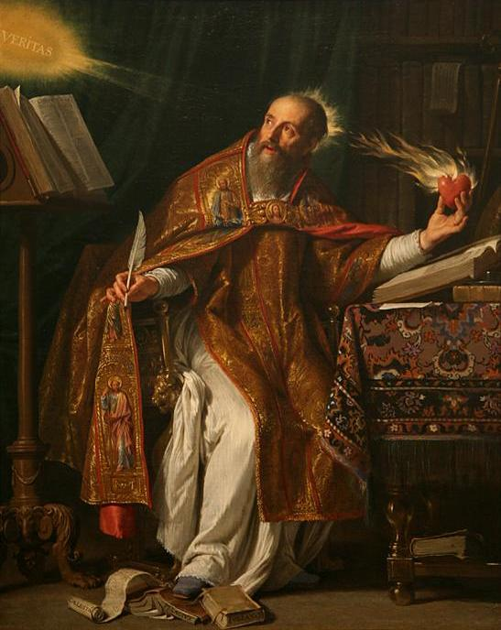
你的呼召是什么
"Love God and do whatever you please: for the soul trained in love to God will do nothing to offend the One who is Beloved."

Slide 11
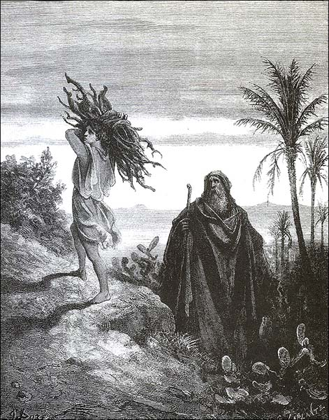
亚伯拉罕的呼召

Slide 12
献上你心中的以撒

Slide 13
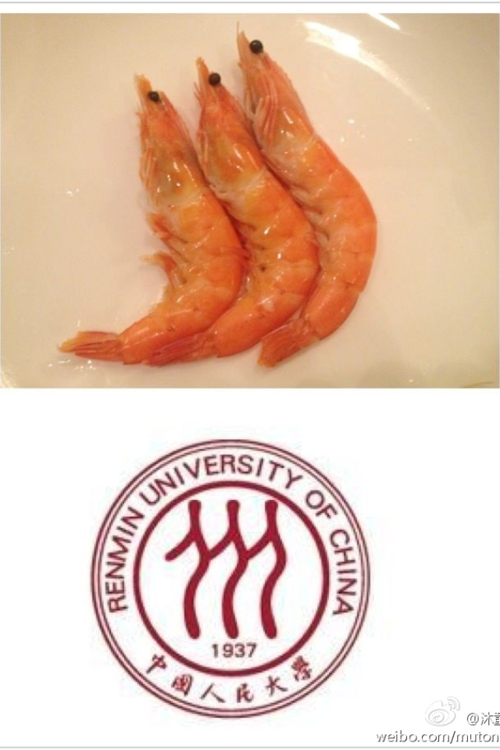
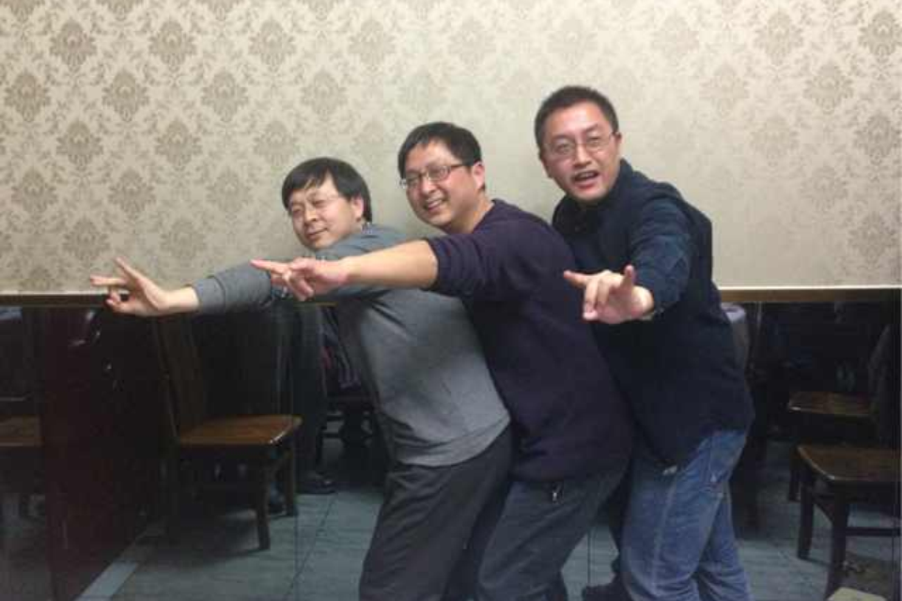
人大时光
Notes:
当年信主的经历：作为知识了解，然后理性分析，决定取舍，杜绝被洗脑，杜绝人云亦云；
占座，考托、考G，1997年来美；

