Slide 1
Spiritual Discipline
Chinese Christian Church at Columbia, SC 2018.3.25 English

Slide 2
Hebrews 12:1-3
Therefore, since we are surrounded by such a great cloud of witnesses, let us throw off everything that hinders and the sin that so easily entangles. And let us run with perseverance the race marked out for us,
² fixing our eyes on Jesus, the pioneer and perfecter of faith. For the joy set before him he endured the cross, scorning its shame, and sat down at the right hand of the throne of God.
³ Consider him who endured such opposition from sinners, so that you will not grow weary and lose heart.

Slide 3
Hebrews 12:4-8
⁴ In your struggle against sin, you have not yet resisted to the point of shedding your blood. ⁵ And have you completely forgotten this word of encouragement that addresses you as a father addresses his son? It says,
“My son, do not make light of the Lord’s discipline,
and do not lose heart when he rebukes you,
⁶ because the Lord disciplines the one he loves,
and he chastens everyone he accepts as his son.”
⁷ Endure hardship as discipline; God is treating you as his children. For what children are not disciplined by their father? ⁸ If you are not disciplined—and everyone undergoes discipline—then you are not legitimate, not true sons and daughters at all.

Slide 4
Hebrews 12:9-14
⁹ Moreover, we have all had human fathers who disciplined us and we respected them for it. How much more should we submit to the Father of spirits and live!
¹⁰ They disciplined us for a little while as they thought best; but God disciplines us for our good, in order that we may share in his holiness.
¹¹ No discipline seems pleasant at the time, but painful. Later on, however, it produces a harvest of righteousness and peace for those who have been trained by it.
¹² Therefore, strengthen your feeble arms and weak knees.
¹³ “Make level paths for your feet,” so that the lame may not be disabled, but rather healed.
¹⁴ Make every effort to live in peace with everyone and to be holy; without holiness no one will see the Lord.

Slide 5
personal story 1

Slide 6
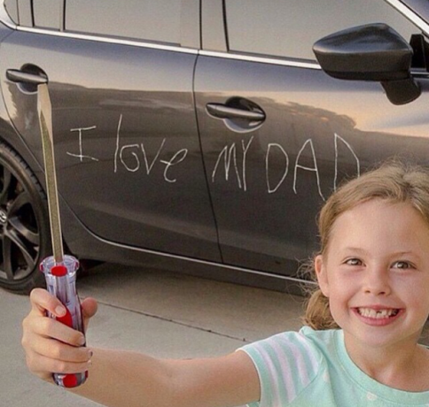
personal story 2

Slide 7
Caning in Singapore

Slide 8
Michael P. Fay, 1994.4.16

Slide 9
the path to maturity

Slide 10
the generation of distraction

Slide 11
Life is a race
Hebrews 12:1-14
race/ἀγών/agony
God is no longer our judge
He is our coach, and our Father
Holiness: the goal of this life journey

