Slide 1
Journey to the Cross
A Call to Repentance

Slide 5
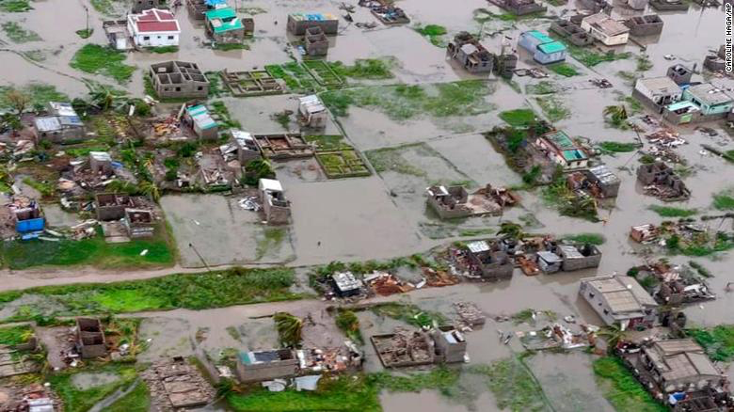
CNN: Cyclone Idai may have killed more than 1,000 people in Mozambique

Slide 6
¹ Now there were some present at that time who told Jesus about the Galileans whose blood Pilate had mixed with their sacrifices. ² Jesus answered, “Do you think that these Galileans were worse sinners than all the other Galileans because they suffered this way? ³ I tell you, no! But unless you repent, you too will all perish. ⁴ Or those eighteen who died when the tower in Siloam fell on them—do you think they were more guilty than all the others living in Jerusalem? ⁵ I tell you, no! But unless you repent, you too will all perish.”

Slide 7
⁶ Then he told this parable: “A man had a fig tree growing in his vineyard, and he went to look for fruit on it but did not find any. ⁷ So he said to the man who took care of the vineyard, ‘For three years now I’ve been coming to look for fruit on this fig tree and haven’t found any. Cut it down! Why should it use up the soil?’
⁸ “‘Sir,’ the man replied, ‘leave it alone for one more year, and I’ll dig around it and fertilize it. ⁹ If it bears fruit next year, fine! If not, then cut it down.’”
Luke 13:1-9

Slide 8
Renew our walk with God through repentance.

Slide 9
Context

Slide 10
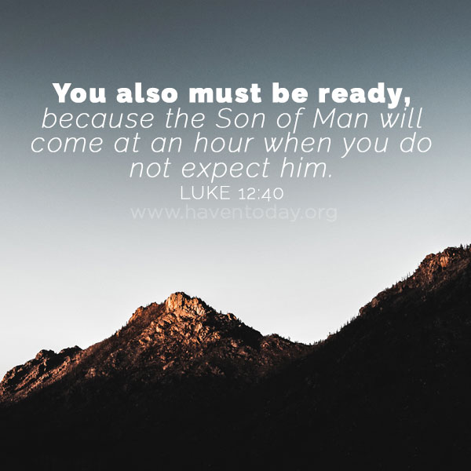

Slide 11
Unfortunate Circumstances

Slide 12
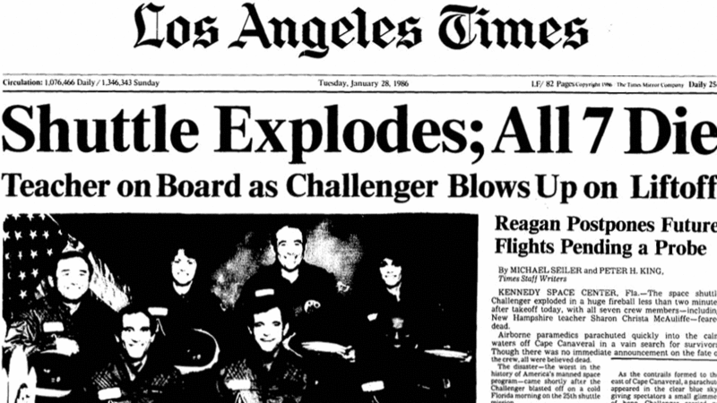

Slide 13
¹ Now there were some present at that time who told Jesus about the Galileans whose blood Pilate had mixed with their sacrifices. ² Jesus answered, “Do you think that these Galileans were worse sinners than all the other Galileans because they suffered this way? ³ I tell you, no! But unless you repent, you too will all perish. ⁴ Or those eighteen who died when the tower in Siloam fell on them—do you think they were more guilty than all the others living in Jerusalem?

Slide 15
All have sinned. . .

Slide 16
¹ Now there were some present at that time who told Jesus about the Galileans whose blood Pilate had mixed with their sacrifices. ² Jesus answered, “Do you think that these Galileans were worse sinners than all the other Galileans because they suffered this way? ³ I tell you, no! But unless you repent, you too will all perish. ⁴ Or those eighteen who died when the tower in Siloam fell on them—do you think they were more guilty than all the others living in Jerusalem?

Slide 17
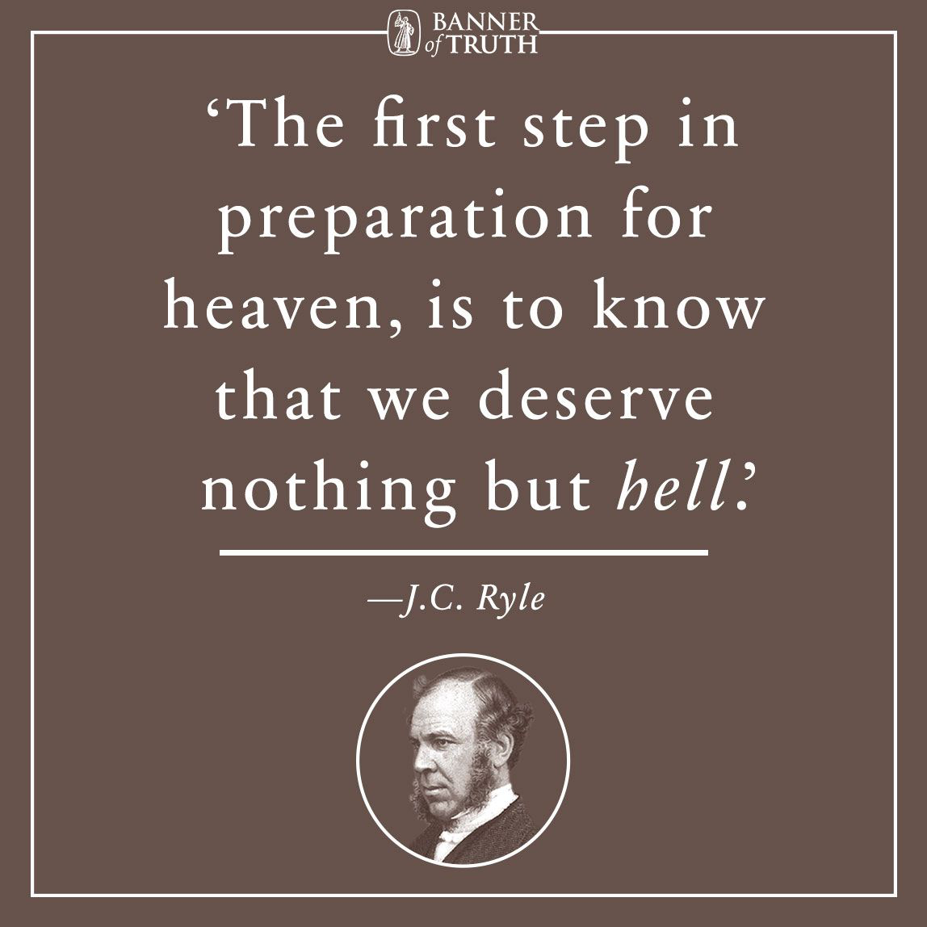

Slide 19
Repent or perish

Slide 20
¹ Now there were some present at that time who told Jesus about the Galileans whose blood Pilate had mixed with their sacrifices. ² Jesus answered, “Do you think that these Galileans were worse sinners than all the other Galileans because they suffered this way? ³ I tell you, no! But unless you repent, you too will all perish. ⁴ Or those eighteen who died when the tower in Siloam fell on them—do you think they were more guilty than all the others living in Jerusalem? ⁵ I tell you, no! But unless you repent, you too will all perish.”

Slide 21
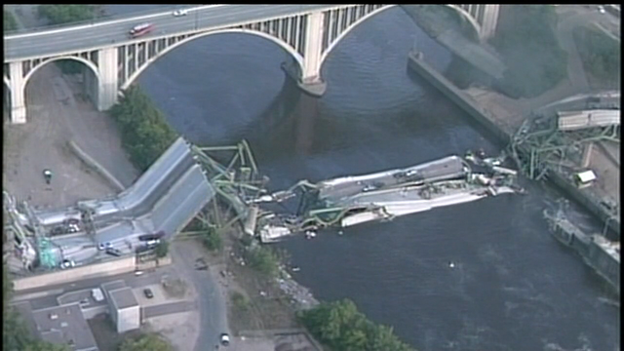

Slide 22
God’s patience

Slide 23
⁶ Then he told this parable: “A man had a fig tree growing in his vineyard, and he went to look for fruit on it but did not find any. ⁷ So he said to the man who took care of the vineyard, ‘For three years now I’ve been coming to look for fruit on this fig tree and haven’t found any. Cut it down! Why should it use up the soil?’
⁸ “‘Sir,’ the man replied, ‘leave it alone for one more year, and I’ll dig around it and fertilize it. ⁹ If it bears fruit next year, fine! If not, then cut it down.’”
Luke 13

Slide 24
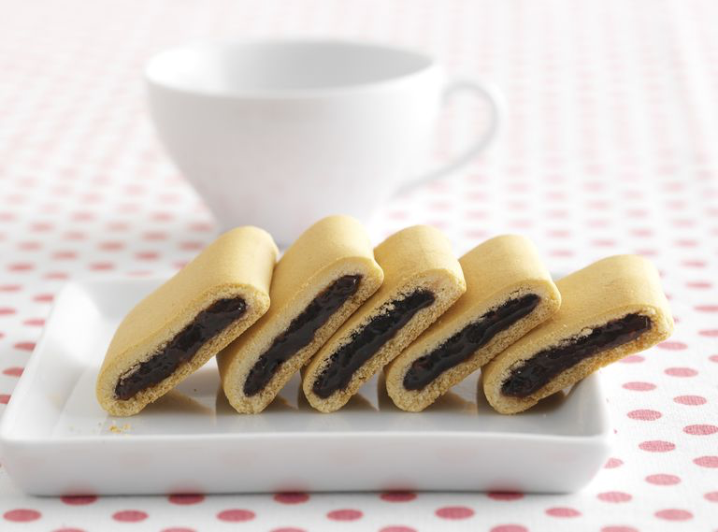

Slide 25
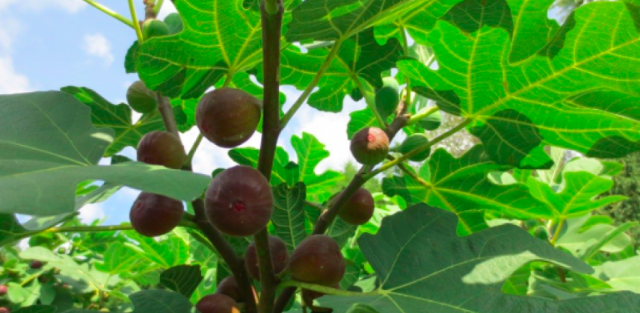

Slide 26
Lesson for disciples

Slide 27
Renew our walk with God through repentance.

Slide 28
