Slide 1
Conformed to Christ’s Image
A Time to Fast

Slide 2
For those God foreknew he also predestined to be conformed to the image of his Son . . .
Romans 8:29

Slide 3
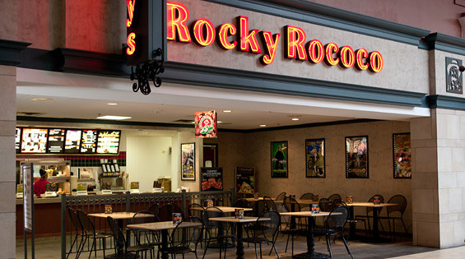

Slide 5
¹⁴ Then John’s disciples came and asked him, “How is it that we and the Pharisees fast often, but your disciples do not fast?”
¹⁵ Jesus answered, “How can the guests of the bridegroom mourn while he is with them? The time will come when the bridegroom will be taken from them; then they will fast.
Matthew 9:14-15

Slide 6
¹⁴ Then John’s disciples came and asked him, “How is it that we and the Pharisees fast often, but your disciples do not fast?”
¹⁵ Jesus answered, “How can the guests of the bridegroom mourn while he is with them? The time will come when the bridegroom will be taken from them; then they will fast.
Matthew 9:14-15

Slide 7
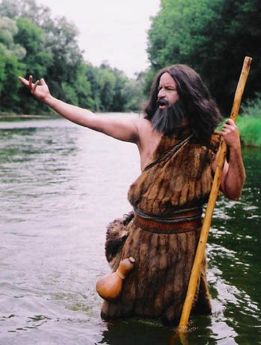
John’s clothes were made of camel’s hair, and he had a leather belt around his waist. His food was locusts and wild honey.
Matthew 3:4

Slide 9
¹⁴ Then John’s disciples came and asked him, “How is it that we and the Pharisees fast often, but your disciples do not fast?”
¹⁵ Jesus answered, “How can the guests of the bridegroom mourn while he is with them? The time will come when the bridegroom will be taken from them; then they will fast.
Matthew 9:14-15

Slide 10
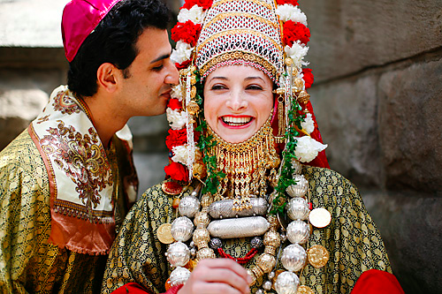

Slide 11
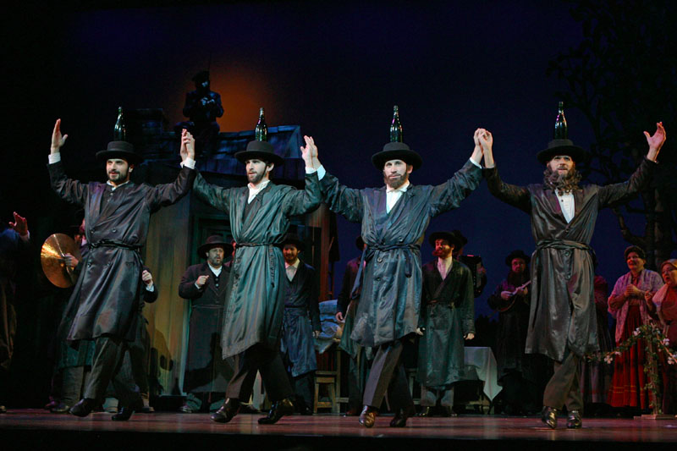

Slide 12
¹⁴ Then John’s disciples came and asked him, “How is it that we and the Pharisees fast often, but your disciples do not fast?”
¹⁵ Jesus answered, “How can the guests of the bridegroom mourn while he is with them? The time will come when the bridegroom will be taken from them; then they will fast.
Matthew 9:14-15

Slide 14
Reasons to Fast
Because Christ Expects it of Christians
For Guidance
For Intensity of Prayer
As a sign of mourning
To show humility in the presence of God
For worship
For spiritual strength
David Peach

Slide 15
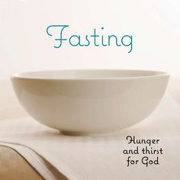

Slide 16
Application: World

Slide 17
Application: Church

Slide 19
Application: Ministry

Slide 20
Application: Personal

Slide 22
Fasting
On a regular basis
During appointed seasons
For a purpose
When God leads

