Slide 1
Jesus
A Wedding Miracle

Slide 2
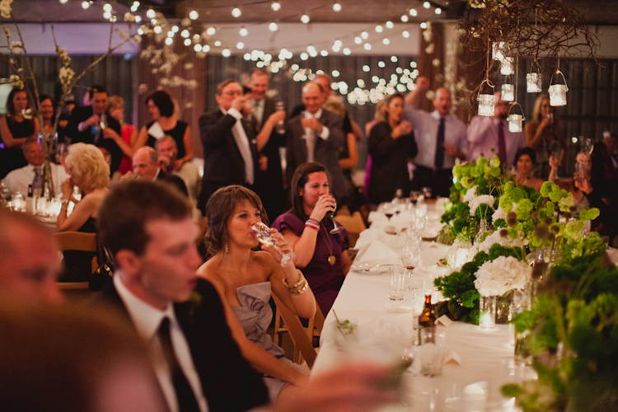

Slide 3
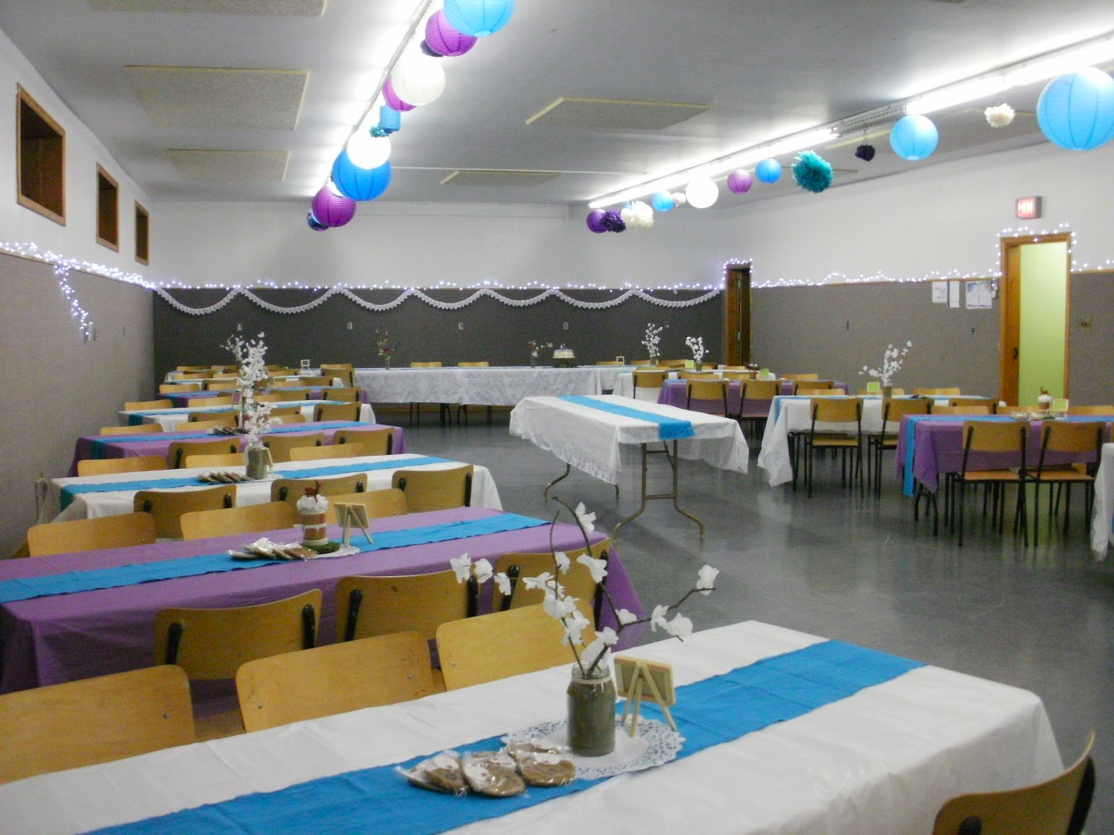

Slide 4
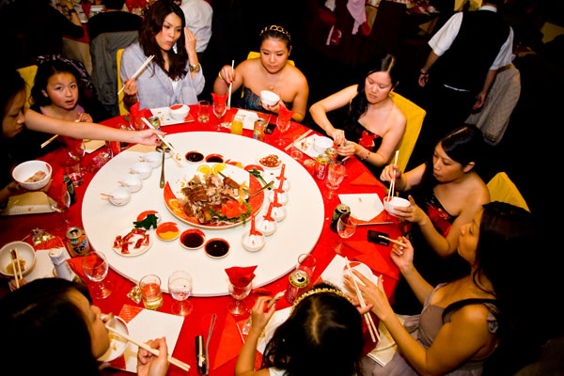

Slide 5
¹ On the third day a wedding took place at Cana in Galilee. Jesus’ mother was there, ² and Jesus and his disciples had also been invited to the wedding.
³ When the wine was gone, Jesus’ mother said to him, “They have no more wine.”
⁴ “Woman, why do you involve me?” Jesus replied. “My hour has not yet come.”
⁵ His mother said to the servants, “Do whatever he tells you.”

Slide 6
⁶ Nearby stood six stone water jars, the kind used by the Jews for ceremonial washing, each holding from twenty to thirty gallons.
⁷ Jesus said to the servants, “Fill the jars with water”; so they filled them to the brim.
⁸ Then he told them, “Now draw some out and take it to the master of the banquet.”

Slide 7
They did so, ⁹ and the master of the banquet tasted the water that had been turned into wine. He did not realize where it had come from, though the servants who had drawn the water knew. Then he called the bridegroom aside ¹⁰ and said, “Everyone brings out the choice wine first and then the cheaper wine after the guests have had too much to drink; but you have saved the best till now.”

Slide 8
¹¹ What Jesus did here in Cana of Galilee was the first of the signs through which he revealed his glory; and his disciples believed in him.
John 2:1-11

Slide 9
¹ 第 三 日 ， 在 加 利 利 的 迦 拿 有 娶 親 的 筵 席 ， 耶 穌 的 母 親 在 那 裡 。
² 耶 穌 和 他 的 門 徒 也 被 請 去 赴 席 。
³ 酒 用 盡 了 ， 耶 穌 的 母 親 對 他 說 ： 「 他 們 沒 有 酒 了 。 」
⁴ 耶 穌 說 ： 「 母 親 （ 原 文 是 婦 人 ） ， 我 與 你 有 甚 麼 相 干 ？ 我 的 時 候 還 沒 有 到 。 」
⁵ 他 母 親 對 用 人 說 ： 「 他 告 訴 你 們 甚 麼 ， 你 們 就 做 甚 麼 。 」
⁶ 照 猶 太 人 潔 淨 的 規 矩 ， 有 六 口 石 缸 擺 在 那 裡 ， 每 口 可 以 盛 兩

Slide 10
⁷ 耶 穌 對 用 人 說 ： 「 把 缸 倒 滿 了 水 。 他 們 就 倒 滿 了 ， 直 到 缸 口 。 」
⁸ 耶 穌 又 說 ： 「 現 在 可 以 舀 出 來 ， 送 給 管 筵 席 的 。 他 們 就 送 了 去 。 」
⁹ 管 筵 席 的 嘗 了 那 水 變 的 酒 ， 並 不 知 道 是 那 裡 來 的 ， 只 有 舀 水 的 用 人 知 道 。 管 筵 席 的 便 叫 新 郎 來 ，
¹⁰ 對 他 說 ： 「 人 都 是 先 擺 上 好 酒 ， 等 客 喝 足 了 ， 才 擺 上 次 的 ， 你 倒 把 好 酒 留 到 如 今 ！ 」
¹¹ 這 是 耶 穌 所 行 的 頭 一 件 神 蹟 ， 是 在 加 利 利 的 迦 拿 行 的 ， 顯 出 他 的 榮 耀 來 ； 他 的 門 徒 就 信 他 了 。
約 翰 福 音 2:1-11

Slide 11
A time to rejoice

Slide 12
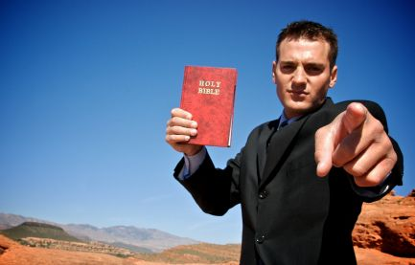

Slide 13
¹ On the third day a wedding took place at Cana in Galilee. Jesus’ mother was there, ² and Jesus and his disciples had also been invited to the wedding.

Slide 14
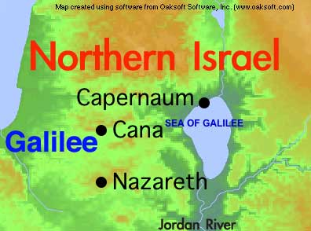

Slide 15
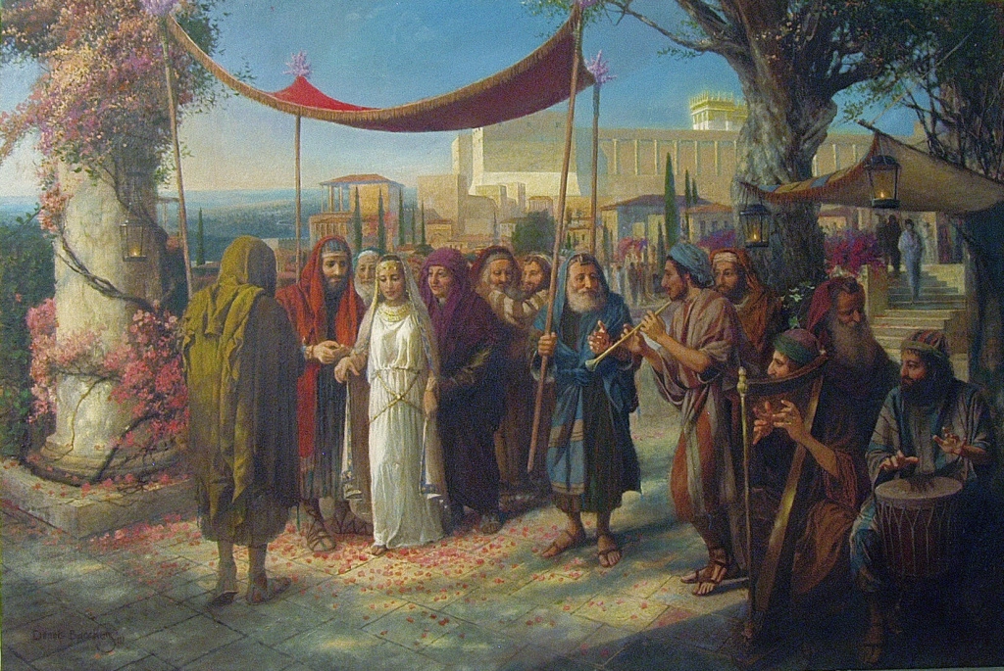

Slide 16
Ancient Jewish Weddings
Marriage Arranged – negotiations & contract to secure bride
Groom – pledge of value; Bride – purification ritual
Preparation – Groom goes to “prepare a place for you” (John 14)
Engaged woman – wears veil to show she is set apart & bought with a price
Procession of oil lamps – groom and his friends get bride
A shout – “Here’s the bridegroom! Come out to meet him!” (Mt. 25:6)
Marriage begins – Groom takes bride to father’s house for 7 days
Wedding Celebration – 7 days of food, music, dance and celebration

Slide 17
An impending crisis

Slide 18
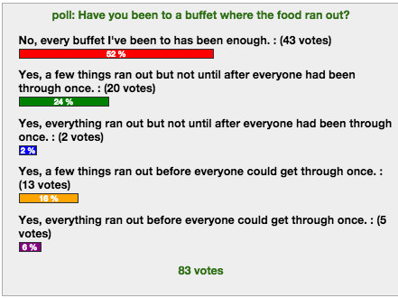

Slide 19
³ When the wine was gone, Jesus’ mother said to him, “They have no more wine.”

Slide 20
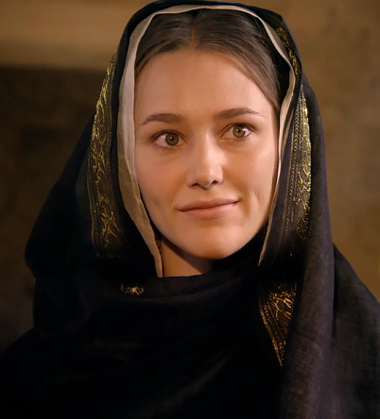

Slide 21
⁴ “Woman, why do you involve me?” Jesus replied. “My hour has not yet come.”
⁵ His mother said to the servants, “Do whatever he tells you.”

Slide 22
A crisis resolved

Slide 23
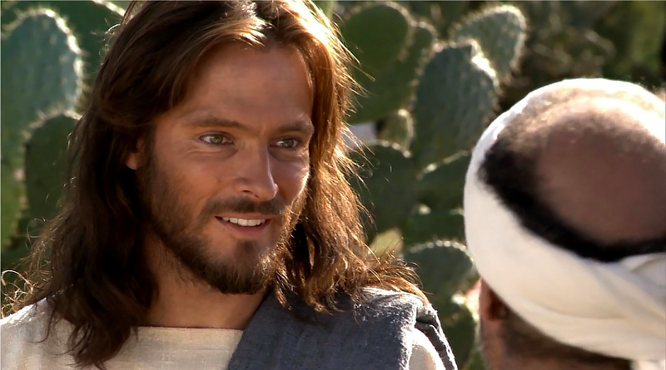

Slide 24
⁶ Nearby stood six stone water jars, the kind used by the Jews for ceremonial washing, each holding from twenty to thirty gallons.
⁷ Jesus said to the servants, “Fill the jars with water”; so they filled them to the brim.
⁸ Then he told them, “Now draw some out and take it to the master of the banquet.”

Slide 25
They did so, ⁹ and the master of the banquet tasted the water that had been turned into wine. He did not realize where it had come from, though the servants who had drawn the water knew. Then he called the bridegroom aside ¹⁰ and said, “Everyone brings out the choice wine first and then the cheaper wine after the guests have had too much to drink; but you have saved the best till now.”

Slide 26
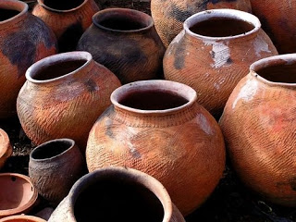

Slide 27
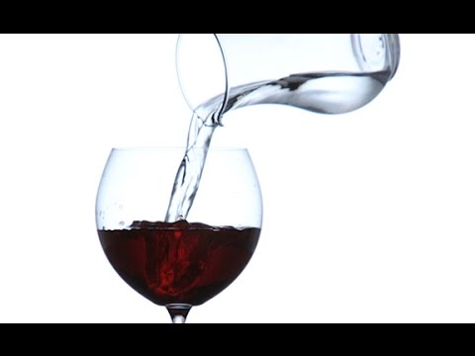

Slide 28
Six 25 gallon jars = 150 gallons
One bottle of wine = 750 ml or 1/5 of a gallon
Bottles of Wine = 750
One Ton of Grapes = approximately 700 bottles of wine

Slide 29
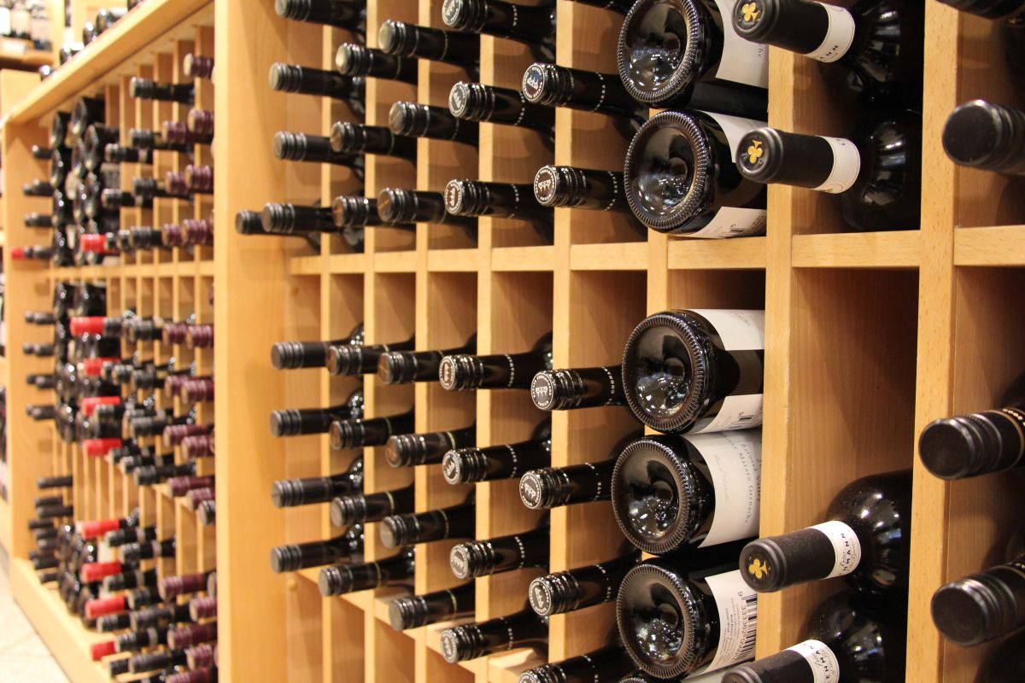

Slide 30
In response to a humble request Jesus provides wine in abundance, over 100 gallons. Here is a free, full, extravagant outpouring, and it is precisely the Son of God's gratuitous, gracious generosity that is the glory revealed in this sign.
IVP New Testament Commentary

Slide 31
Respond in humble faith to God’s extravagant grace.

Slide 32
⁵ His mother said to the servants, “Do whatever he tells you.”

Slide 33
⁹ and the master of the banquet tasted the water that had been turned into wine. He did not realize where it had come from, though the servants who had drawn the water knew.

Slide 34
¹¹ What Jesus did here in Cana of Galilee was the first of the signs through which he revealed his glory; and his disciples believed in him.
John 2:1-11

