Slide 1
Advent
Repent

Slide 2
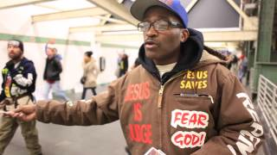
Shawn the Subway Preacher

Slide 3
¹ In those days John the Baptist came, preaching in the wilderness of Judea ² and saying, “Repent, for the kingdom of heaven has come near.” ³ This is he who was spoken of through the prophet Isaiah:
“A voice of one calling in the wilderness, ‘Prepare the way for the Lord, make straight paths for him.’”

Slide 4
⁴ John’s clothes were made of camel’s hair, and he had a leather belt around his waist. His food was locusts and wild honey. ⁵ People went out to him from Jerusalem and all Judea and the whole region of the Jordan. ⁶ Confessing their sins, they were baptized by him in the Jordan River.

Slide 5
⁷ But when he saw many of the Pharisees and Sadducees coming to where he was baptizing, he said to them: “You brood of vipers! Who warned you to flee from the coming wrath? ⁸ Produce fruit in keeping with repentance. ⁹ And do not think you can say to yourselves, ‘We have Abraham as our father.’ I tell you that out of these stones God can raise up children for Abraham. ¹⁰ The ax is already at the root of the trees, and every tree that does not produce good fruit will be cut down and thrown into the fire.

Slide 6
¹¹ “I baptize you with water for repentance. But after me comes one who is more powerful than I, whose sandals I am not worthy to carry. He will baptize you with the Holy Spirit and fire. ¹² His winnowing fork is in his hand, and he will clear his threshing floor, gathering his wheat into the barn and burning up the chaff with unquenchable fire.”
Matthew 3:1-12

Slide 7
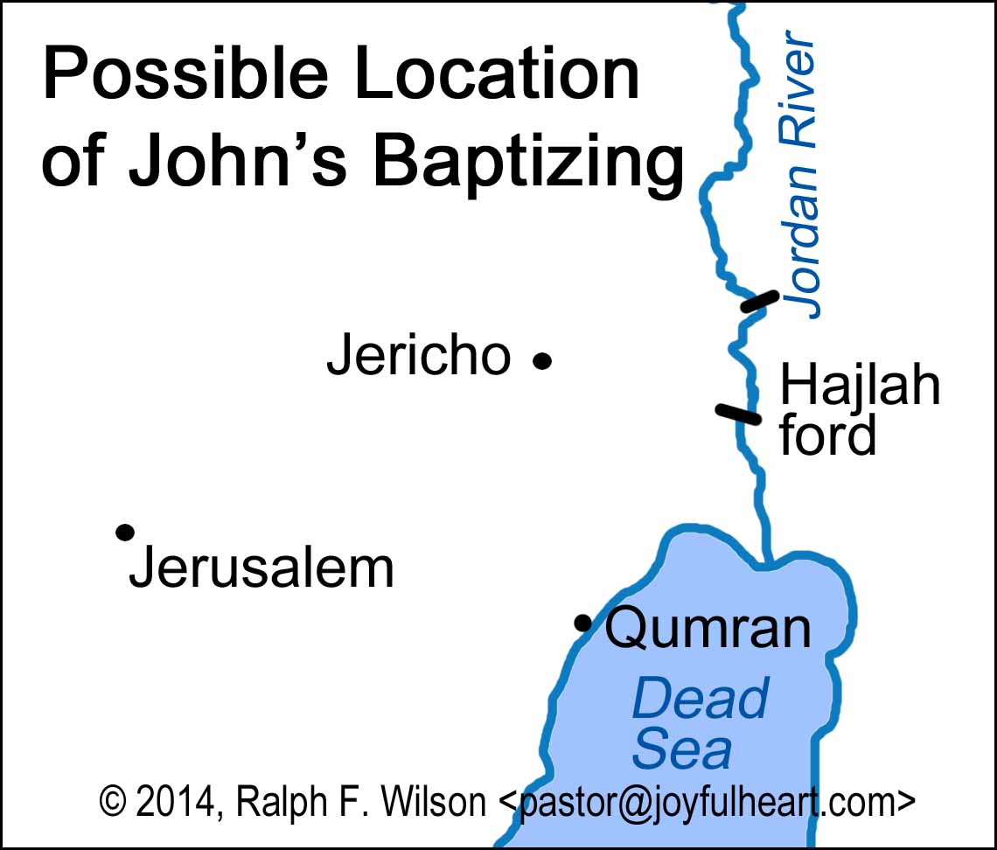

Slide 8
⁴ John’s clothes were made of camel’s hair, and he had a leather belt around his waist. His food was locusts and wild honey. ⁵ People went out to him from Jerusalem and all Judea and the whole region of the Jordan. ⁶ Confessing their sins, they were baptized by him in the Jordan River.

Slide 9
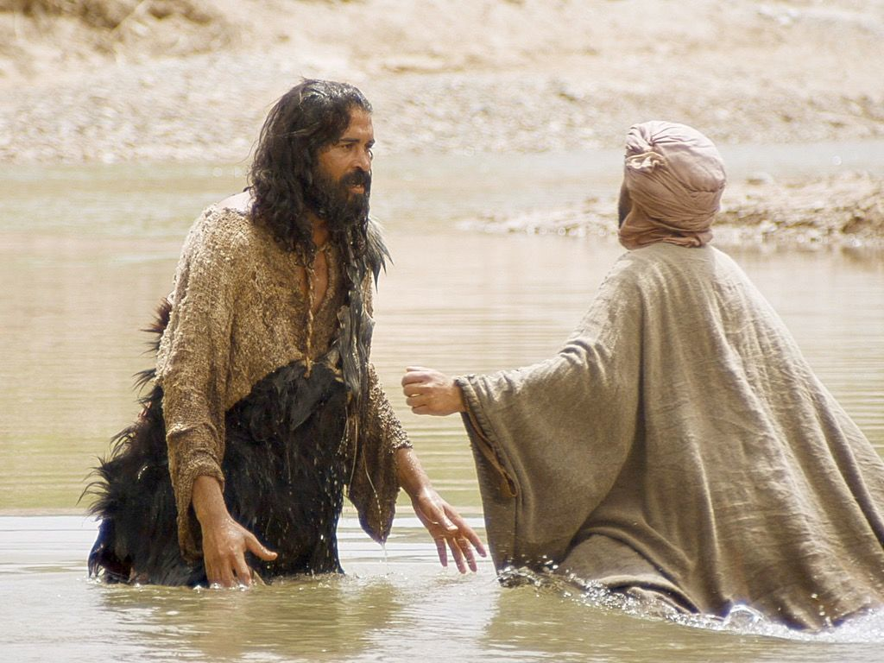

Slide 10
Prepare the way for Jesus by repenting, reflecting and being revitalized.

Slide 11
¹ In those days John the Baptist came, preaching in the wilderness of Judea ² and saying, “Repent, for the kingdom of heaven has come near.” ³ This is he who was spoken of through the prophet Isaiah:
“A voice of one calling in the wilderness, ‘Prepare the way for the Lord, make straight paths for him.’”

Slide 13
Repentance includes feeling sorry for one’s personal sins, but it is much more. To repent is to take a clear-minded look at the ways in which one’s life colludes with the assumptions and behaviors of the old age, to turn away from such complicity, and to turn towards God and the attitudes and actions of the realm of heaven.
Prof. Ron Allen
Christian Theological Seminary

Slide 14
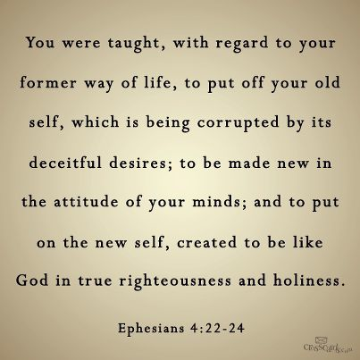

Slide 15
Prepare the way for Jesus by repenting, reflecting and being revitalized.

Slide 16
⁷ But when he saw many of the Pharisees and Sadducees coming to where he was baptizing, he said to them: “You brood of vipers! Who warned you to flee from the coming wrath? ⁸ Produce fruit in keeping with repentance. ⁹ And do not think you can say to yourselves, ‘We have Abraham as our father.’ I tell you that out of these stones God can raise up children for Abraham. ¹⁰ The ax is already at the root of the trees, and every tree that does not produce good fruit will be cut down and thrown into the fire.

Slide 17
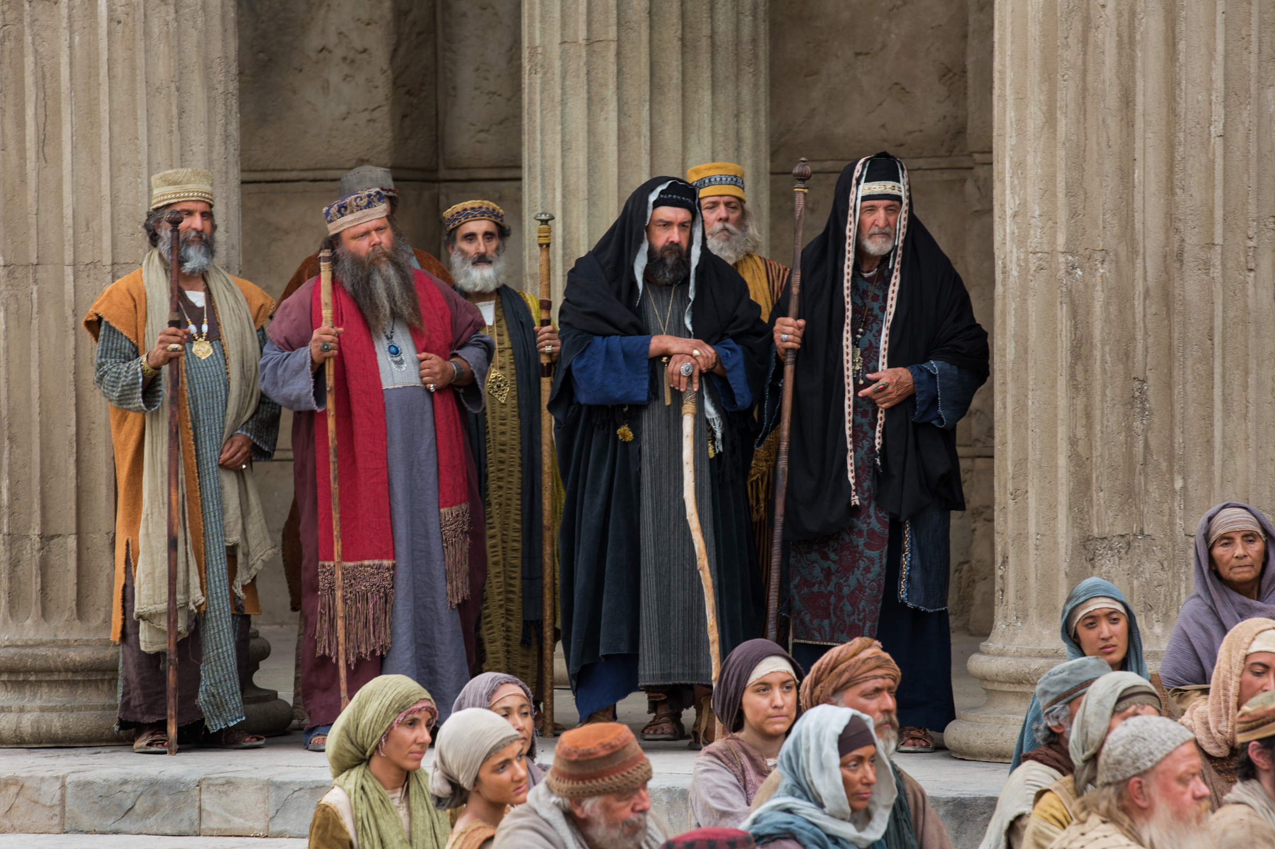

Slide 18
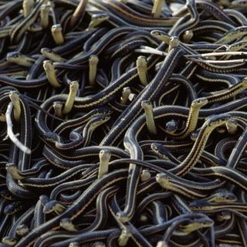

Slide 19
But we forbid no believer to confirm and support this faith by the signs of the divine favor towards him. For if when we call to mind the gifts which God has bestowed upon us . . . much more is this the case with the gift of good works, which shows that we have received the Spirit of adoption.
John Calvin

Slide 20
Prepare the way for Jesus by repenting, reflecting and being revitalized.

Slide 21
¹¹ “I baptize you with water for repentance. But after me comes one who is more powerful than I, whose sandals I am not worthy to carry. He will baptize you with the Holy Spirit and fire. ¹² His winnowing fork is in his hand, and he will clear his threshing floor, gathering his wheat into the barn and burning up the chaff with unquenchable fire.”
Matthew 3:1-12

Slide 24
Prepare the way for Jesus by repenting, reflecting and being revitalized.

