Slide 1
Advent
A Message of Hope

Slide 2
The Village Church

Slide 3
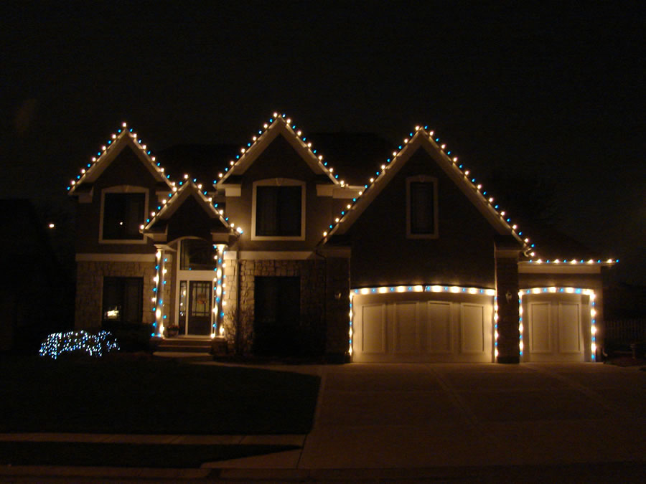

Slide 5
¹⁴ “‘The days are coming,’ declares the Lord, ‘when I will fulfill the good promise I made to the people of Israel and Judah.
¹⁵ “‘In those days and at that time
I will make a righteous Branch sprout from David’s line;
he will do what is just and right in the land.
¹⁶ In those days Judah will be saved
and Jerusalem will live in safety.
This is the name by which it will be called:
The Lord Our Righteous Savior.’
Jeremiah 33:14-16

Slide 7
655 - Birth
626 - Call
587 - Captivity

Slide 8
Trials of Obedience

Slide 9
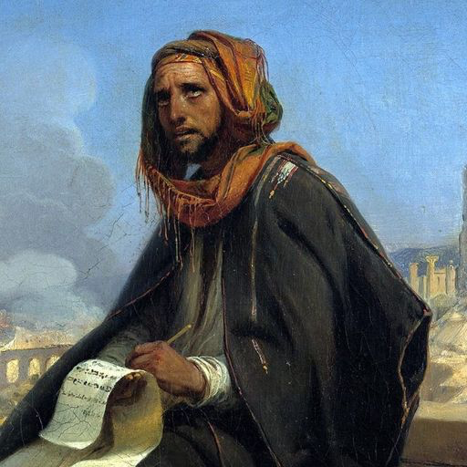

Slide 10
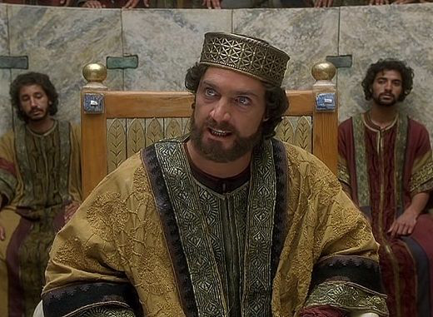

Slide 11
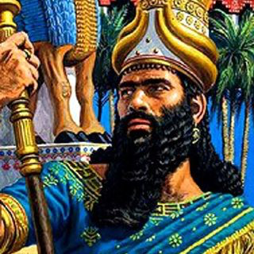

Slide 12
² The army of the king of Babylon was then besieging Jerusalem, and Jeremiah the prophet was confined in the courtyard of the guard in the royal palace of Judah.
³ Now Zedekiah king of Judah had imprisoned him there, saying, “Why do you prophesy as you do? You say, ‘This is what the Lord says: I am about to give this city into the hands of the king of Babylon, and he will capture it.
Jeremiah 32:2-3

Slide 13
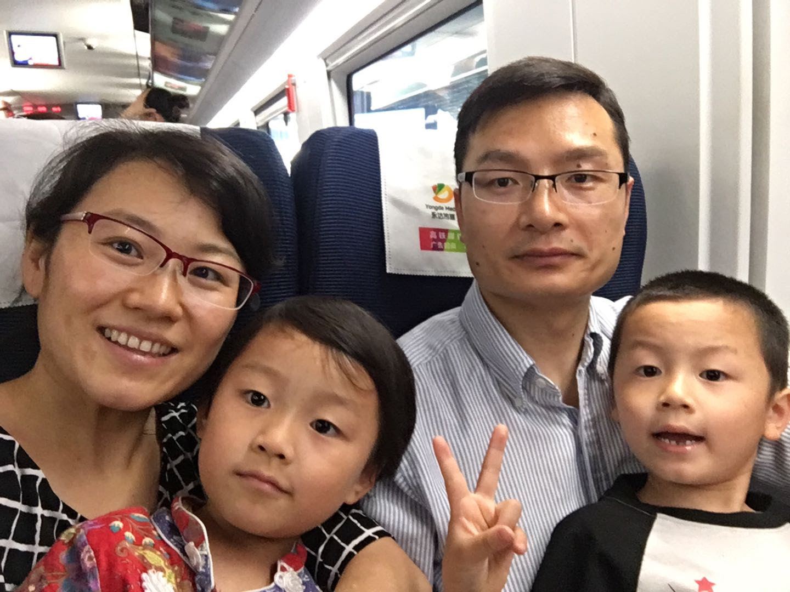
Li Dong, Nelly & Family

Slide 14
Consequences of Disobedience

Slide 15
²⁸ Therefore this is what the Lord says: I am about to give this city into the hands of the Babylonians and to Nebuchadnezzar king of Babylon, who will capture it. ²⁹ The Babylonians who are attacking this city will come in and set it on fire; they will burn it down, along with the houses where the people aroused my anger by burning incense on the roofs to Baal and by pouring out drink offerings to other gods.
Jeremiah 32:28-29

Slide 16
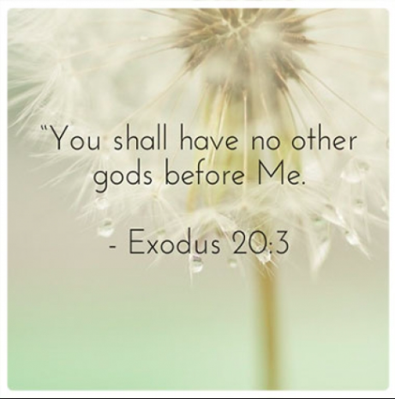

Slide 17
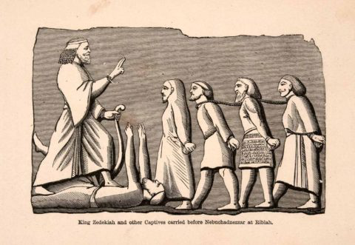

Slide 19
Words of Promise

Slide 20
¹⁴ “‘The days are coming,’ declares the Lord, ‘when I will fulfill the good promise I made to the people of Israel and Judah.
¹⁵ “‘In those days and at that time
I will make a righteous Branch sprout from David’s line;
he will do what is just and right in the land.
¹⁶ In those days Judah will be saved
and Jerusalem will live in safety.
This is the name by which it will be called:
The Lord Our Righteous Savior.’
Jeremiah 33:14-16

Slide 22
¹⁴ ‘This is what the Lord Almighty, the God of Israel, says: Take these documents, both the sealed and unsealed copies of the deed of purchase, and put them in a clay jar so they will last a long time. ¹⁵ For this is what the Lord Almighty, the God of Israel, says: Houses, fields and vineyards will again be bought in this land.’”
Jeremiah 32:14-15

Slide 23
Lessons for disciples

Slide 24
Hope in the midst difficulties
Hope in God’s purpose
Hope in Christ’s Return

