Slide 1
Ordinary Time
An Amazing Gift

Slide 2
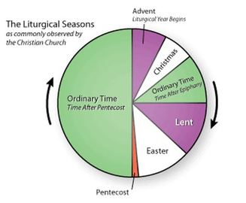

Slide 3
Faithfully serving God through the power of the Holy Spirit.

Slide 5
¹¹ Soon afterward, Jesus went to a town called Nain, and his disciples and a large crowd went along with him. ¹² As he approached the town gate, a dead person was being carried out—the only son of his mother, and she was a widow. And a large crowd from the town was with her. ¹³ When the Lord saw her, his heart went out to her and he said, “Don’t cry.”

Slide 6
¹⁴ Then he went up and touched the bier they were carrying him on, and the bearers stood still. He said, “Young man, I say to you, get up!” ¹⁵ The dead man sat up and began to talk, and Jesus gave him back to his mother.

Slide 7
¹⁶ They were all filled with awe and praised God. “A great prophet has appeared among us,” they said. “God has come to help his people.” ¹⁷ This news about Jesus spread throughout Judea and the surrounding country.
Luke 7:11-17

Slide 8
Context

Slide 9
A few days later, when Jesus again entered Capernaum, the people heard that he had come home.
Mark 2:1

Slide 10
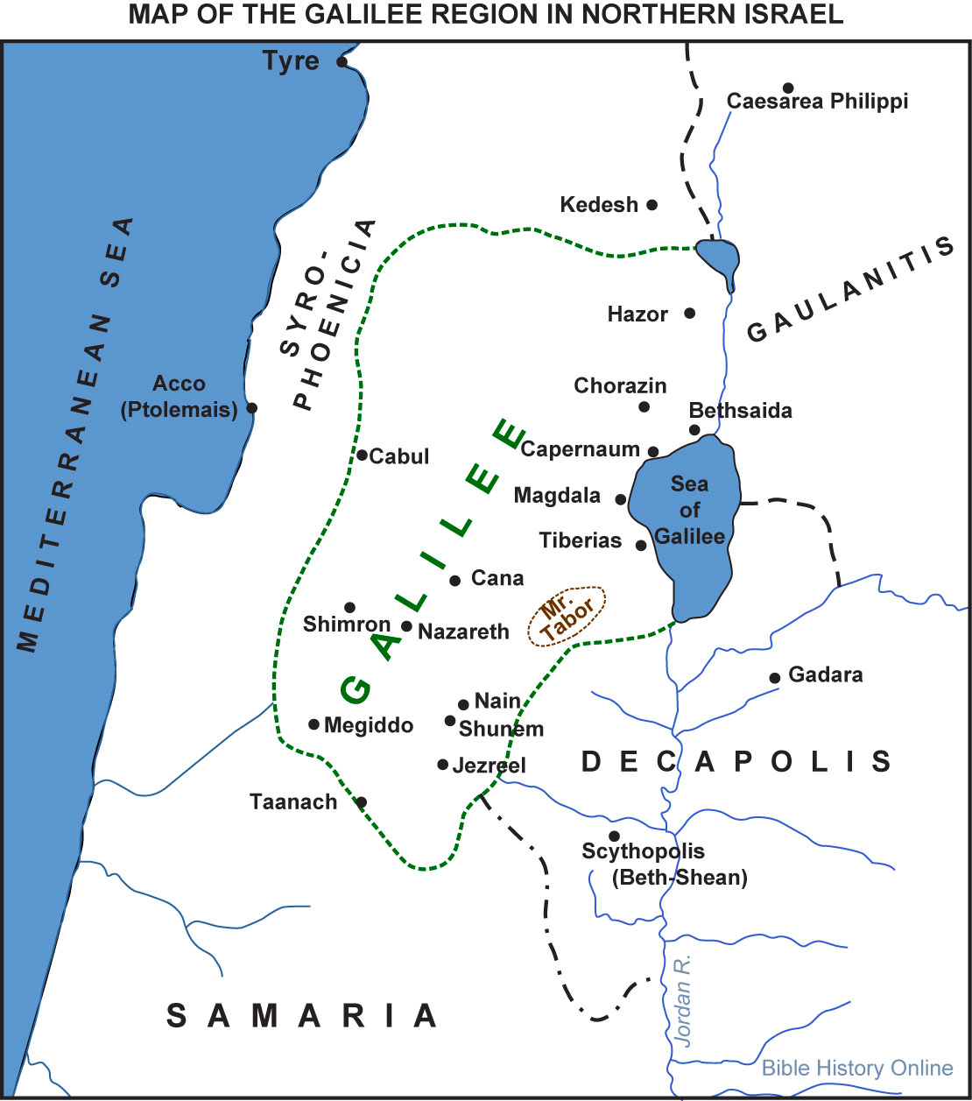

Slide 11
A Grieving Widow

Slide 12
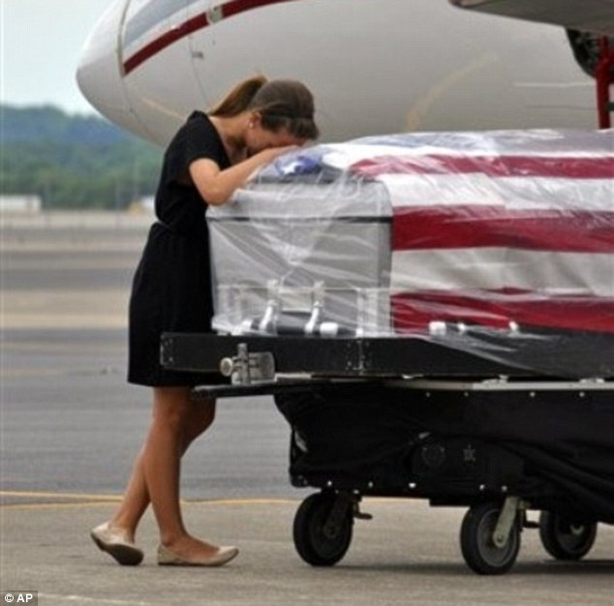
Devastated: Ashley Edens weeps over late husband, 22-year-old Spc. Jason Edens, who was injured while on tour in Afghanistan.

Slide 13
¹¹ Soon afterward, Jesus went to a town called Nain, and his disciples and a large crowd went along with him. ¹² As he approached the town gate, a dead person was being carried out—the only son of his mother, and she was a widow. And a large crowd from the town was with her.

Slide 14
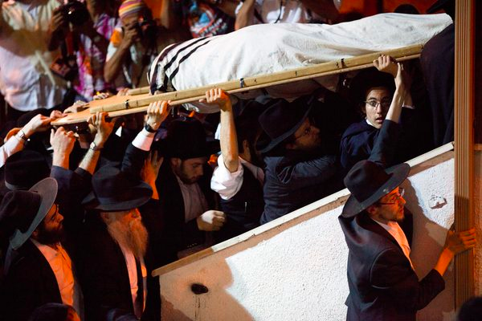

Slide 16
Jesus’ Gift

Slide 17
¹³ When the Lord saw her, his heart went out to her and he said, “Don’t cry.” ¹⁴ Then he went up and touched the bier they were carrying him on, and the bearers stood still. He said, “Young man, I say to you, get up!” ¹⁵ The dead man sat up and began to talk. . .

Slide 18
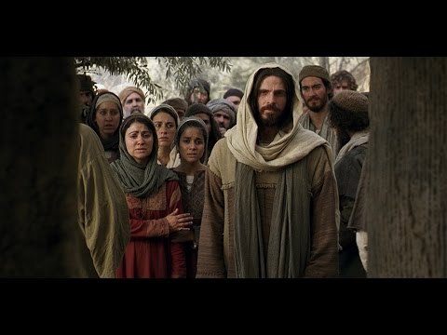

Slide 19
A Prophet Acknowledged

Slide 20
¹⁵ The dead man sat up and began to talk, and Jesus gave him back to his mother.
¹⁶ They were all filled with awe and praised God. “A great prophet has appeared among us,” they said. “God has come to help his people.” ¹⁷ This news about Jesus spread throughout Judea and the surrounding country.
Luke 7

Slide 21
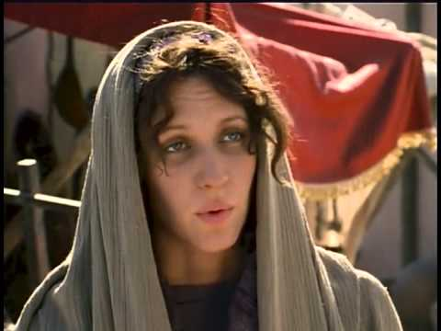

Slide 22
²² The Lord heard Elijah’s cry, and the boy’s life returned to him, and he lived. ²³ Elijah picked up the child and carried him down from the room into the house. He gave him to his mother and said, “Look, your son is alive!”
1 Kings 17

Slide 23
Lessons for Disciples

Slide 24
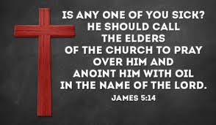

Slide 25
