Slide 1
Believing God’s Promises: His Word
2 Timothy 3:16-17

Slide 2
2 Timothy 3:16-17
¹⁶ All Scripture is God-breathed and is useful for teaching, rebuking, correcting and training in righteousness, ¹⁷ so that the servant of God may be thoroughly equipped for every good work.

Slide 3
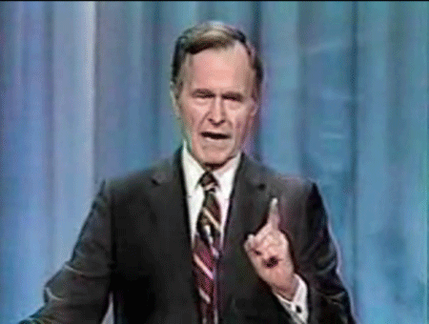
Promises

Slide 4
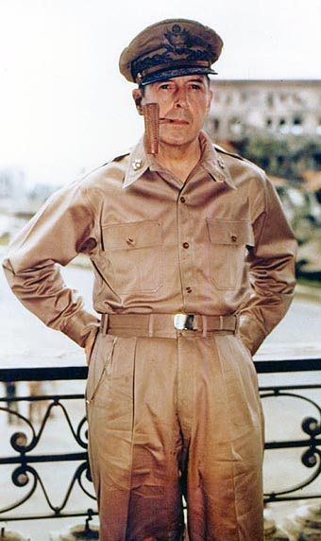
I Shall Return

Slide 5
God’s Word is Inspired
¹⁶ All Scripture is God-breathed. . .

Slide 6
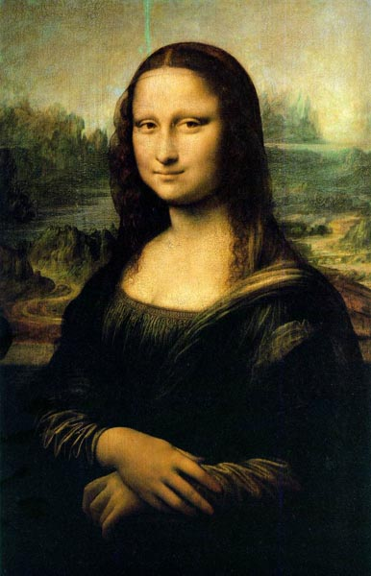

Slide 7
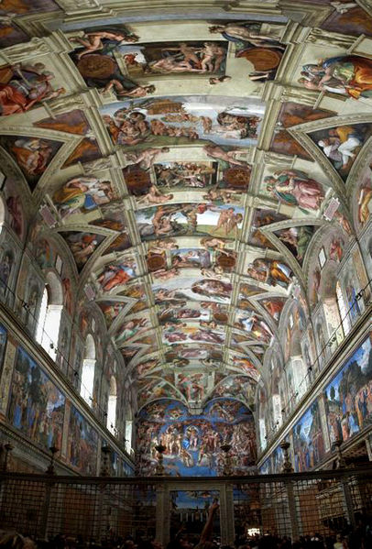

Slide 8
"Scripture is not only man's word, but also, and equally God's word, spoken through man's lips or written with man's pen"
J.I.Packer, The Origin of the Bible

Slide 9
God’s Word is Profitable
“and is useful for teaching, rebuking, correcting and training in righteousness,. . .”

Slide 11
Jesus’ Teaching
God’s Word is Profitable for:
Teaching –
Rebuking –
Correcting –
Training in Righteousness –

Slide 12
God’s Word Equips
¹⁷ so that the servant of God may be thoroughly equipped for every good work.

Slide 13
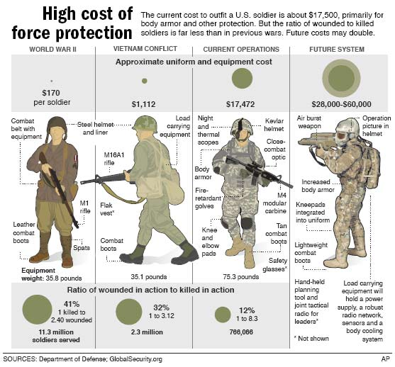

Slide 14
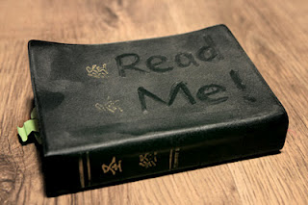
Apply

Slide 15
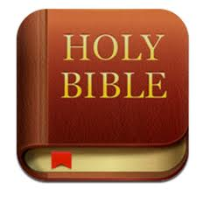

Slide 16
Read
Study
Meditate
Share
Discuss
Apply

