Slide 1
Believing God’s Promises: His Love
1 John 3:1
Revelation 1:5-6

Slide 2
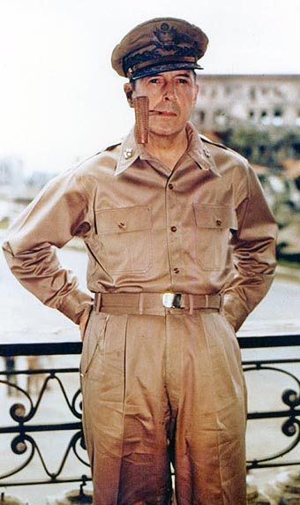
A Trustworthy Promise: I Shall Return

Slide 3
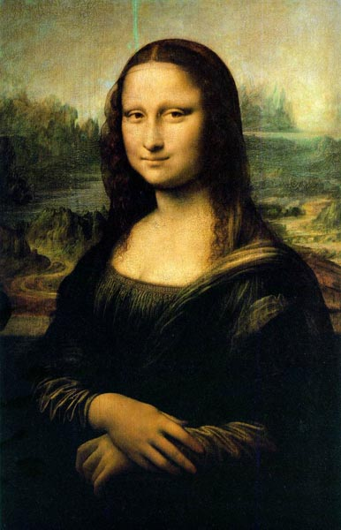
God’s Word is Inspired

Slide 4
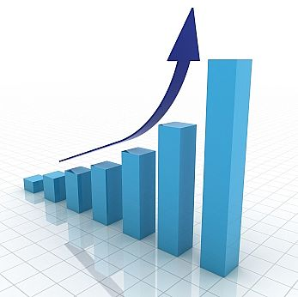
God’s Word is Profitable

Slide 5
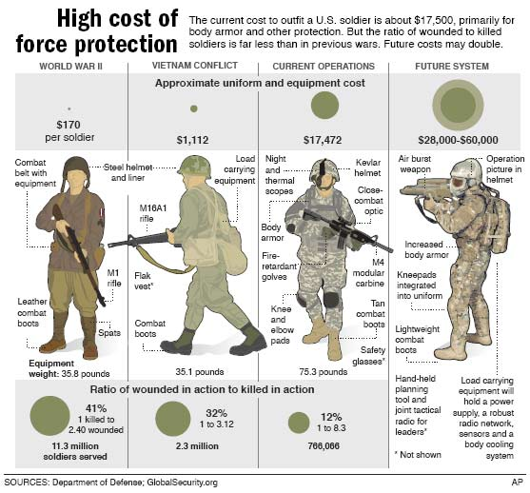
God’s Word Equips

Slide 6
Apply

Slide 7
Survey Says:
What three word sentence would you most like to hear?
1.
2.
3.

Slide 8
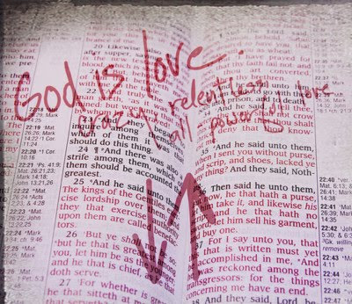
God’s Love:

Slide 9
See what kind of love the Father has given to us, that we should be called children of God; and so we are. The reason why the world does not know us is that it did not know him.
1 John 3:1

Slide 10
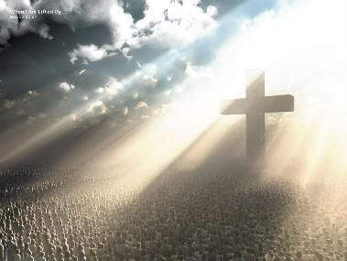
God’s Love is Out of this World

Slide 11
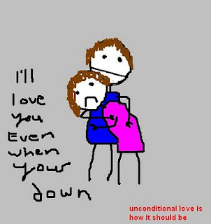
God’s Love Equalizes

Slide 12
God’s Love Emancipates
To him [Jesus] who loves us and has freed us from our sins by his blood, ⁶ and has made us to be a kingdom and priests to serve his God and Father —to him be glory and power for ever and ever! Amen.
Revelation 1:5-6

Slide 13
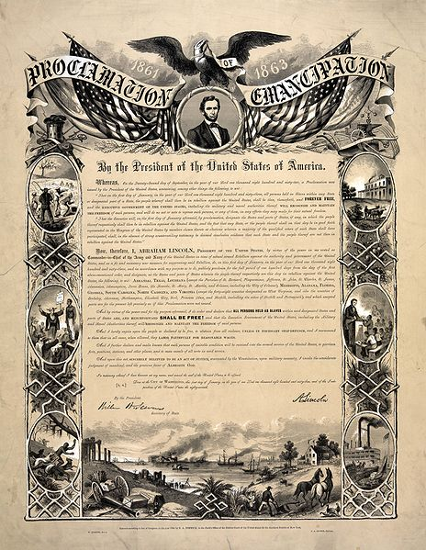

Slide 14
The Love of God Elevates
[Jesus] has made us to be a kingdom and priests to serve his God and Father. Revelation 1:6
See what great love the Father has lavished on us, that we should be called children of God! And that is what we are! 1 John 3:1

Slide 15
God’s Child

Slide 16
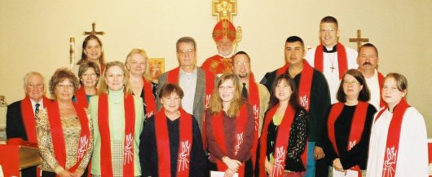
Priesthood of All Believers

