Slide 1
Church
Healthy Characteristics: Fellowship

Slide 2
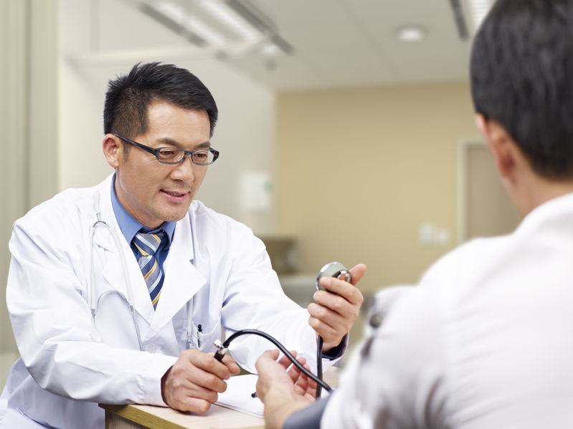

Slide 4
Basis of a healthy fellowship

Slide 5
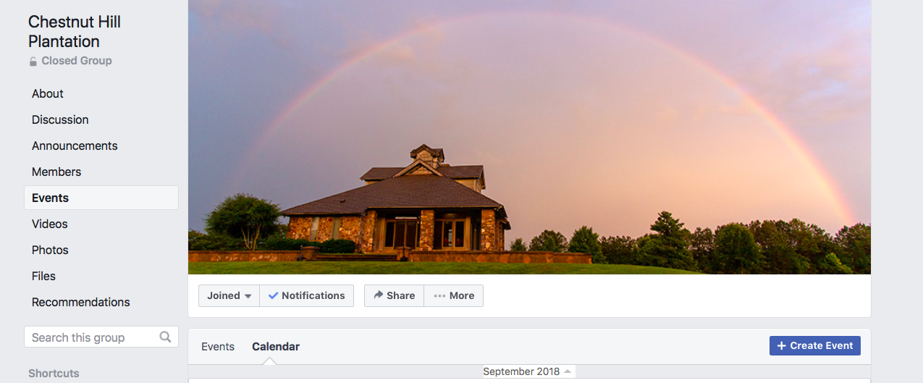

Slide 6
⁹ For God did not appoint us to suffer wrath but to receive salvation through our Lord Jesus Christ. ¹⁰ He died for us so that, whether we are awake or asleep, we may live together with him.
I Thessalonians 5:9-10

Slide 7
One anothering

Slide 8
⁹ Now concerning brotherly love you have no need for anyone to write to you, for you yourselves have been taught by God to love one another, ¹⁰ for that indeed is what you are doing to all the brothers throughout Macedonia. But we urge you, brothers, to do this more and more.
I Thessalonians 4:9-10

Slide 9
11. “…Love one another…” (Romans 13:8)
12. “…Stop passing judgment on one another.” (Romans 14:13)
13. “Accept one another, then, just as Christ accepted you…” (Rm. 15:7)
14. “…Instruct one another.” (Romans 15:14)
15. “Greet one another with a holy kiss…” (Romans 16:16)
16. “…When you come together to eat, wait for each other.” (I Cor. 11:33)
17. “…Have equal concern for each other.” (I Corinthians 12:25)
18. “…Greet one another with a holy kiss.” (I Corinthians 16:20)
19. “Greet one another with a holy kiss.” (II Corinthians 13:12)

Slide 10
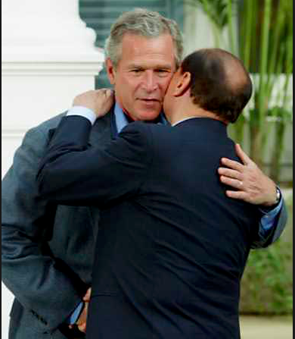

Slide 13
Love one another

Slide 14
⁹ Now concerning brotherly love you have no need for anyone to write to you, for you yourselves have been taught by God to love one another, ¹⁰ for that indeed is what you are doing to all the brothers throughout Macedonia. But we urge you, brothers, to do this more and more.
I Thessalonians 4:9-10

Slide 17
⁹ Now concerning brotherly love you have no need for anyone to write to you, for you yourselves have been taught by God to love one another, ¹⁰ for that indeed is what you are doing to all the brothers throughout Macedonia. But we urge you, brothers, to do this more and more.
I Thessalonians 4:9-10

Slide 19
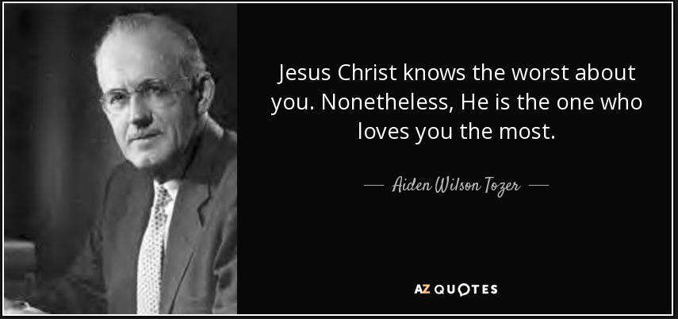

Slide 20
Encourage one another

Slide 21
⁹ For God did not appoint us to suffer wrath but to receive salvation through our Lord Jesus Christ. ¹⁰ He died for us so that, whether we are awake or asleep, we may live together with him.
11 Therefore encourage one another and build one another up, just as you are doing.
I Thessalonians 5:9-10

Slide 22
We live in a broken world . . . Sin steals joy, our bodies break down, our plans falter, our dreams die, our resolves weaken, our perspective dims. We are promised suffering, persecution, and trials of various kinds. . . God knows his people are in need of grace-filled reminders, so he calls us to encourage each other every day until his Son returns.
Pastor Garrett Kell

Slide 23
Build up one another

Slide 24
⁹ For God did not appoint us to suffer wrath but to receive salvation through our Lord Jesus Christ. ¹⁰ He died for us so that, whether we are awake or asleep, we may live together with him.
11 Therefore encourage one another and build one another up, just as you are doing.
I Thessalonians 5:9-10

Slide 26
Lessons for disciples

Slide 27
Engage in a fellowship
Treat one another as a family
Seek to encourage someone this week

