Slide 1
Trinity Sunday
Blessed Trinity

Slide 2
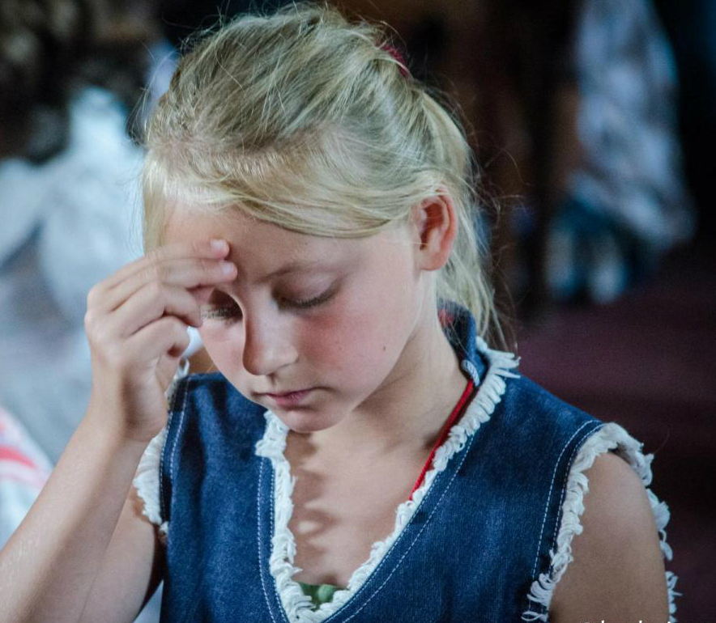

Slide 4
God is a missionary God, wishing for all to be saved.

Slide 5
¹⁶ Then the eleven disciples went to Galilee, to the mountain where Jesus had told them to go. ¹⁷ When they saw him, they worshiped him; but some doubted. ¹⁸ Then Jesus came to them and said, “All authority in heaven and on earth has been given to me. ¹⁹ Therefore go and make disciples of all nations, baptizing them in the name of the Father and of the Son and of the Holy Spirit, ²⁰ and teaching them to obey everything I have commanded you. And surely I am with you always, to the very end of the age.”
Matthew 28:16-20

Slide 6
Context

Slide 7
¹⁶ Then the eleven disciples went to Galilee, to the mountain where Jesus had told them to go. ¹⁷ When they saw him, they worshiped him; but some doubted.

Slide 8
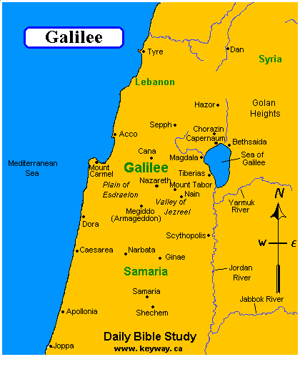

Slide 9
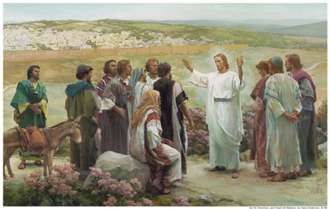

Slide 10
God loves the world. . .

Slide 11
¹⁸ Then Jesus came to them and said, “All authority in heaven and on earth has been given to me. ¹⁹ Therefore go and make disciples of all nations,

Slide 14
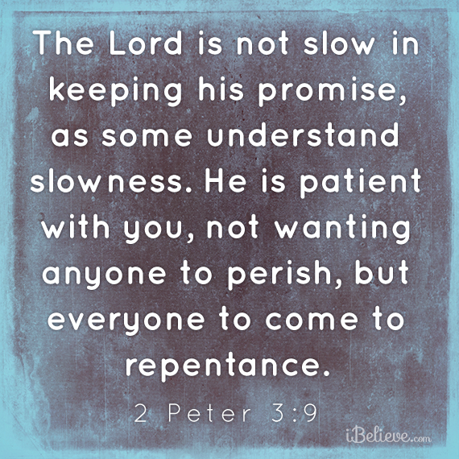

Slide 15
God saves the world. . .

Slide 16
¹⁸ Then Jesus came to them and said, “All authority in heaven and on earth has been given to me. ¹⁹ Therefore go and make disciples of all nations, baptizing them in the name of the Father and of the Son and of the Holy Spirit. . .

Slide 17
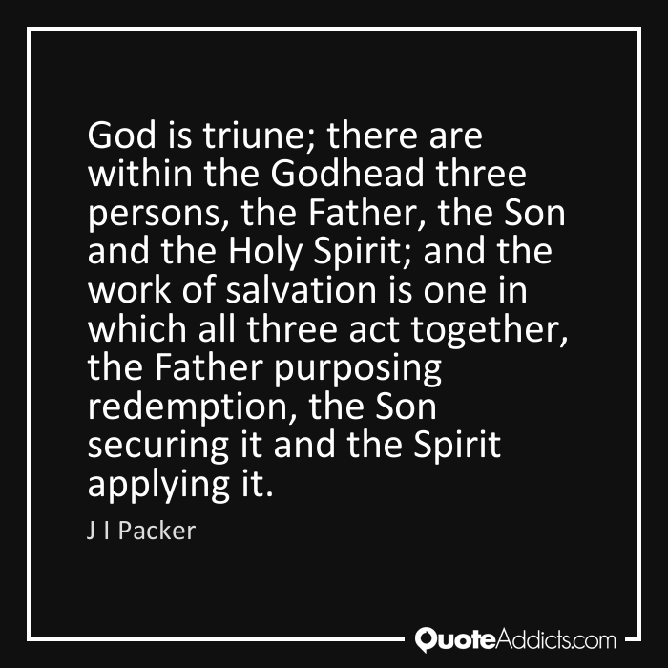

Slide 18
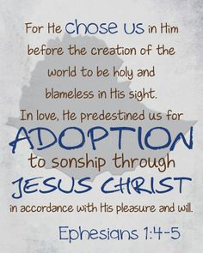
Purposing

Slide 19
Securing

Slide 20
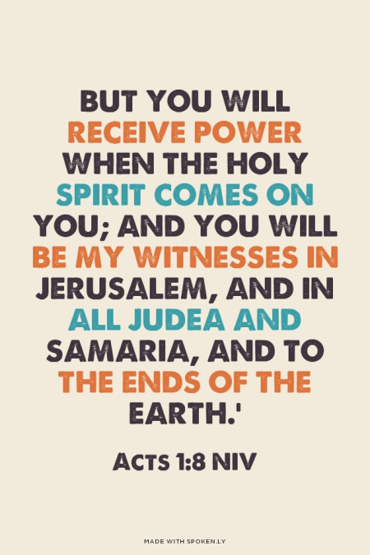
Applying

Slide 21
God reaches the world. . .

Slide 22
¹⁸ Then Jesus came to them and said, “All authority in heaven and on earth has been given to me. ¹⁹ Therefore go and make disciples of all nations, baptizing them in the name of the Father and of the Son and of the Holy Spirit, ²⁰ and teaching them to obey everything I have commanded you. And surely I am with you always, to the very end of the age.”

Slide 24
God is a missionary God, wishing for all to be saved.

Slide 25
American Muslim Doctor converts to Christianity

Slide 26
