Slide 1
Transformed
Blind Man: Bold Witness

Slide 2
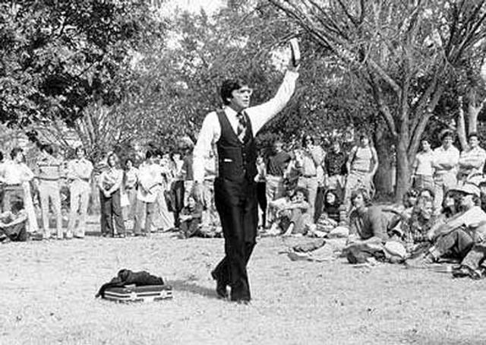

Slide 3
¹ As he went along, he saw a man blind from birth. ² His disciples asked him, “Rabbi, who sinned, this man or his parents, that he was born blind?”
³ “Neither this man nor his parents sinned,” said Jesus, “but this happened so that the works of God might be displayed in him. ⁴ As long as it is day, we must do the works of him who sent me. Night is coming, when no one can work. ⁵ While I am in the world, I am the light of the world.”

Slide 4
⁶ After saying this, he spit on the ground, made some mud with the saliva, and put it on the man’s eyes. ⁷ “Go,” he told him, “wash in the Pool of Siloam” (this word means “Sent”). So the man went and washed, and came home seeing.
⁸ His neighbors and those who had formerly seen him begging asked, “Isn’t this the same man who used to sit and beg?”

Slide 5
⁹ Some claimed that he was.
Others said, “No, he only looks like him.”
But he himself insisted, “I am the man.”
¹⁰ “How then were your eyes opened?” they asked.
¹¹ He replied, “The man they call Jesus made some mud and put it on my eyes. He told me to go to Siloam and wash. So I went and washed, and then I could see.”

Slide 6
¹² “Where is this man?” they asked him.
“I don’t know,” he said.
¹³ They brought to the Pharisees the man who had been blind. ¹⁴ Now the day on which Jesus had made the mud and opened the man’s eyes was a Sabbath. ¹⁵ Therefore the Pharisees also asked him how he had received his sight. “He put mud on my eyes,” the man replied, “and I washed, and now I see.”
John 1:1-15

Slide 7
Encounter with Jesus

Slide 8
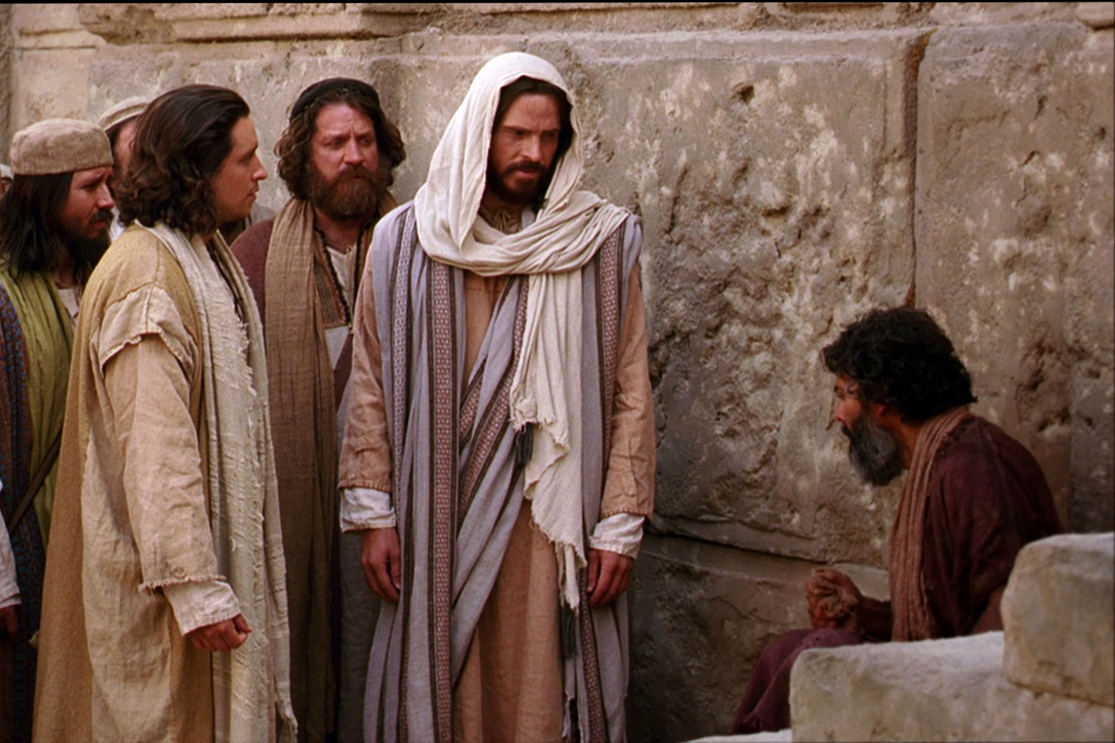

Slide 9
¹ As he went along, he saw a man blind from birth. ² His disciples asked him, “Rabbi, who sinned, this man or his parents, that he was born blind?”
³ “Neither this man nor his parents sinned,” said Jesus, “but this happened so that the works of God might be displayed in him. ⁴ As long as it is day, we must do the works of him who sent me. Night is coming, when no one can work. ⁵ While I am in the world, I am the light of the world.”

Slide 10
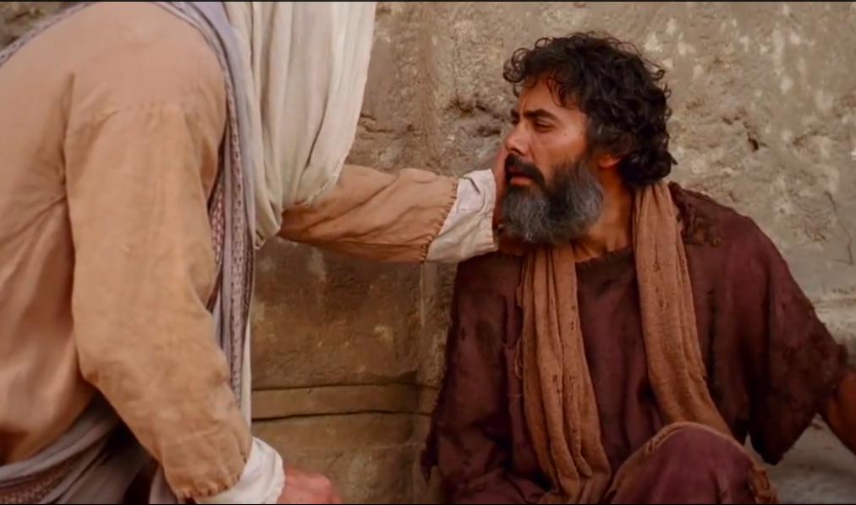

Slide 11
⁶ After saying this, he spit on the ground, made some mud with the saliva, and put it on the man’s eyes. ⁷ “Go,” he told him, “wash in the Pool of Siloam” (this word means “Sent”). So the man went and washed, and came home seeing.
⁸ His neighbors and those who had formerly seen him begging asked, “Isn’t this the same man who used to sit and beg?”

Slide 12
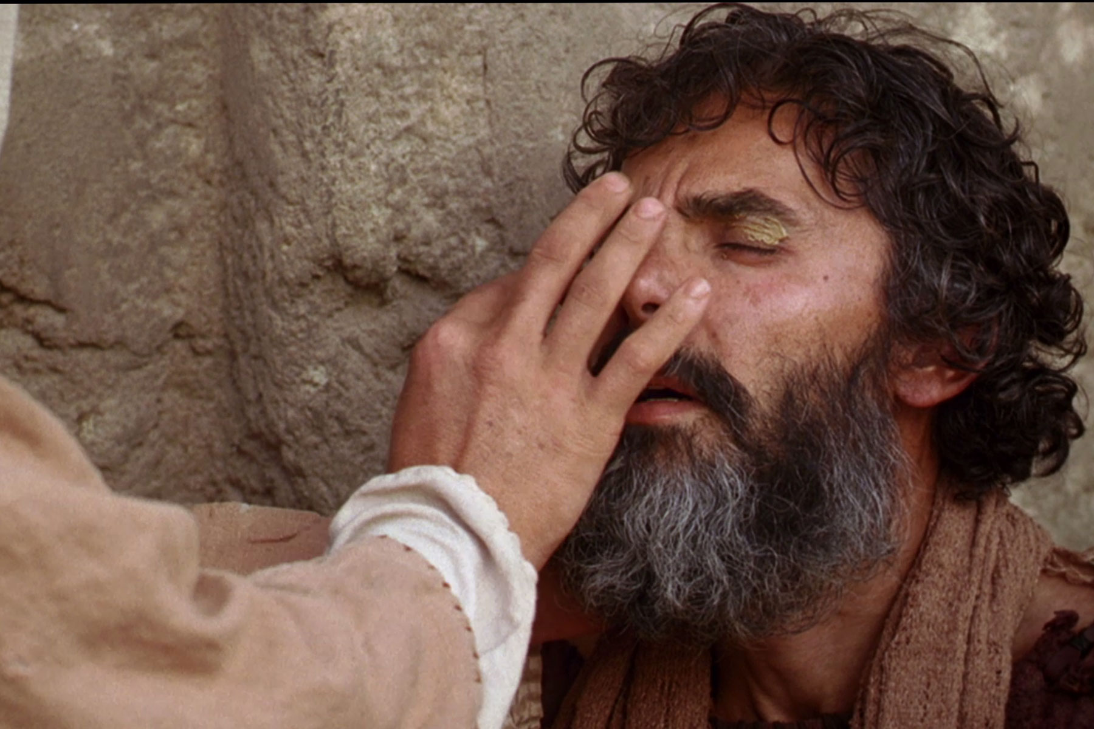

Slide 14
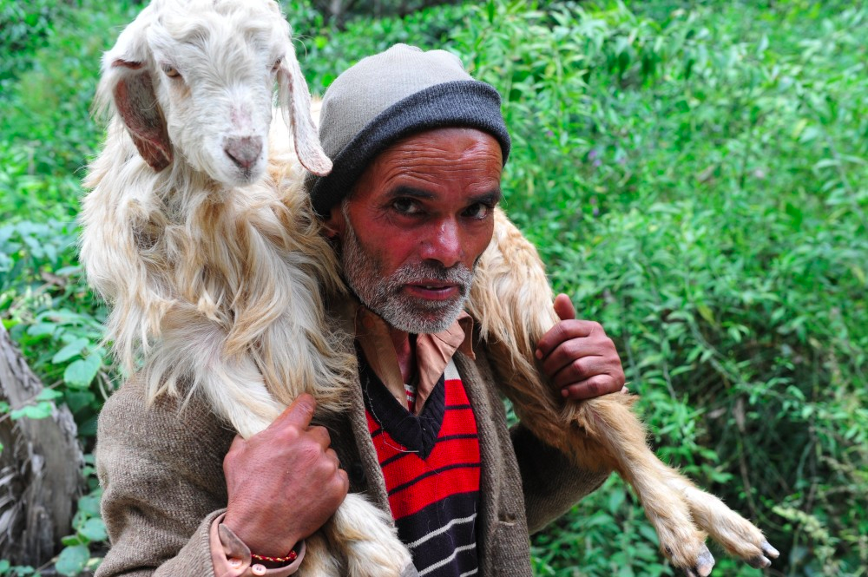

Slide 15
Testify about Jesus

Slide 16
¹⁰ “How then were your eyes opened?” they asked.
¹¹ He replied, “The man they call Jesus made some mud and put it on my eyes. He told me to go to Siloam and wash. So I went and washed, and then I could see.”

Slide 17
¹³ They brought to the Pharisees the man who had been blind. ¹⁴ Now the day on which Jesus had made the mud and opened the man’s eyes was a Sabbath. ¹⁵ Therefore the Pharisees also asked him how he had received his sight. “He put mud on my eyes,” the man replied, “and I washed, and now I see.”

Slide 18
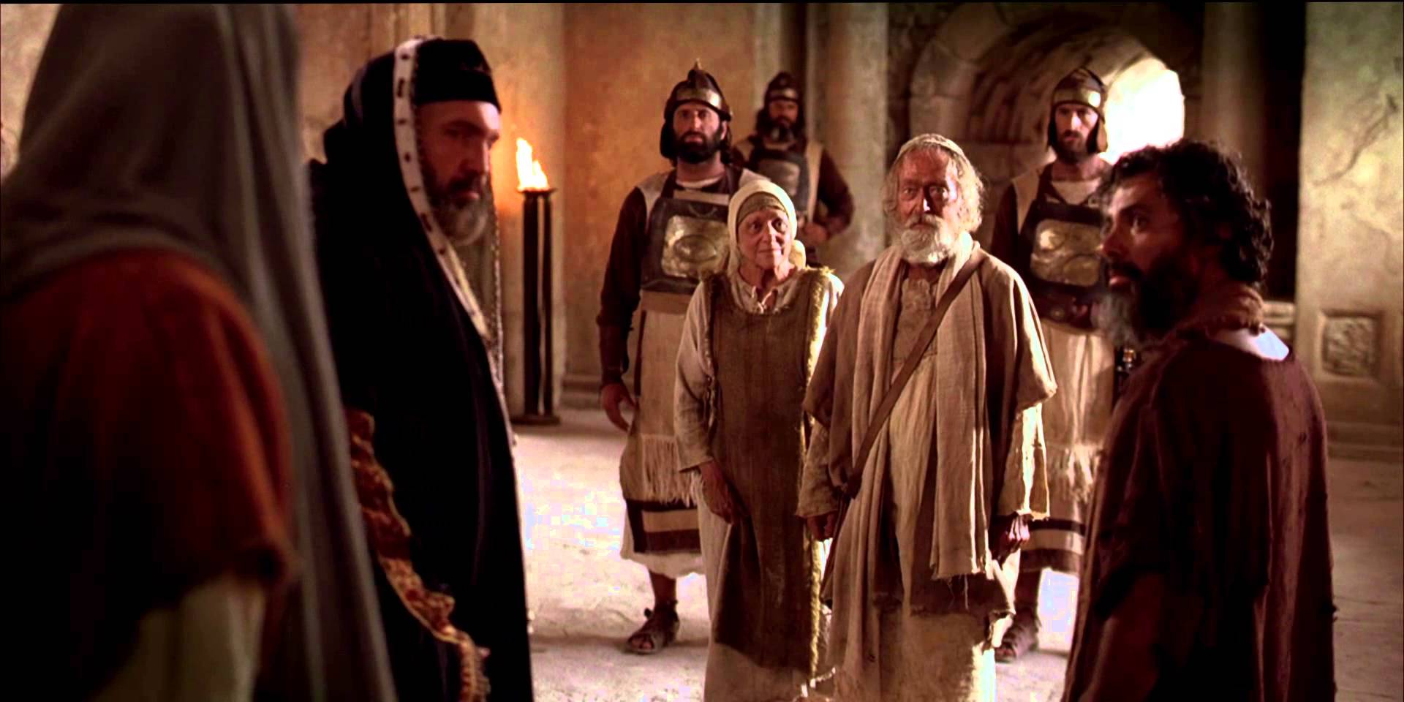

Slide 19
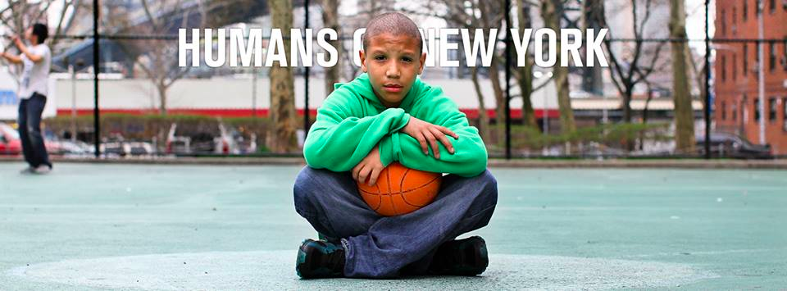

Slide 20
Defend the Faith

Slide 22
²⁴ A second time they summoned the man who had been blind. “Give glory to God by telling the truth,” they said. “We know this man is a sinner.”
²⁵ He replied, “Whether he is a sinner or not, I don’t know. One thing I do know. I was blind but now I see!”
²⁶ Then they asked him, “What did he do to you? How did he open your eyes?”

Slide 23
²⁷ He answered, “I have told you already and you did not listen. Why do you want to hear it again? Do you want to become his disciples too?”
²⁸ Then they hurled insults at him and said, “You are this fellow’s disciple! We are disciples of Moses! ²⁹ We know that God spoke to Moses, but as for this fellow, we don’t even know where he comes from.”

Slide 24
³⁰ The man answered, “Now that is remarkable! You don’t know where he comes from, yet he opened my eyes. ³¹ We know that God does not listen to sinners. He listens to the godly person who does his will. ³² Nobody has ever heard of opening the eyes of a man born blind. ³³ If this man were not from God, he could do nothing.”
³⁴ To this they replied, “You were steeped in sin at birth; how dare you lecture us!” And they threw him out.

Slide 30
³⁵ Jesus heard that they had thrown him out, and when he found him, he said, “Do you believe in the Son of Man?”
³⁶ “Who is he, sir?” the man asked. “Tell me so that I may believe in him.”
³⁷ Jesus said, “You have now seen him; in fact, he is the one speaking with you.”
³⁸ Then the man said, “Lord, I believe,” and he worshiped him.

Slide 34
