Slide 1
What is Our Legacy?

Slide 2
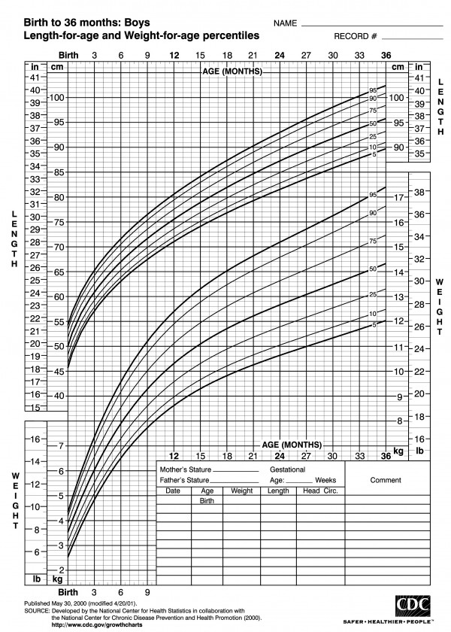

Slide 4
1st John 2:12-14
I am writing to you, little children,
because your sins are forgiven
for his name's sake.
I am writing to you, fathers,
because you know him
who is from the beginning.
I am writing to you, young men,
because you have overcome the evil one.

Slide 5
1st John 2:12-14
I write to you, children,
because you know the Father.
I write to you, fathers,
because you know him
who is from the beginning.
I write to you, young men,
because you are strong,
and the word of God abides in you,
and you have overcome the evil one.

Slide 6
1st John 2:1
My little children, I am writing these things to you so that you may not sin. But if anyone does sin, we have an advocate with the Father, Jesus Christ the righteous.
“Children” used as term of endearment.
“Child, young men, fathers” indicating the spiritual age of the church family (not necessarily physical age also)

Slide 8
Little Children- New Believers
1st John 2:12-13
I am writing to you, little children,
because your sins are forgiven
for his name's sake.
I write to you, children,
because you know the Father.
Characteristics- unstable, needy, enthusiastic
Focus- repentance, forgiveness, relationship

Slide 9
Little Children- New Believers
John 17:3
And this is eternal life, that they know you, the only true God, and Jesus Christ whom you have sent.
True Christian faith is a relationship with the living Savior and Lord Jesus, not a dead religion of do’s and don’ts!

Slide 10
Little Children- New Believers
1st Peter 2:2-3
Like newborn infants, long for the pure spiritual milk, that by it you may grow up into salvation— if indeed you have tasted that the Lord is good.
One key need of children is healthy growth!
New believers key need is to grow up in knowing and living the Gospel of Christ.

Slide 11
Little Children- New Believers
Ephesians 4:11-15
And he gave the apostles, the prophets, the evangelists, the shepherds and teachers, to equip the saints for the work of ministry, for building up the body of Christ, until we all attain to the unity of the faith and of the knowledge of the Son of God, to mature manhood, to the measure of the stature of the fullness of Christ, so that we may no
longer be children, tossed to and fro by the waves and carried about by every wind of doctrine, by human cunning, by craftiness in deceitful schemes. 15 Rather, speaking the truth in love, we are to grow up in every way into him who is the head, into Christ,

Slide 12
Little Children- New Believers
Ephesians 4:11-15
longer be children, tossed to and fro by the waves and carried about by every wind of doctrine, by human cunning, by craftiness in deceitful schemes. Rather, speaking the truth in love, we are to grow up in every way into him who is the head, into Christ.
One key need of children is healthy growth!

Slide 13
Young Men/Women- Maturing Believers
1st John 2:13-14
I am writing to you, young men,
because you have overcome the evil one.
I write to you, young men,
because you are strong,
and the word of God abides in you,
and you have overcome the evil one.
Characteristics- vigor, strength, pride
Focus- battle, victory, God’s Word

Slide 14
Young Men/Women- Maturing Believers
1st John 2:13-14
How can a young man keep his way pure?
By guarding it according to your word.
With my whole heart I seek you; let me not wander from your commandments!
I have stored up your word in my heart,
that I might not sin against you.

Slide 15
Fathers/Mothers- Servant Leaders
1st John 2:13-14
I am writing to you, fathers,
because you know him
who is from the beginning.
I write to you, fathers,
because you know him
who is from the beginning.
Characteristics- Multiplication, relationship
Focus- Deeper relationship, mentoring others

Slide 16
Colossians 1:28-29
Him we proclaim, warning everyone and teaching everyone with all wisdom, that we may present everyone mature in Christ. For this I toil, struggling with all his energy that he powerfully works within me.

