Slide 1
C4 Vision
Grow

Slide 2
“Bring inspiration and innovation to every athlete in the world.* If you have a body, you are an athlete.”
“Our deepest purpose as an organization is helping support the health, well-being, and healing of both people. . . and the planet.”
“To prevent and alleviate human suffering in the face of emergencies by mobilizing the power of volunteers and the generosity of donors.”

Slide 3
Chinese Christian Church of Columbia’s vision is to be a Christ-centered community that seeks to make disciples who learn, grow, and serve in the Lord.”

Slide 5
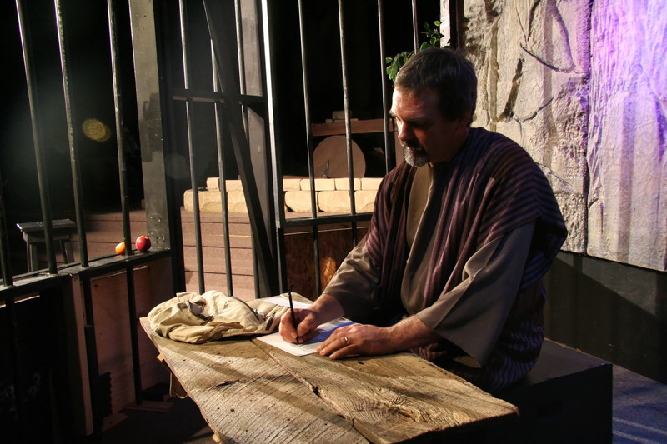

Slide 6
Equipping the Saints

Slide 7
¹¹ So Christ himself gave the apostles, the prophets, the evangelists, the pastors and teachers, ¹² to equip his people for works of service, so that the body of Christ may be built up ¹³ until we all reach unity in the faith and in the knowledge of the Son of God and become mature, attaining to the whole measure of the fullness of Christ.
Ephesians 4:11-13

Slide 9
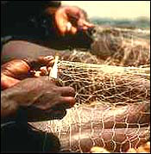
Equip - making someone or something adequate or sufficient for some purpose

Slide 10
The idea is that pastor-teachers are to teach the Word to help the rest of the body become adequate or prepared so that they may serve the Lord in accordance with their gifts.
Steven J. Cole
Pastor, Flagstaff Christian Fellowship

Slide 11
Becoming Mature

Slide 12
¹² to equip his people for works of service, so that the body of Christ may be built up ¹³ until we all reach unity in the faith and in the knowledge of the Son of God and become mature, attaining to the whole measure of the fullness of Christ.

Slide 14
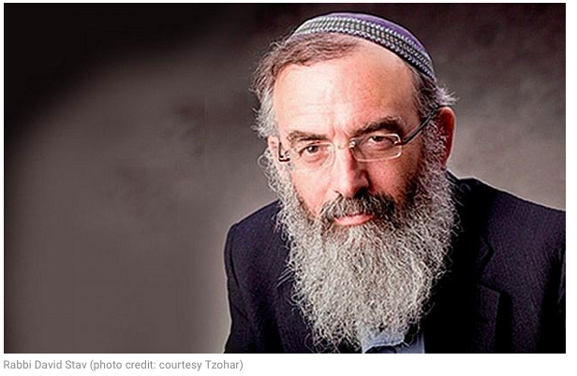

Slide 16
Becoming Christlike

Slide 17
¹² to equip his people for works of service, so that the body of Christ may be built up ¹³ until we all reach unity in the faith and in the knowledge of the Son of God and become mature, attaining to the whole measure of the fullness of Christ.

Slide 18
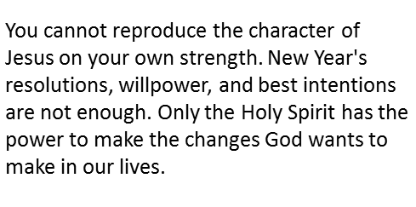
Rick Warren

Slide 22
Living it out

