Slide 1
The Cambrian Explosion (Gen 7:1-5)

Slide 3
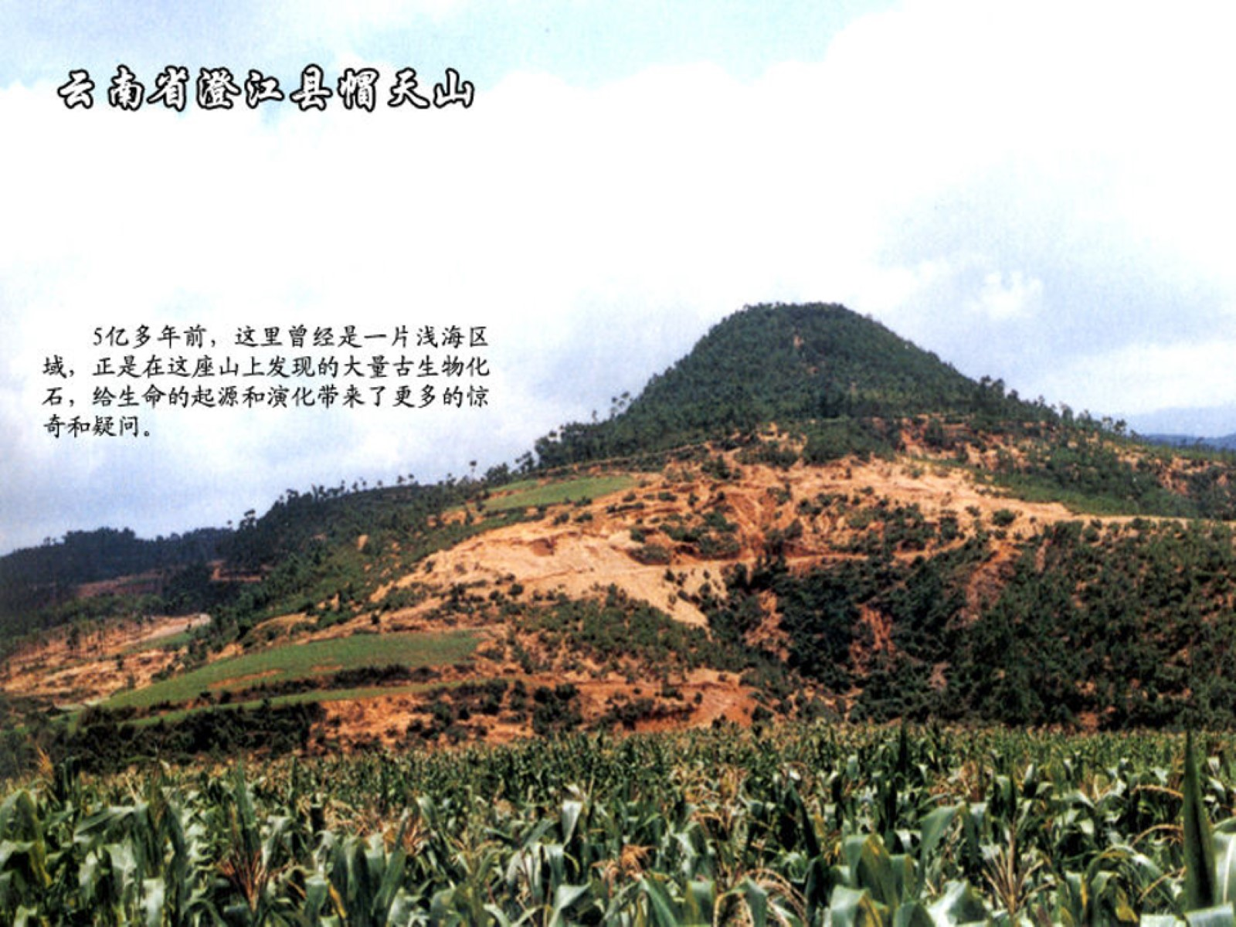

Slide 5
Maotianshan Shales

Slide 6
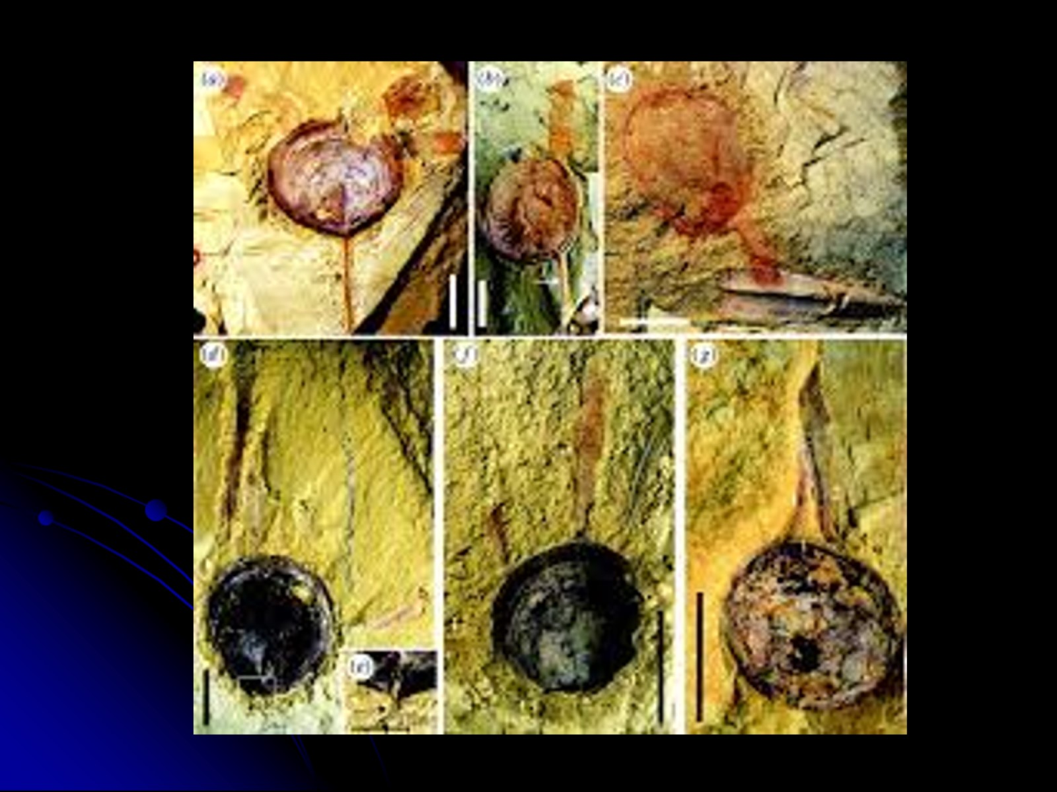

Slide 7
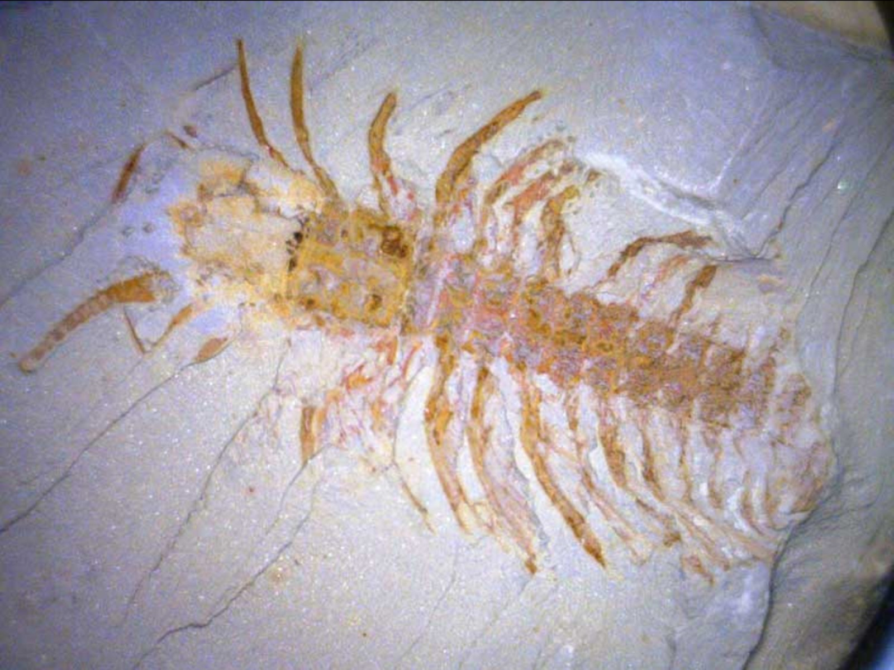

Slide 8
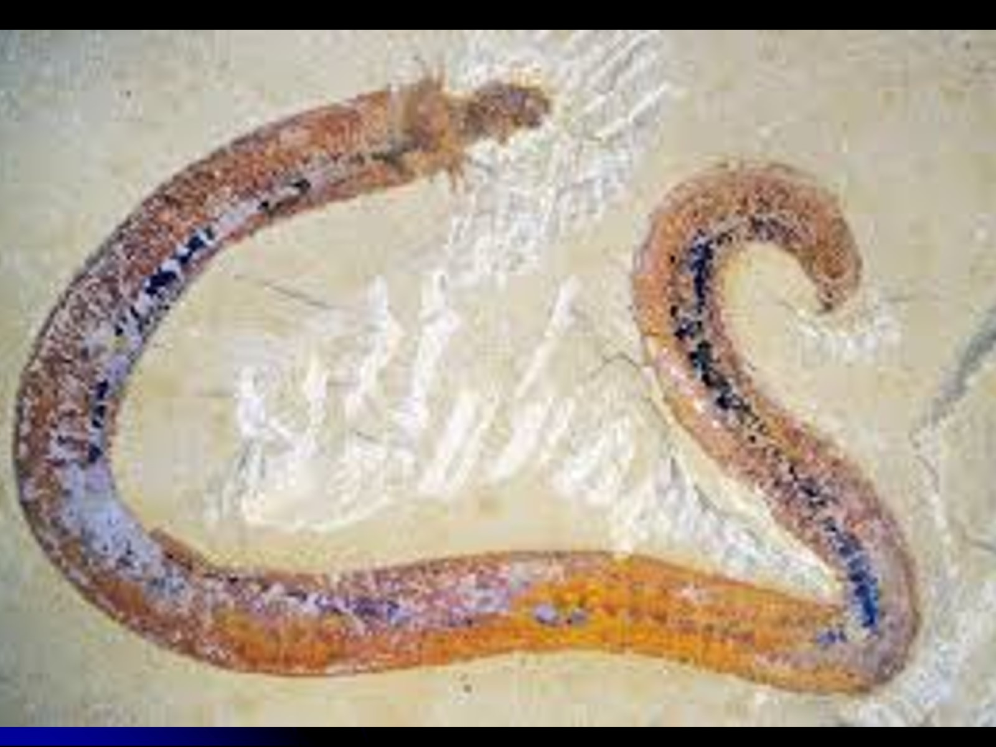

Slide 9
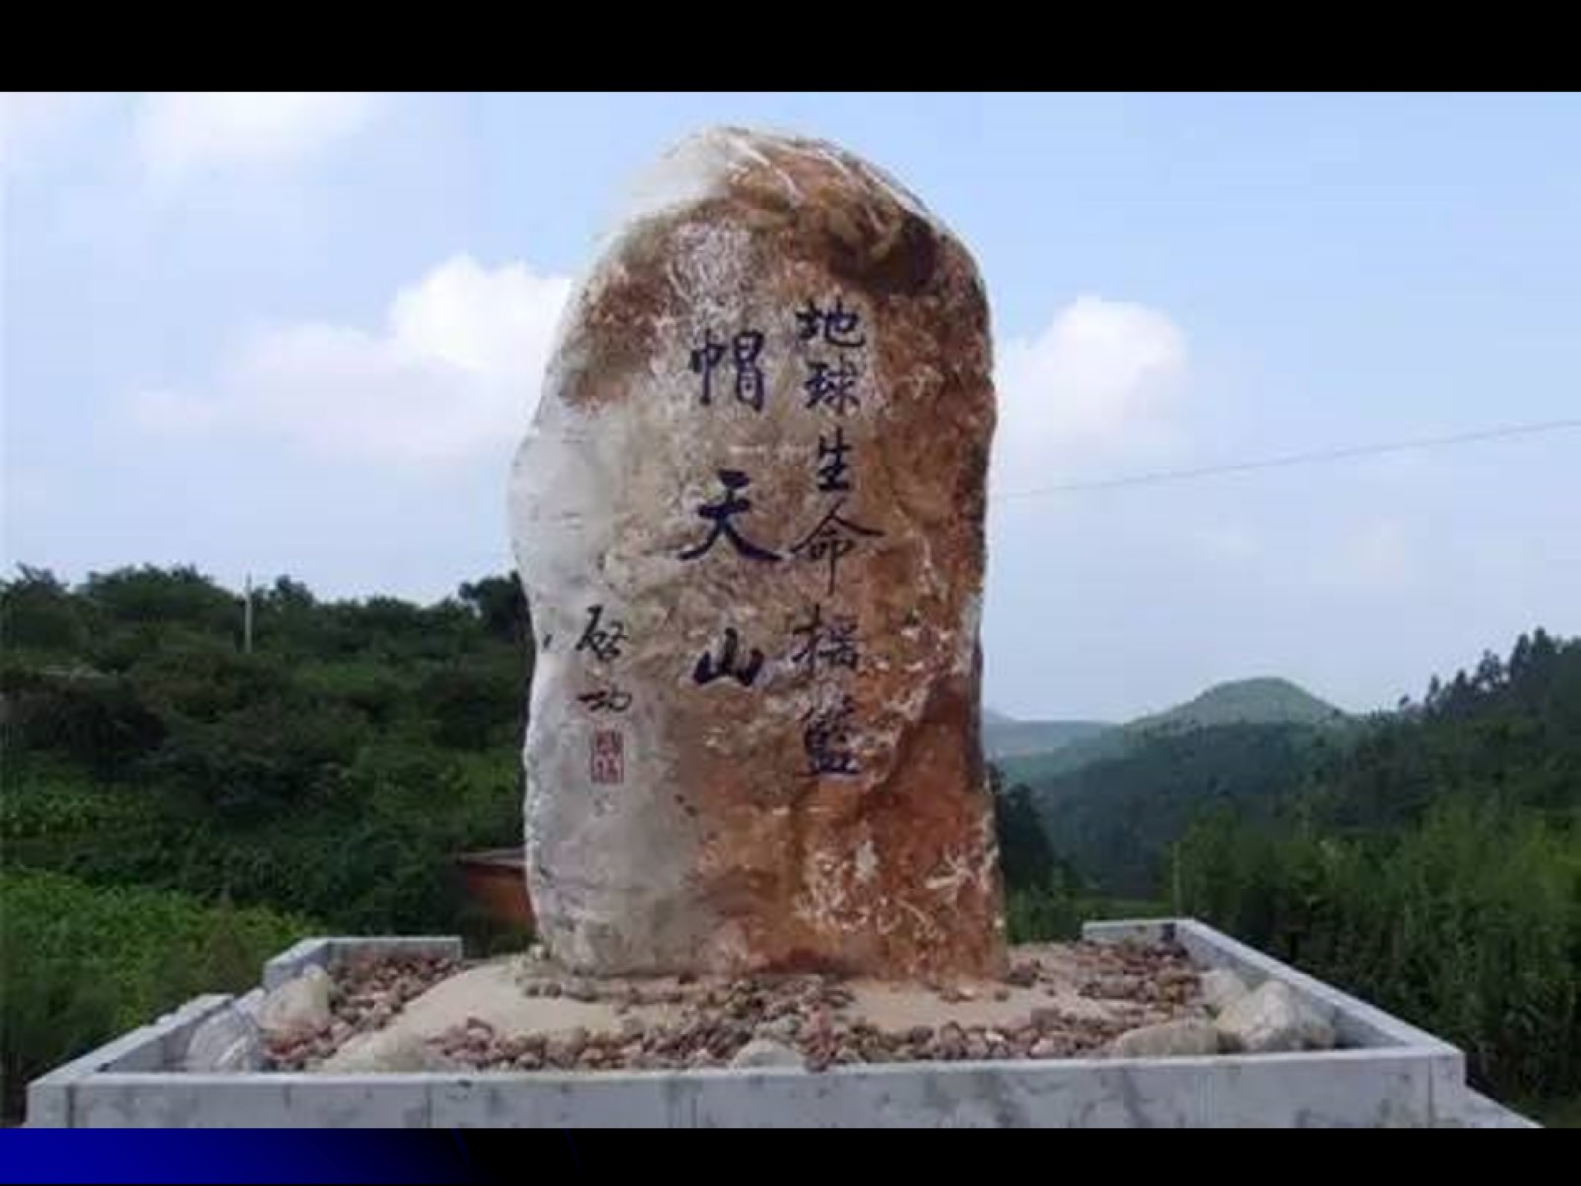

Slide 10
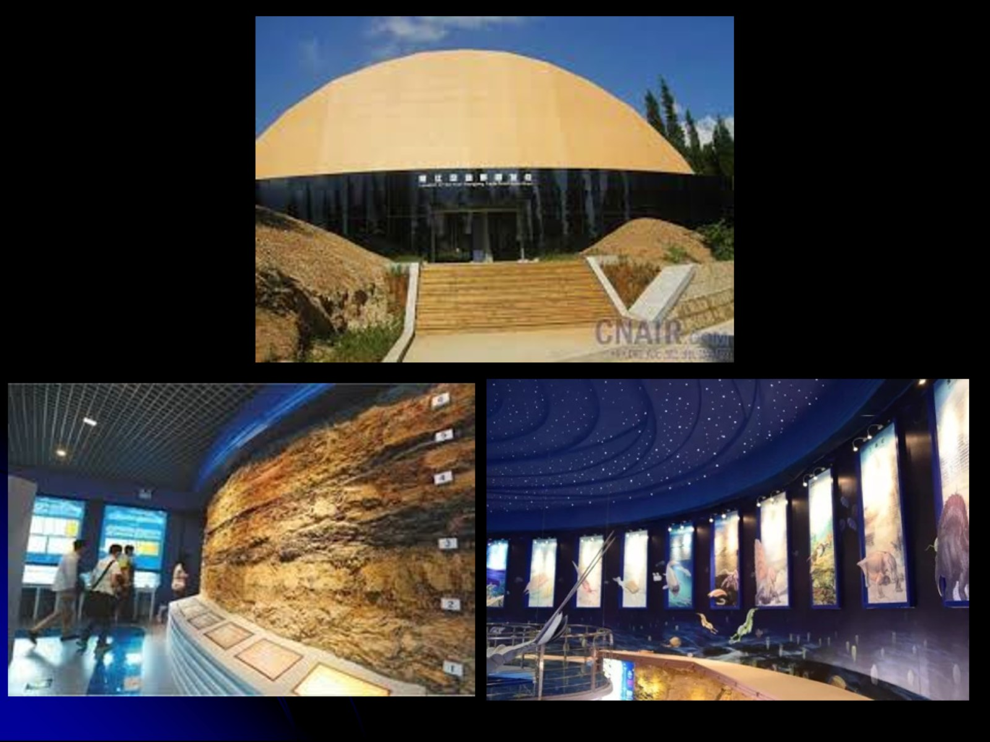

Slide 12
Maotianshan Shales 14 Articles

Slide 15
The Cambrian Explosion

Slide 16
Darwin’s Evolutionism

Slide 19
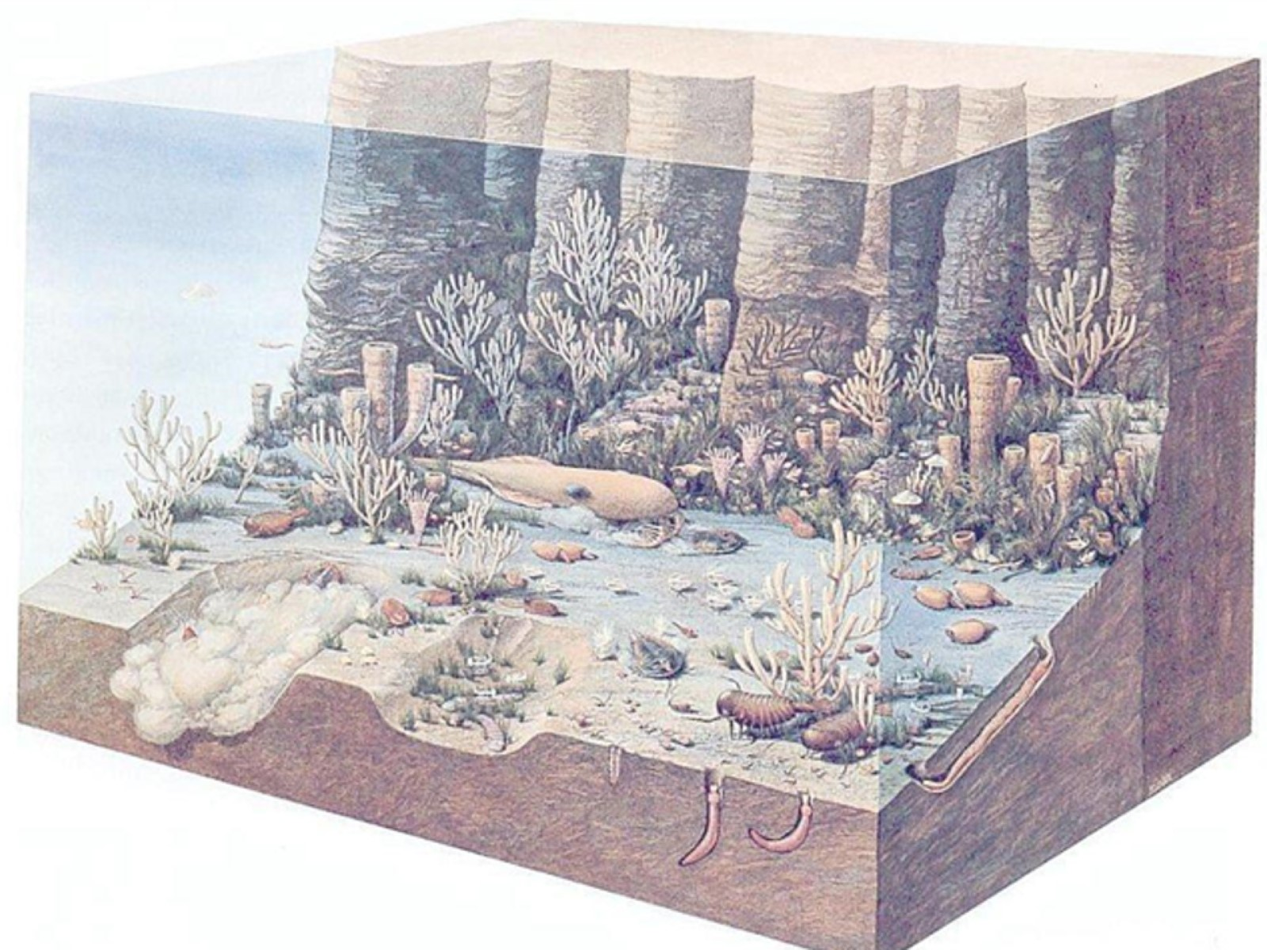

Slide 20
Darwin’s Evolutionism

Slide 21
How Rock Strata Formed

Slide 23
Instructions to Noah (Gen 7:1-5)

Slide 25
Reason for the Flood (Gen 6:5-6)

Slide 26
God’s Instructions to Noah (Gen 7:1-5)

Slide 27
The Arrival of the Flood (Genesis 7)

Slide 28
How Large was the Ark?

Slide 29
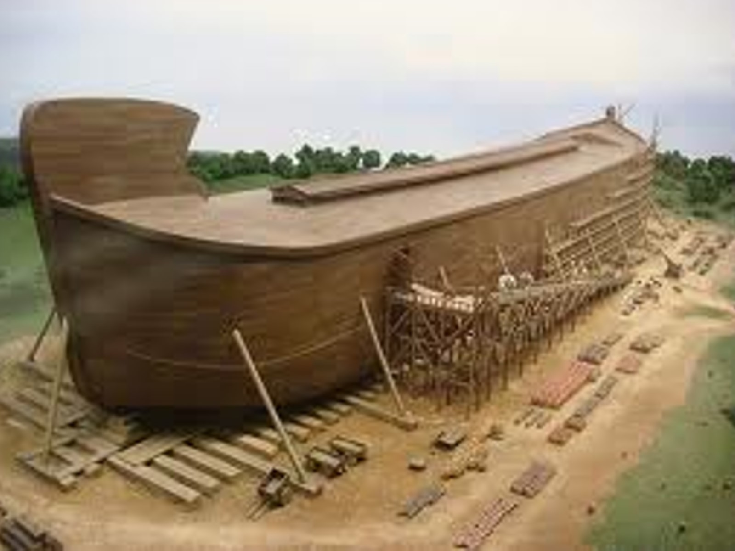

Slide 30
Which Creatures Were Preserved?

Slide 31
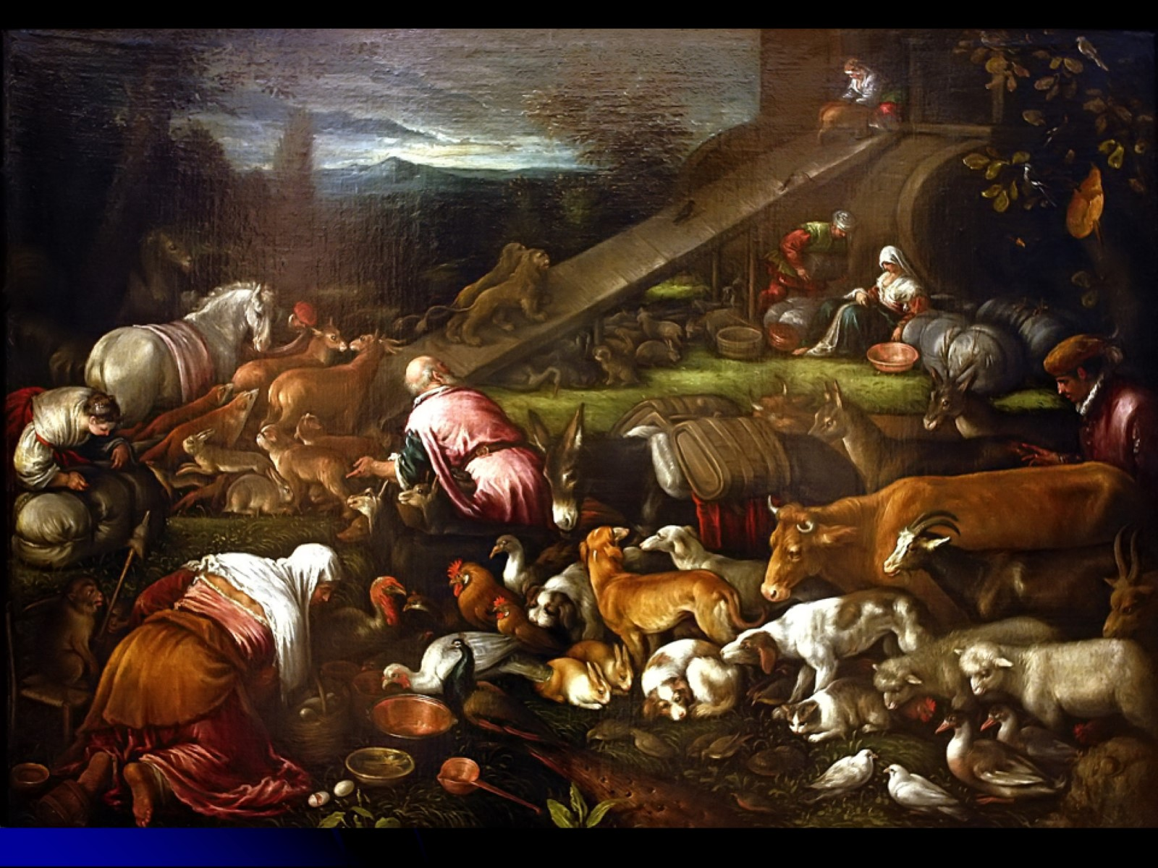

Slide 32
Where Did Water Come From?

Slide 33
Where Did Water Come From?

Slide 34
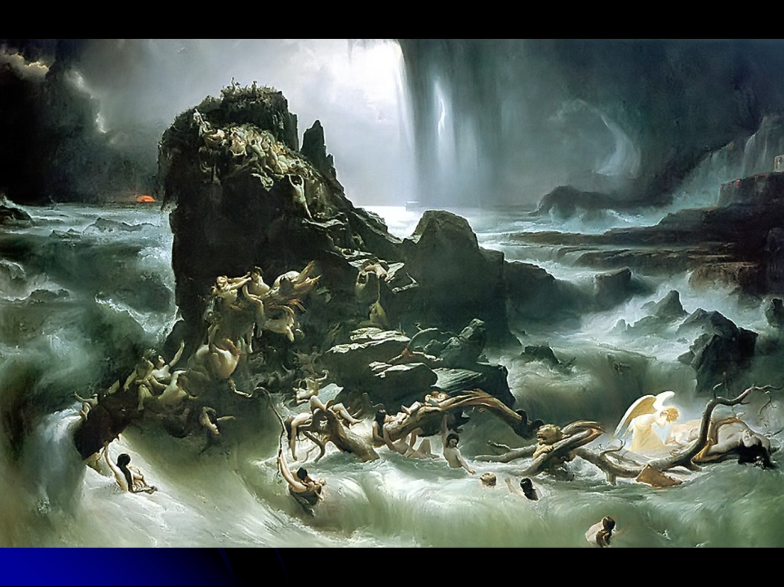

Slide 35
The Receding of the Flood

Slide 36
The Receding of the Flood

Slide 37
Rainbow Covenant

Slide 38
Earth Changes after the Flood

Slide 39
Recent Discoveries

Slide 40
Does the Ark Really Exist?

Slide 42
Reflection on Cambrian Explosion

Slide 43
The Type of Flood (Matt 24:36-39)

Slide 44
Responsibility of Today’s “Noah”

Slide 45
