Slide 1
Christ’s Coming
Holiness

Slide 2
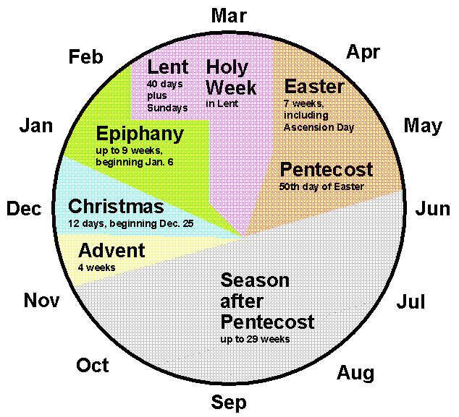

Slide 4
“I will send my messenger, who will prepare the way before me. Then suddenly the Lord you are seeking will come to his temple; the messenger of the covenant, whom you desire, will come,” says the Lord Almighty.
2 But who can endure the day of his coming? Who can stand when he appears? For he will be like a refiner’s fire or a launderer’s soap.
Malachi 3:1-2

Slide 5
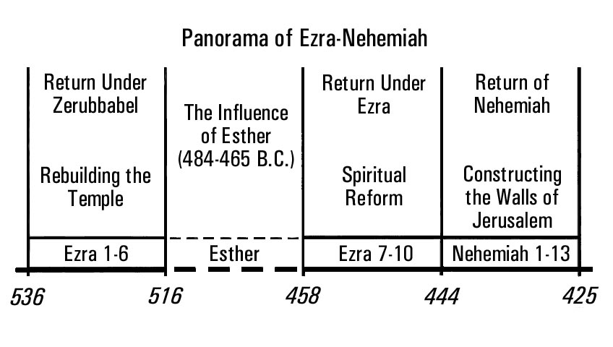

Slide 6
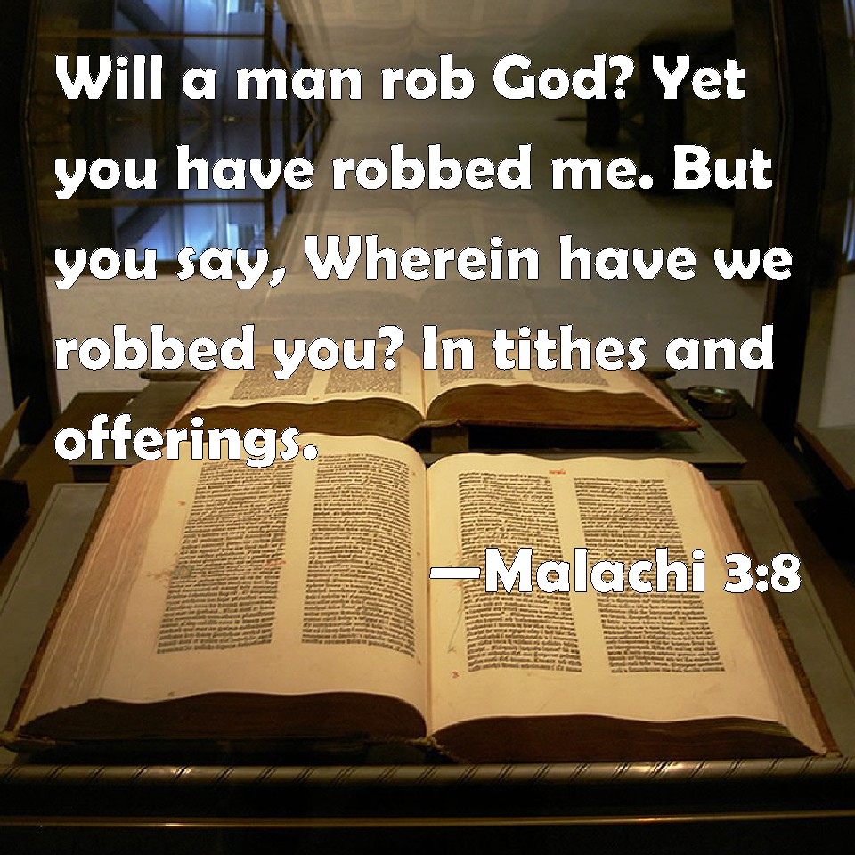

Slide 7
Prepare for Christ’s coming through fear and fire.

Slide 8
“I will send my messenger, who will prepare the way before me. Then suddenly the Lord you are seeking will come to his temple; the messenger of the covenant, whom you desire, will come,” says the Lord Almighty.
Malachi 3:1

Slide 9
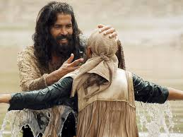

Slide 10
Paul said, "John's baptism was a baptism of repentance. He told the people to believe in the one coming after him, that is, in Jesus.”
Acts 19:4

Slide 13
Repentance includes saying “I’m sorry,” but it is not only saying “I’m sorry.” It requires action.
John Perkins

Slide 14
“I will send my messenger, who will prepare the way before me. Then suddenly the Lord you are seeking will come to his temple; the messenger of the covenant, whom you desire, will come,” says the Lord Almighty.
2 But who can endure the day of his coming? Who can stand when he appears? For he will be like a refiner’s fire or a launderer’s soap.
Malachi 3:1-3

Slide 15
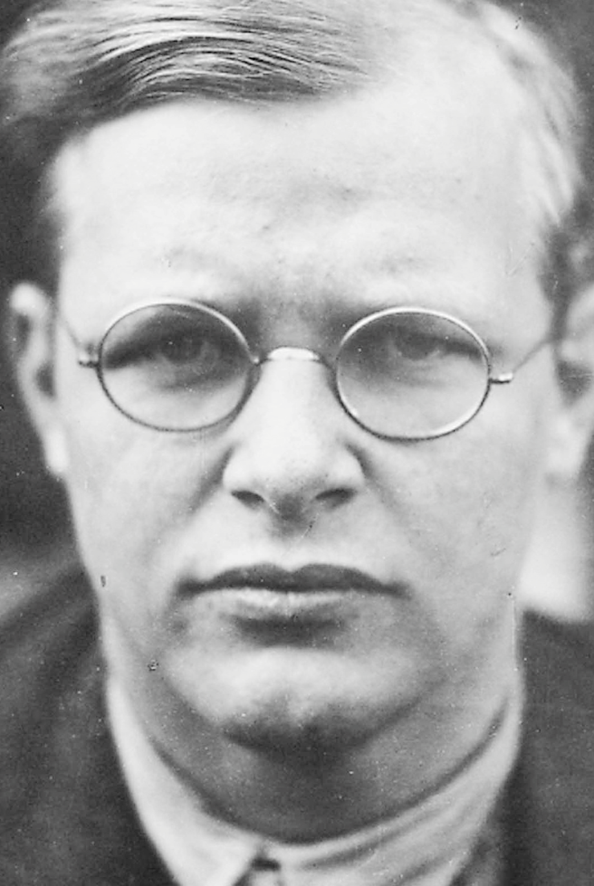

Slide 16
It is very remarkable that we face the thought that God is coming, so calmly, whereas previously peoples trembled at the day of God . . . . We have become so accustomed to the idea of divine love and of God's coming at Christmas that we no longer feel the shiver of fear that God's coming should arouse in us.

Slide 17
We are indifferent to the message, taking only the pleasant and agreeable out of it and forgetting the serious aspect, that the God of the world draws near to the people of our little earth and lays claim to us. The coming of God is truly not only glad tidings, but first of all frightening news for every one who has a conscience.
Dietrich Bonhoeffer
Advent , 1928

Slide 19
“I will send my messenger, who will prepare the way before me. Then suddenly the Lord you are seeking will come to his temple; the messenger of the covenant, whom you desire, will come,” says the Lord Almighty.
2 But who can endure the day of his coming? Who can stand when he appears? For he will be like a refiner’s fire or a launderer’s soap.
Malachi 3:1-3

Slide 20
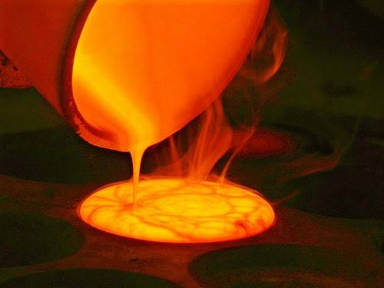

Slide 21
Will it be painful?

Slide 22
Consider it pure joy, my brothers and sisters, whenever you face trials of many kinds, because you know that the testing of your faith produces perseverance. Let perseverance finish its work so that you may be mature and complete, not lacking anything.
James 1:2-4

Slide 23
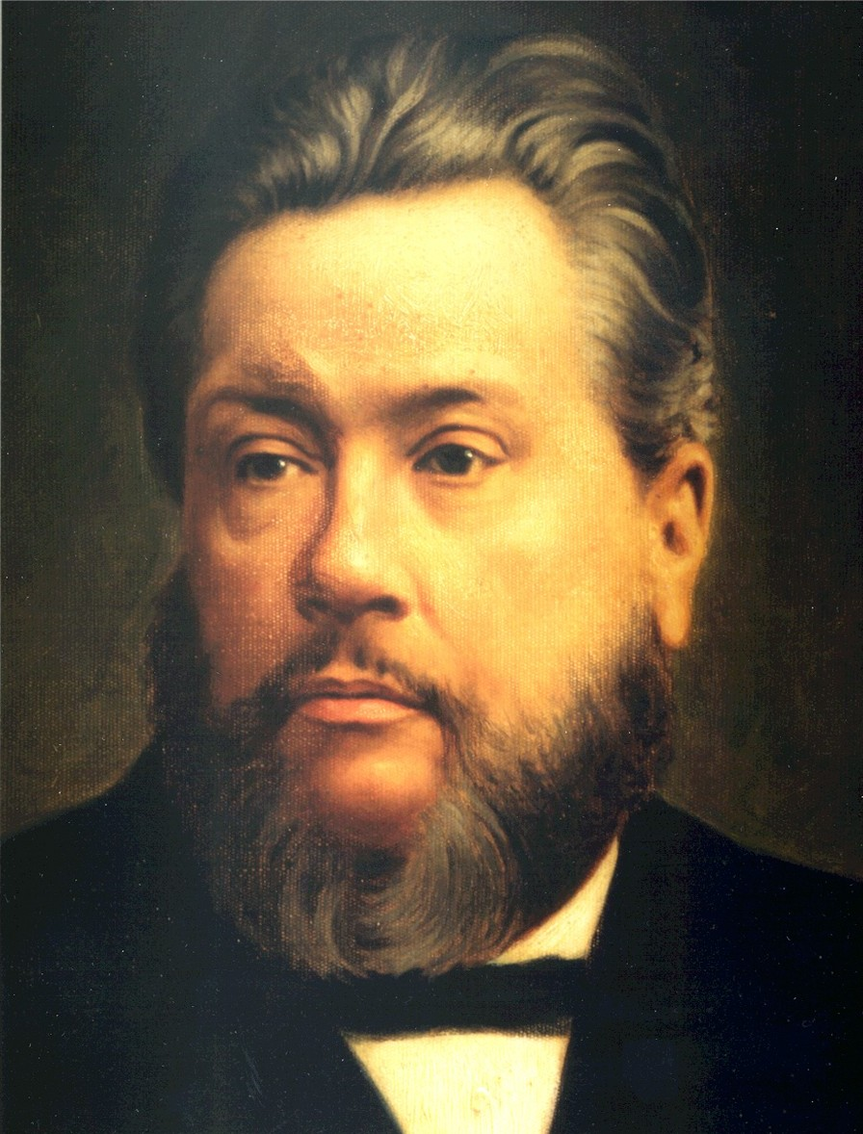

Slide 24
“I have derived more real benefit and permanent strength and growth in grace, and every precious thing, from the furnace of affliction, than I have ever derived from prosperity . . . We would have but little usefulness, if we had not been made to pass through the furnace. And in all our troubles we have found the character of God a comfort, for the Refiner is never very far from the mouth of the furnace when His gold is in the fire.”
Charles Spurgeon

Slide 25
Prepare for Christ’s coming through fear and fire.

