Slide 1
Christmas
Explorations

Slide 3
¹ In the beginning was the Word, and the Word was with God, and the Word was God. ² He was with God in the beginning. ³ Through him all things were made; without him nothing was made that has been made. ⁴ In him was life, and that life was the light of all mankind. ⁵ The light shines in the darkness, and the darkness has not overcome it.

Slide 4
⁶ There was a man sent from God whose name was John. ⁷ He came as a witness to testify concerning that light, so that through him all might believe. ⁸ He himself was not the light; he came only as a witness to the light.
⁹ The true light that gives light to everyone was coming into the world. ¹⁰ He was in the world, and though the world was made through him, the world did not recognize him.

Slide 5
¹¹ He came to that which was his own, but his own did not receive him. ¹² Yet to all who did receive him, to those who believed in his name, he gave the right to become children of God— ¹³ children born not of natural descent, nor of human decision or a husband’s will, but born of God.
¹⁴ The Word became flesh and made his dwelling among us. We have seen his glory, the glory of the one and only Son, who came from the Father, full of grace and truth.

Slide 6
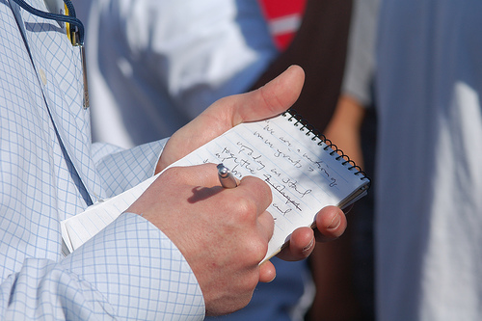

Slide 8
When and Where does John begin the story of Jesus?

Slide 9
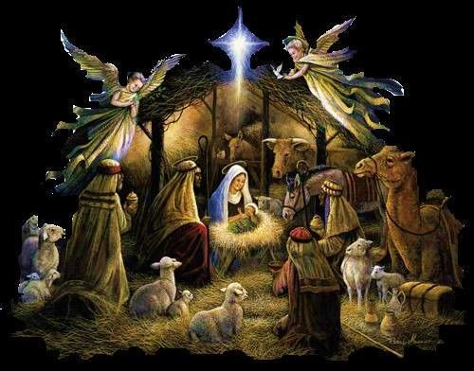

Slide 10
¹ In the beginning was the Word, and the Word was with God, and the Word was God.

Slide 12
Who is Jesus?

Slide 13
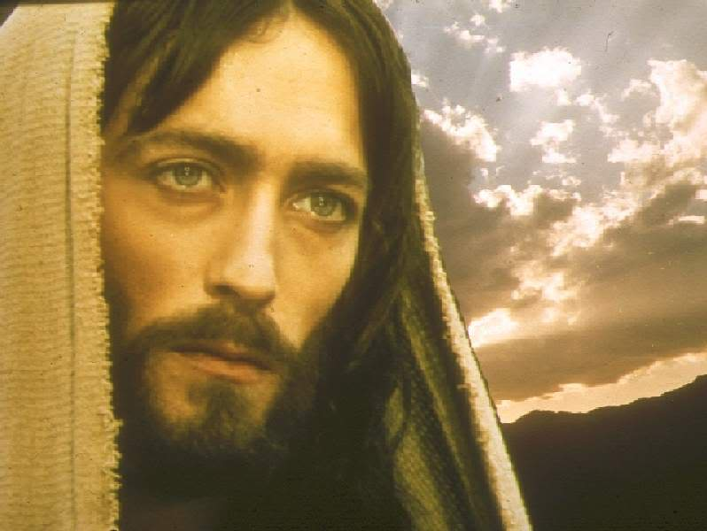

Slide 14
¹ In the beginning was the Word, and the Word was with God, and the Word was God. ² He was with God in the beginning. ³ Through him all things were made; without him nothing was made that has been made.
¹⁴ The Word became flesh and made his dwelling among us. We have seen his glory, the glory of the one and only Son

Slide 15
Why did God send His Son?

Slide 16
⁴ In him was life, and that life was the light of all mankind. ⁵ The light shines in the darkness, and the darkness has not overcome it.

Slide 19
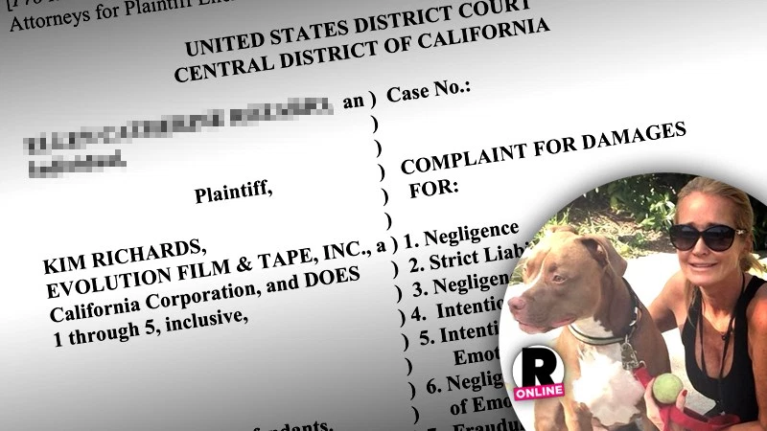

Slide 20
What is God’s desire?

Slide 21
¹² Yet to all who did receive him, to those who believed in his name, he gave the right to become children of God— ¹³ children born not of natural descent, nor of human decision or a husband’s will, but born of God.

Slide 22
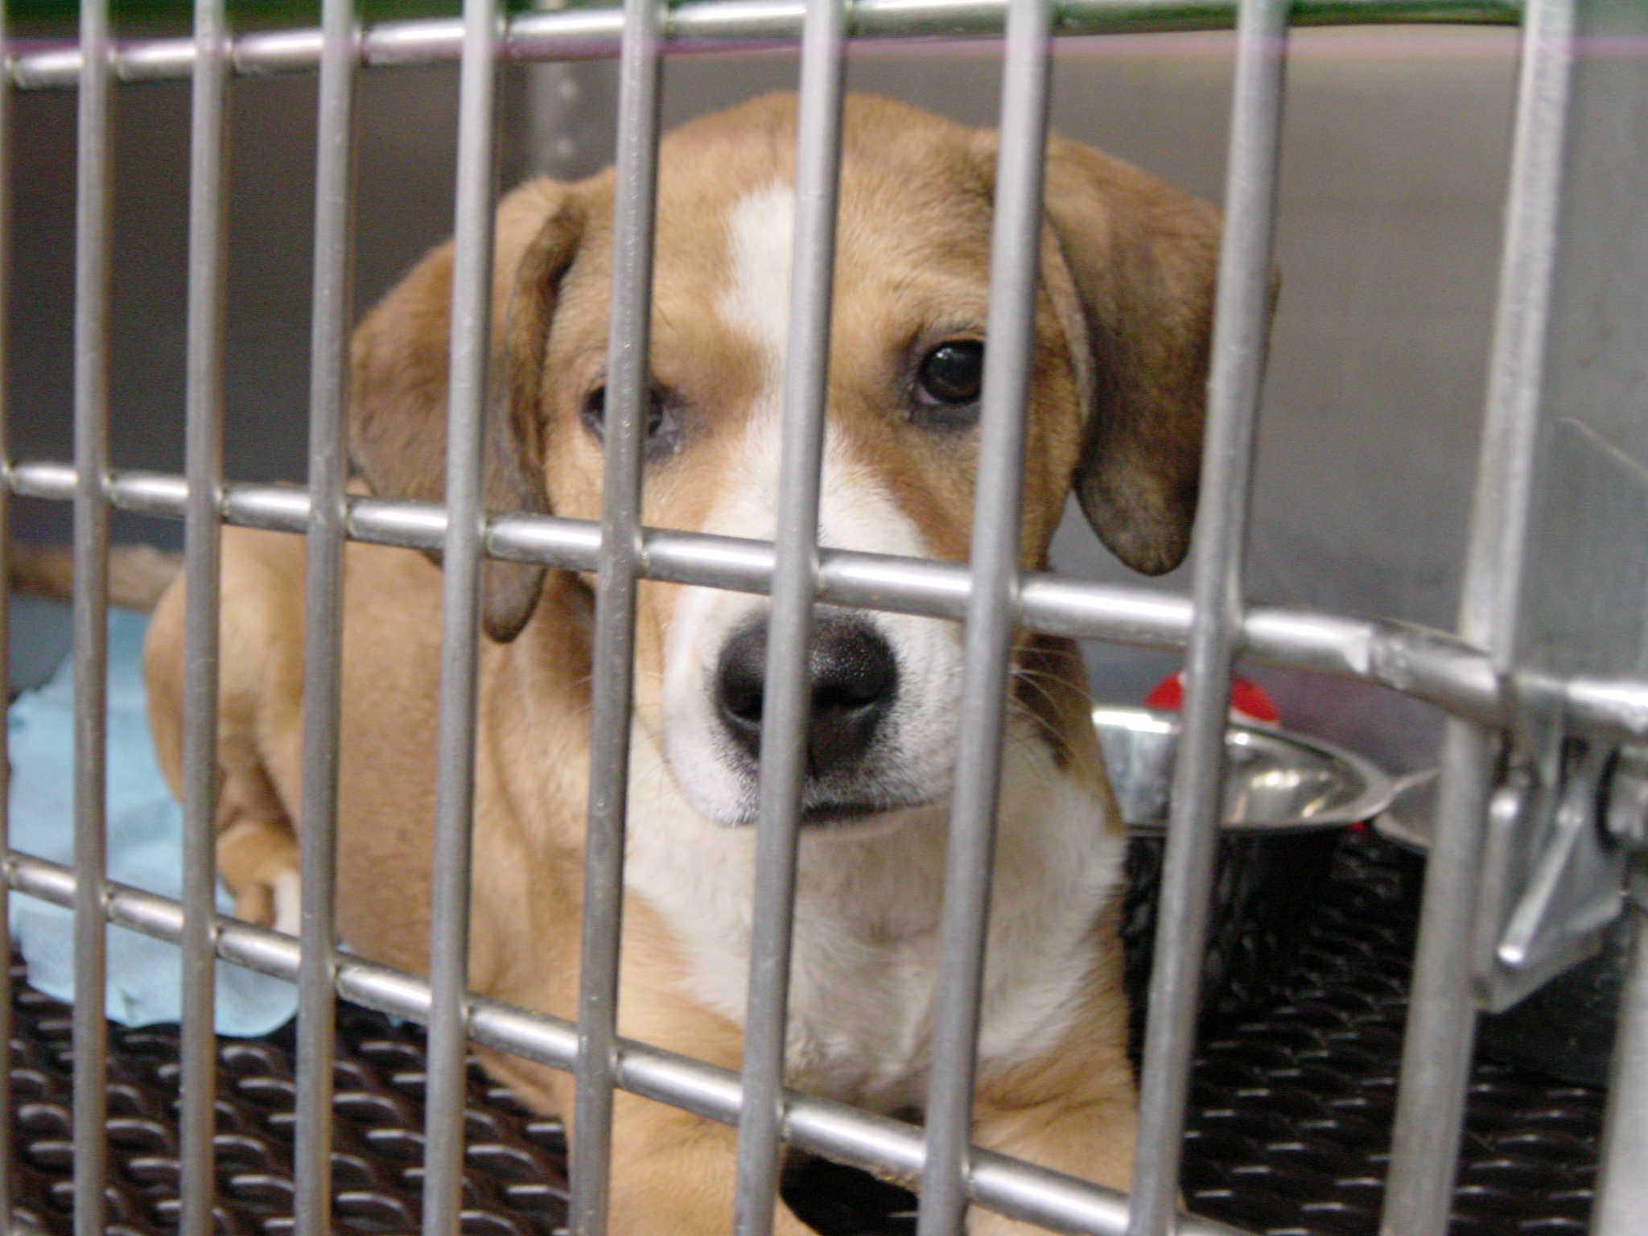

Slide 23
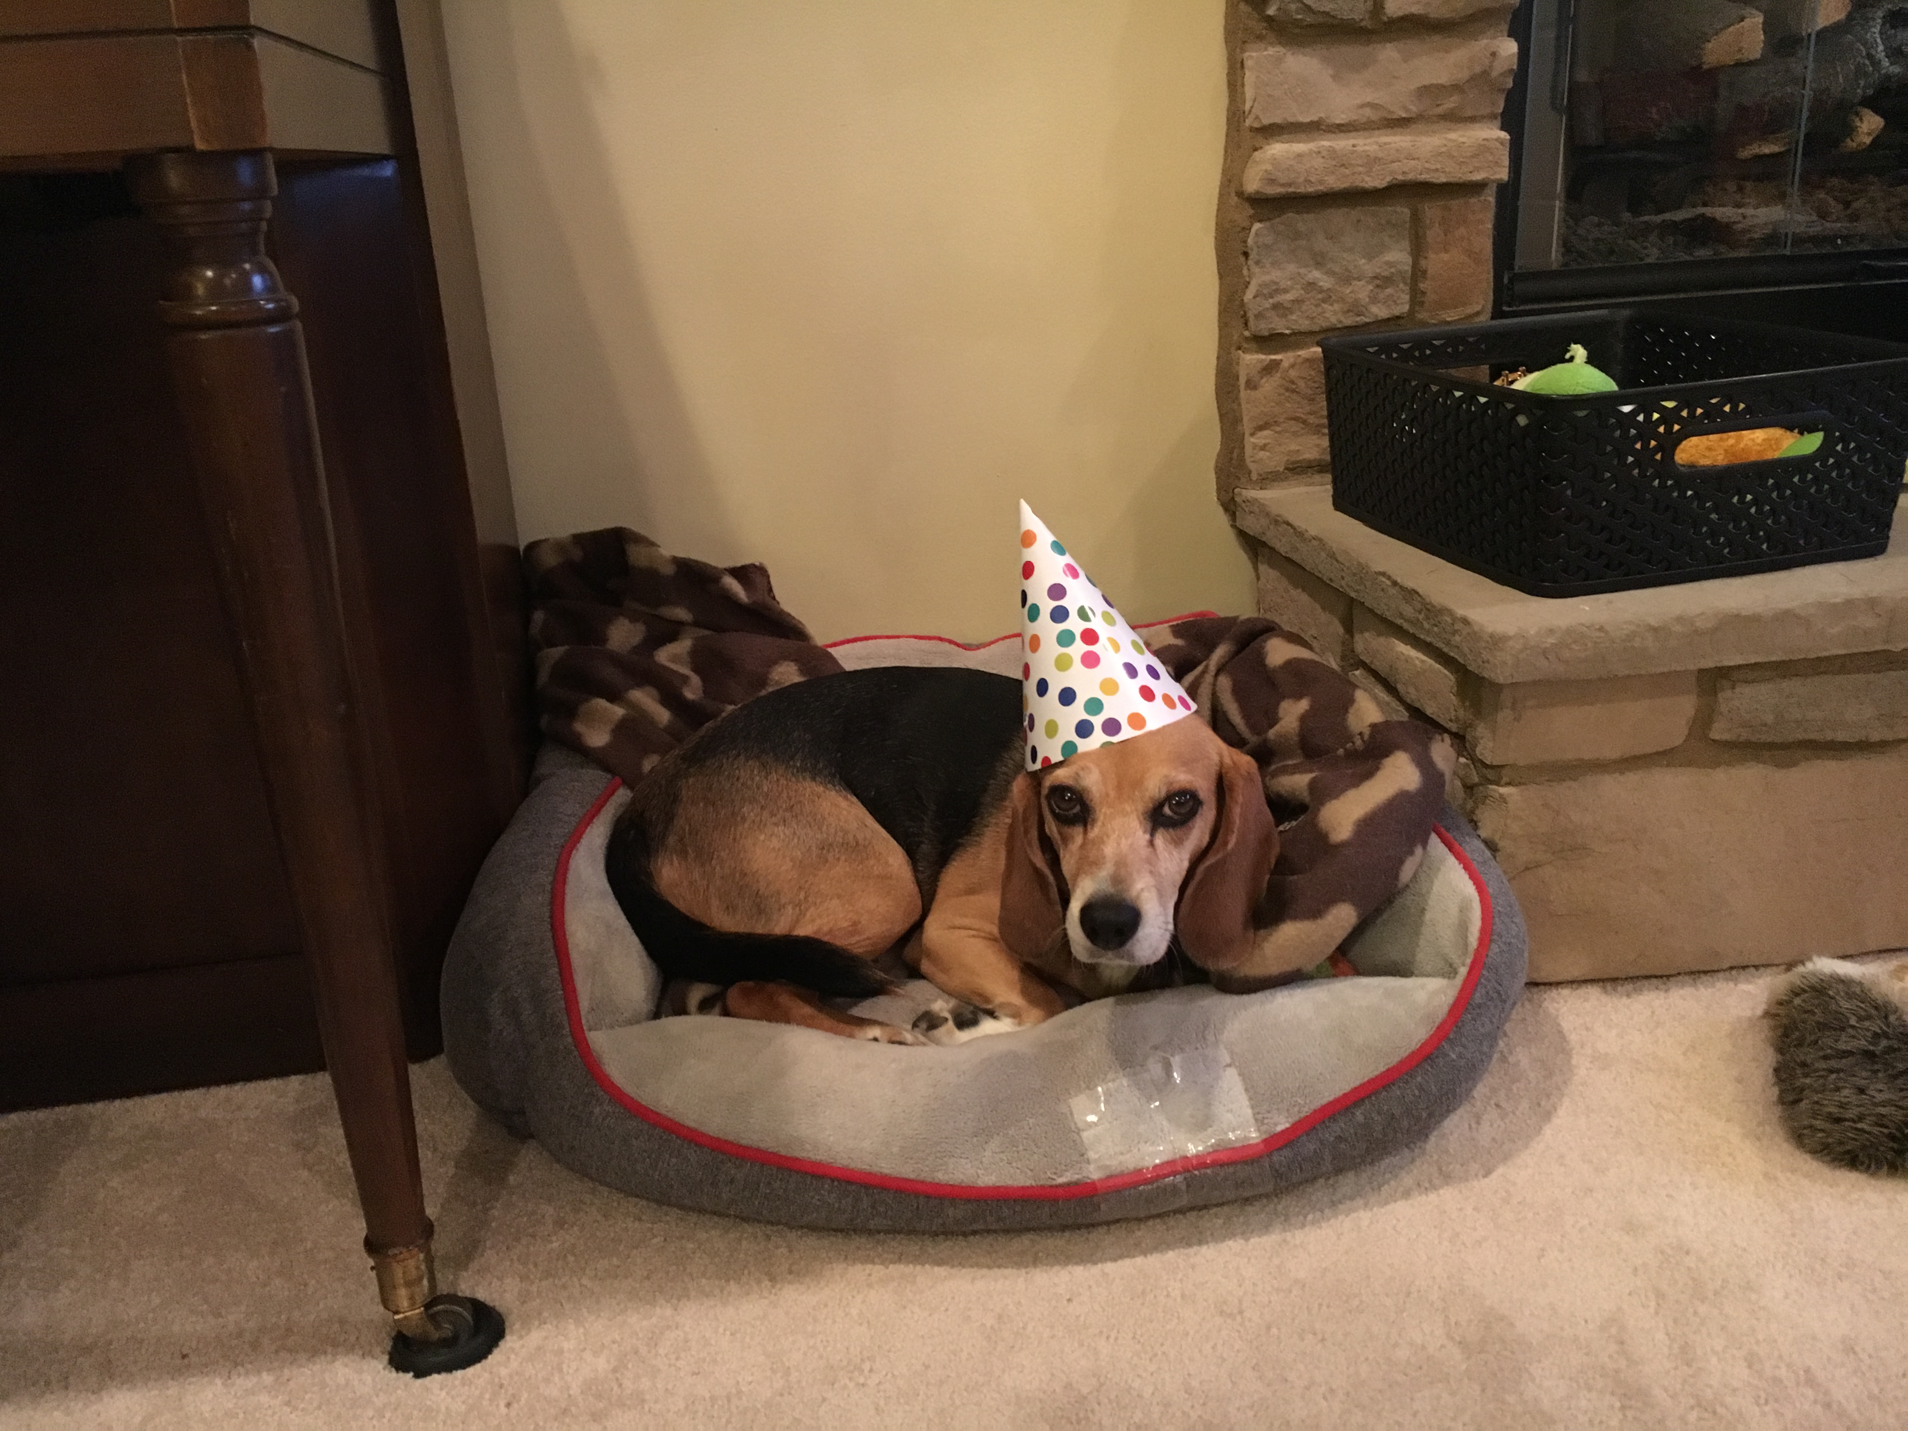

Slide 24
How should we respond?

Slide 25
Celebrate Christmas by receiving Jesus into your heart and life.

Slide 30
