Slide 1
The Christian Life
Count the Cost

Slide 2
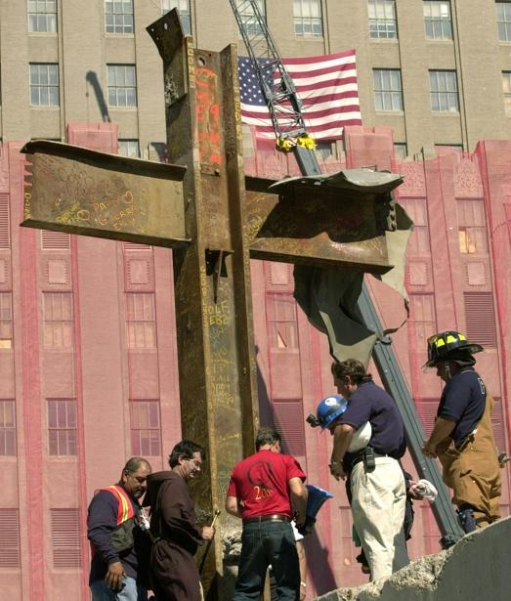

Slide 3
²⁵ Large crowds were traveling with Jesus, and turning to them he said: ²⁶ “If anyone comes to me and does not hate father and mother, wife and children, brothers and sisters—yes, even their own life—such a person cannot be my disciple. ²⁷ And whoever does not carry their cross and follow me cannot be my disciple.

Slide 4
²⁸ “Suppose one of you wants to build a tower. Won’t you first sit down and estimate the cost to see if you have enough money to complete it? ²⁹ For if you lay the foundation and are not able to finish it, everyone who sees it will ridicule you, ³⁰ saying, ‘This person began to build and wasn’t able to finish.’

Slide 5
³¹ “Or suppose a king is about to go to war against another king. Won’t he first sit down and consider whether he is able with ten thousand men to oppose the one coming against him with twenty thousand? ³² If he is not able, he will send a delegation while the other is still a long way off and will ask for terms of peace. ³³ In the same way, those of you who do not give up everything you have cannot be my disciples.
Luke 14:25-33

Slide 6
Coming to Jesus
Carry Your Cross
Count the Cost

Slide 7
²⁶ “If anyone comes to me and does not hate father and mother, wife and children, brothers and sisters—yes, even their own life—such a person cannot be my disciple.

Slide 8
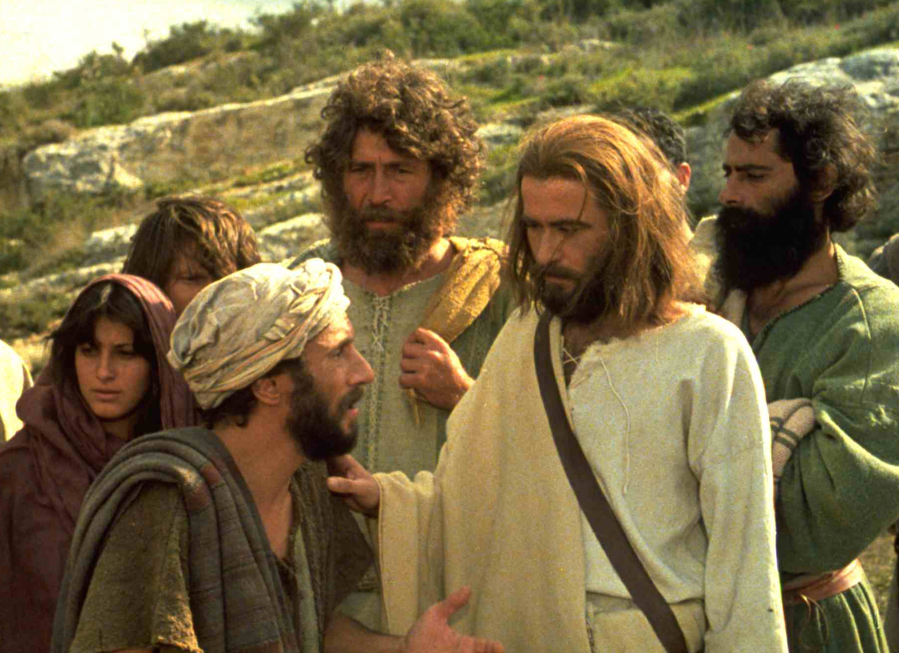

Slide 10
We know that in biblical idiom to hate can mean to love less. When, for example, regulations are laid down in the Old Testament law for a man who has two wives, "one beloved and the other hated" (Deut. 21:15), it is not necessary to suppose that he positively hates the latter wife; all that need be meant is that he loves her less than the other.
Dr. FF Bruce

Slide 12
Coming to Jesus
Carry Your Cross
Count the Cost

Slide 13
²⁷ And whoever does not carry their cross and follow me cannot be my disciple.

Slide 14
Bearing the cross and coming after Jesus is the issue of discipleship. Learning from Jesus means following him, experiencing the rejection he experienced and so bearing the cross he bore. We cannot "learn Jesus" without being prepared to walk this path.
Dr. Darrell Bock
Dallas Theological Seminary

Slide 15
Remember what I told you: ‘A servant is not greater than his master.’ If they persecuted me, they will persecute you also. If they obeyed my teaching, they will obey yours also.
John 15:20

Slide 17
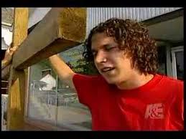

Slide 18
Coming to Jesus
Carry Your Cross
Count the Cost

Slide 19
²⁸ “Suppose one of you wants to build a tower. Won’t you first sit down and estimate the cost to see if you have enough money to complete it? ²⁹ For if you lay the foundation and are not able to finish it, everyone who sees it will ridicule you. . .

Slide 21
³¹ “Or suppose a king is about to go to war against another king. Won’t he first sit down and consider whether he is able with ten thousand men to oppose the one coming against him with twenty thousand?
³² If he is not able, he will send a delegation while the other is still a long way off and will ask for terms of peace.

Slide 23
Lessons for Disciples

Slide 24
As Christ’s disciple, we are called to count the cost
. . . by making Jesus #1 in our lives
. . . by sharing in His sufferings
. . . by committing ourselves fully to Him

