Slide 2
Decision Making in Light of God’s Will

Slide 3
36 And after some days Paul said to Barnabas, "Let us return and visit the brothers in every city where we proclaimed the word of the Lord, and see how they are." 37 Now Barnabas wanted to take with them John called Mark. 38 But Paul thought best not to take with them one who had withdrawn from them in Pamphylia and had not gone with them to the work.
–Acts 15:36-41 ESV

Slide 4
6 And they went through the region of Phrygia and Galatia, having been forbidden by the Holy Spirit to speak the word in Asia. 7 And when they had come up to Mysia, they attempted to go into Bithynia, but the Spirit of Jesus did not allow them. 8 So, passing by Mysia, they went down to Troas. 9 And a vision appeared to Paul in the night: a man of Macedonia was standing there, urging him and saying, "Come over to Macedonia and help us." 10 And when Paul had seen the vision, immediately we sought to go on into Macedonia, concluding that God had called us to preach the gospel to them.
–Acts 16:6-10 ESV

Slide 5
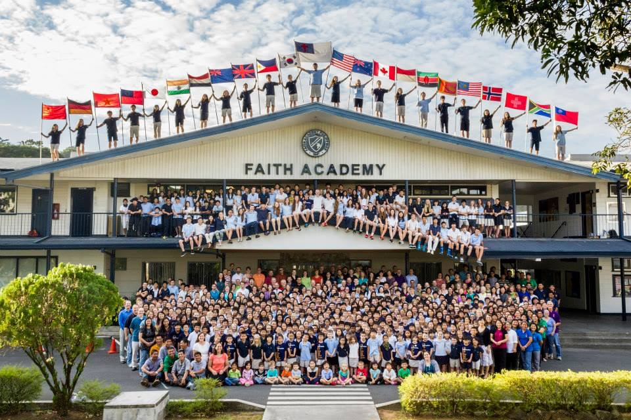
Notes:
Faith Academy is a K-12 international Christian school that primarily serves the children of missionaries in Asia. We currently have more than 500 students. To help keep tuition costs affordable for families, Faith Academy teachers and support staff are all missionaries. We raise our own support. The past 58 years, God has used churches, family, and friends in our home countries to send us to share the gospel in Asia.

Slide 6
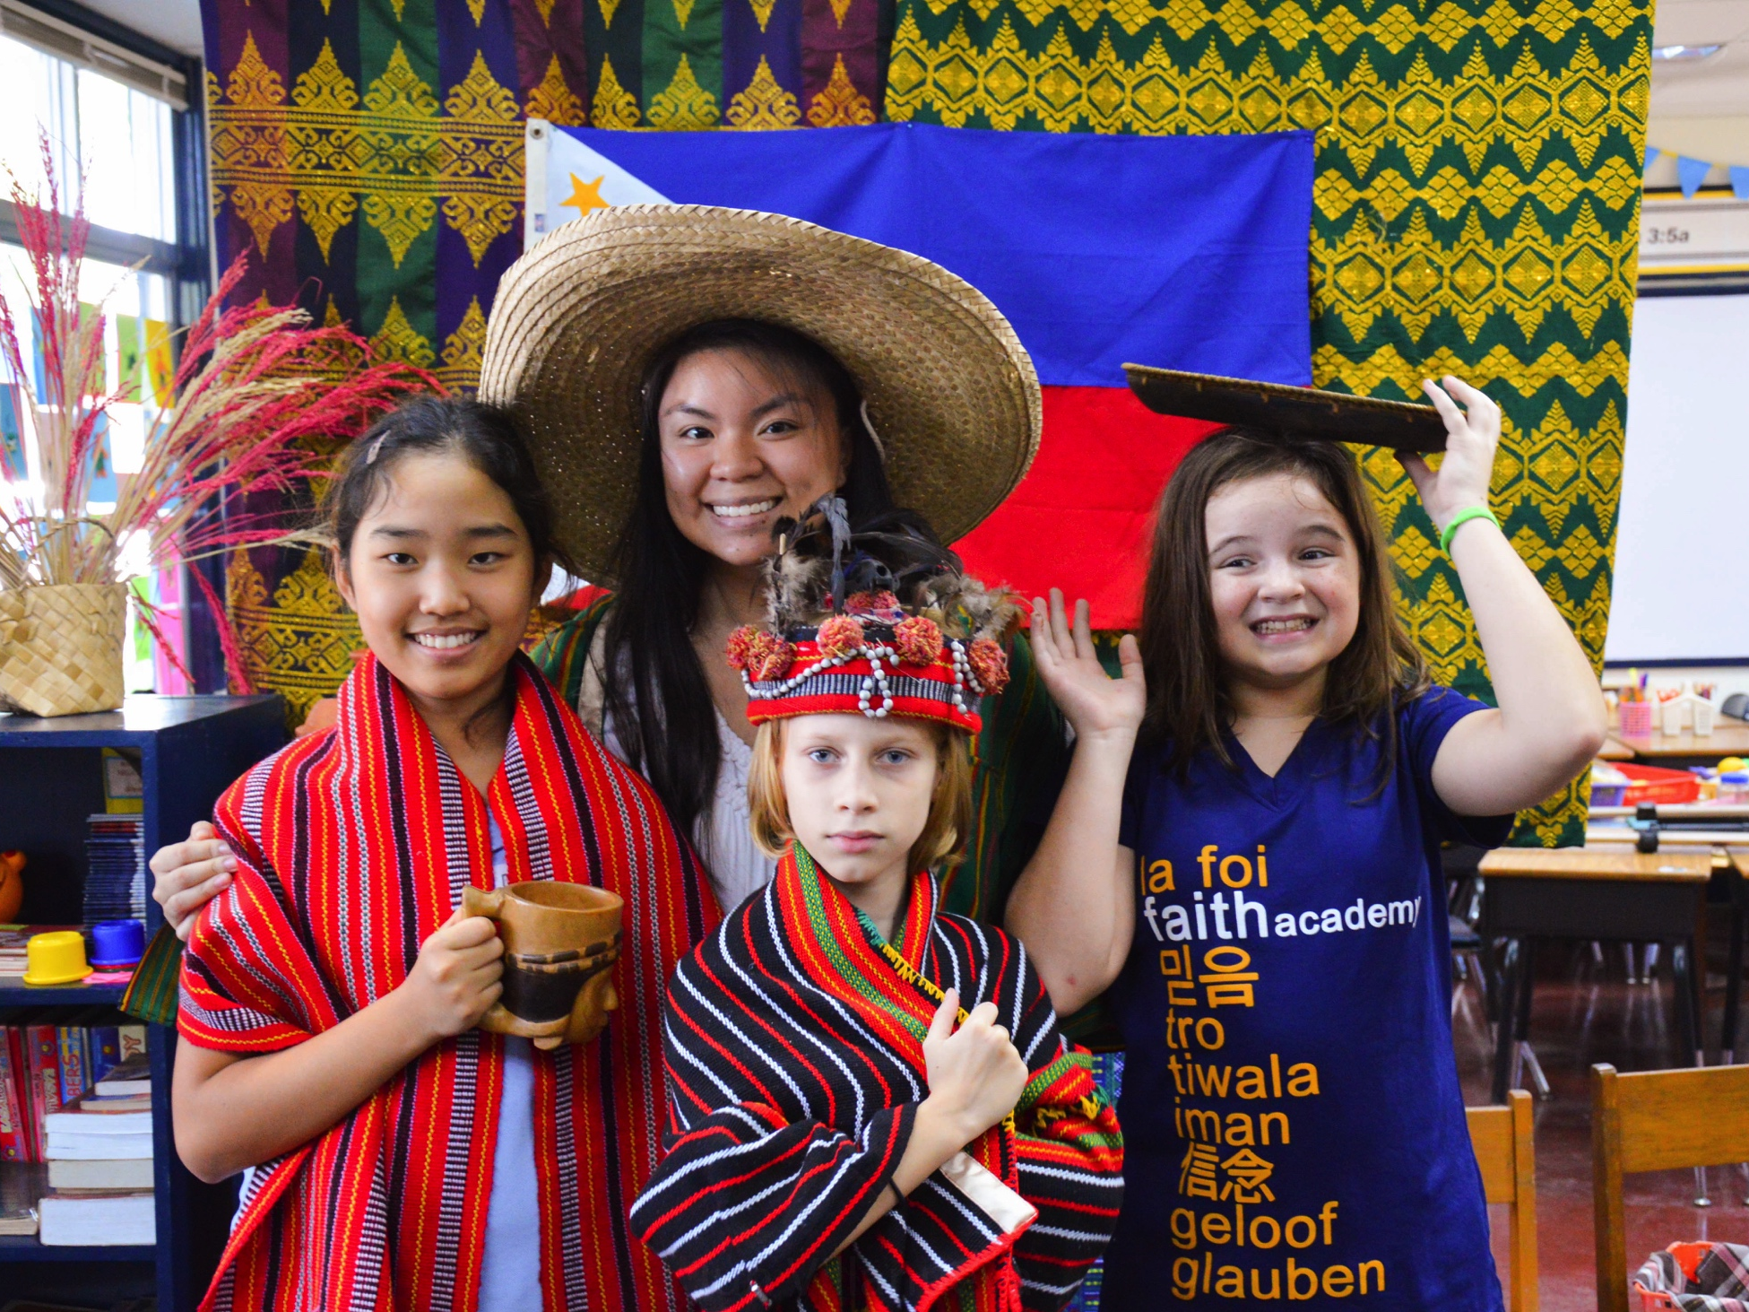
Notes:
I am an ordinary teacher. I worked for 3 years as a public school teacher in Virginia. I loved my students. My co-workers and students knew that I was a Christ follower. I lived as a light, but I always had to “hold back” the Christian beliefs with my students. I could pray for a student. I could not pray with a student. I could encourage good decisions. I could not disciple my students using the Bible. At Faith Academy, I have the opportunity to partner with parents to help children to become more like Christ.
In 5th grade, we start our days with a morning meeting. Each day I introduce an “Unreached People Group” of the day. We read and pray for groups by name in countries like South Sudan and Kyrgyzstan. This year I had 23 students in my Grade 5 class. My kids are amazing. I want you to meet two students. They are both MKs (missionary kids) and TCKs (third culture kids). Ha Jun and Sarah Joy are a glimpse into the people group God has called me to love.

Slide 7
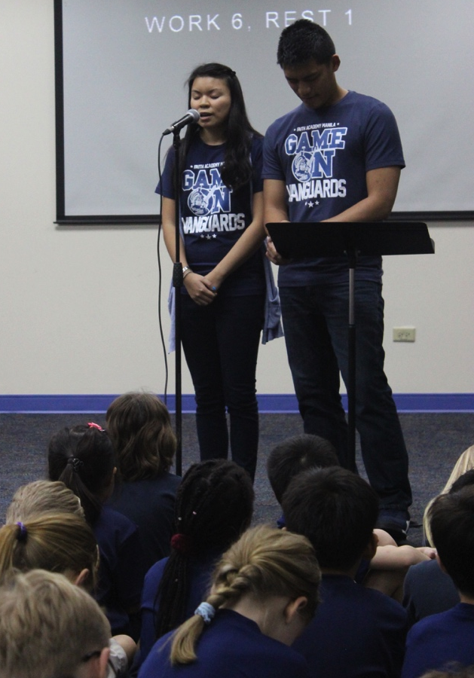
Partnering Together
Prayer for discernment in Evangeline’s teaching role when we return (Chinese students, Special Ed, or Elementary)
Prayer for new ministry partners and support raising
Can sign up for further information
Notes:
Pray for my daily walk with God and that I’d rest more in Him. Pray for my transitions back to the United States and anxiety that comes with new life stages.

Slide 8
25 About midnight Paul and Silas were praying and singing hymns to God, and the prisoners were listening to them, 26 and suddenly there was a great earthquake, so that the foundations of the prison were shaken. And immediately all the doors were opened, and everyone's bonds were unfastened. 27 When the jailer woke and saw that the prison doors were open, he drew his sword and was about to kill himself, supposing that the prisoners had escaped. 28 But Paul cried with a loud voice, "Do not harm yourself, for we are all here." 29 And the jailer called for lights and rushed in, and trembling with fear he fell down before Paul and Silas. 30 Then he brought them out and said, "Sirs, what must I do to be saved?"
–Acts 16:25-30 ESV

