Slide 1
Transformed
Demas: A Cautionary Tale

Slide 3
⁹ Do your best to come to me quickly, ¹⁰ for Demas, because he loved this world, has deserted me and has gone to Thessalonica. Crescens has gone to Galatia, and Titus to Dalmatia. ¹¹ Only Luke is with me. Get Mark and bring him with you, because he is helpful to me in my ministry.
2 Timothy 4:9-11

Slide 4
Companion

Slide 5
¹⁰ My fellow prisoner Aristarchus sends you his greetings, as does Mark, the cousin of Barnabas. . . . ¹⁴ Our dear friend Luke, the doctor, and Demas send greetings.
Colossians 4:10, 14

Slide 6
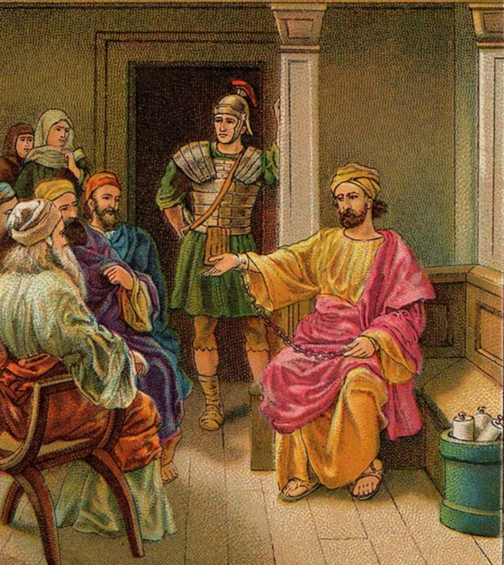

Slide 9
Coworker

Slide 10
²³ Epaphras, my fellow prisoner in Christ Jesus, sends you greetings. ²⁴ And so do Mark, Aristarchus, Demas and Luke, my fellow workers.
Philemon 23-24

Slide 11
The word coworker “implies that two people are working closely together as partners, sharing work and responsibility. There is even the suggestion of equality in the word co-worker.”
W. D. Thomas

Slide 12
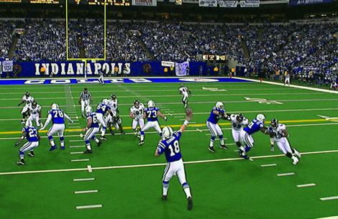

Slide 13
Carnal

Slide 14
⁹ Do your best to come to me quickly, ¹⁰ for Demas, because he loved this world, has deserted me and has gone to Thessalonica. Crescens has gone to Galatia, and Titus to Dalmatia. ¹¹ Only Luke is with me. Get Mark and bring him with you, because he is helpful to me in my ministry.
2 Timothy 4:9-11

Slide 18
The lust of the flesh, has to do with the gratification of the flesh (what makes me feel good physically).

Slide 19
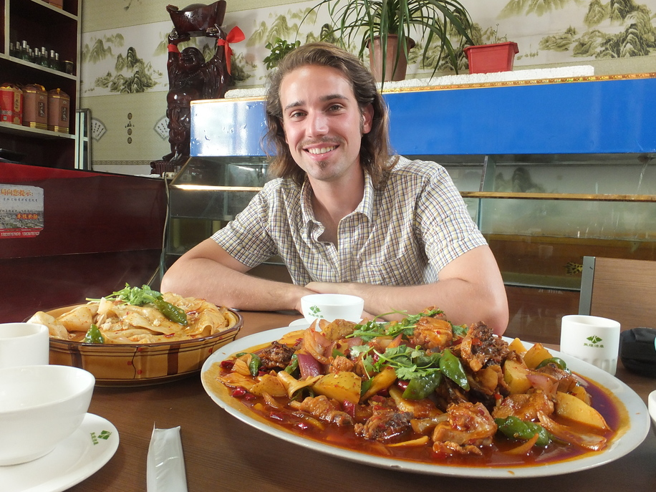

Slide 21
Lust of the eyes (what possessions I want to make me happy). These sins would be what we see and desire to have, but the object we want is not ours to have because it belongs to someone else.

Slide 22
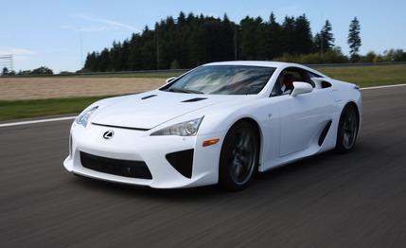

Slide 24
Pride of life (what I want to be). This is the arrogance that one has when they boast about themselves, their accomplishments, or their possessions.

Slide 25
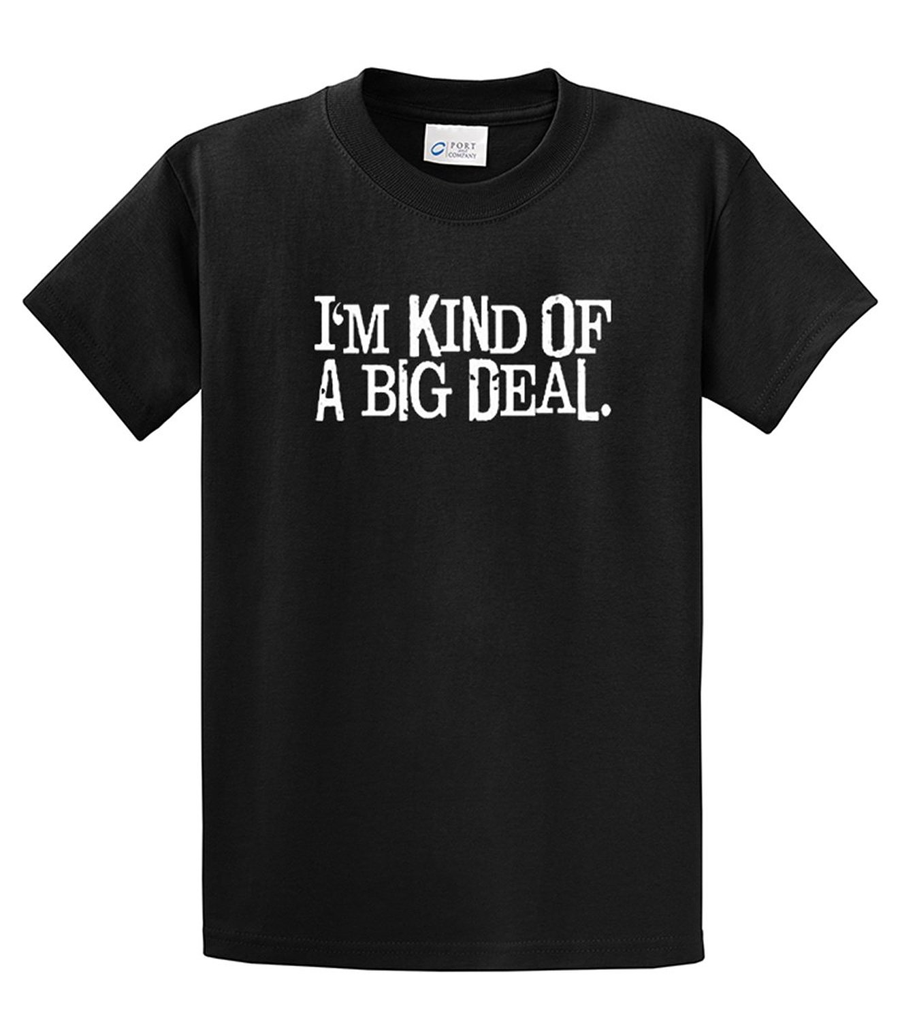

Slide 29
I am not saying this because I am in need, for I have learned to be content whatever the circumstances.
Philippians 4:11

Slide 31
Only Luke is with me. Get Mark and bring him with you, because he is helpful to me in my ministry.
2 Timothy 4:11

