Slide 1
The Christian Life
Dinner Etiquette

Slide 3
¹ One Sabbath, when Jesus went to eat in the house of a prominent Pharisee, he was being carefully watched.

Slide 4
⁷ When he noticed how the guests picked the places of honor at the table, he told them this parable: ⁸ “When someone invites you to a wedding feast, do not take the place of honor, for a person more distinguished than you may have been invited. ⁹ If so, the host who invited both of you will come and say to you, ‘Give this person your seat.’ Then, humiliated, you will have to take the least important place.

Slide 5
¹⁰ But when you are invited, take the lowest place, so that when your host comes, he will say to you, ‘Friend, move up to a better place.’ Then you will be honored in the presence of all the other guests. ¹¹ For all those who exalt themselves will be humbled, and those who humble themselves will be exalted.”

Slide 6
¹² Then Jesus said to his host, “When you give a luncheon or dinner, do not invite your friends, your brothers or sisters, your relatives, or your rich neighbors; if you do, they may invite you back and so you will be repaid. ¹³ But when you give a banquet, invite the poor, the crippled, the lame, the blind, ¹⁴ and you will be blessed. Although they cannot repay you, you will be repaid at the resurrection of the righteous.”
Luke 14:1, 7-14

Slide 7
Be Christ’s example by living humbly.

Slide 8
Watchful Eyes
Table Assignments
Dinner Invitations

Slide 9
¹ One Sabbath, when Jesus went to eat in the house of a prominent Pharisee, he was being carefully watched.

Slide 10
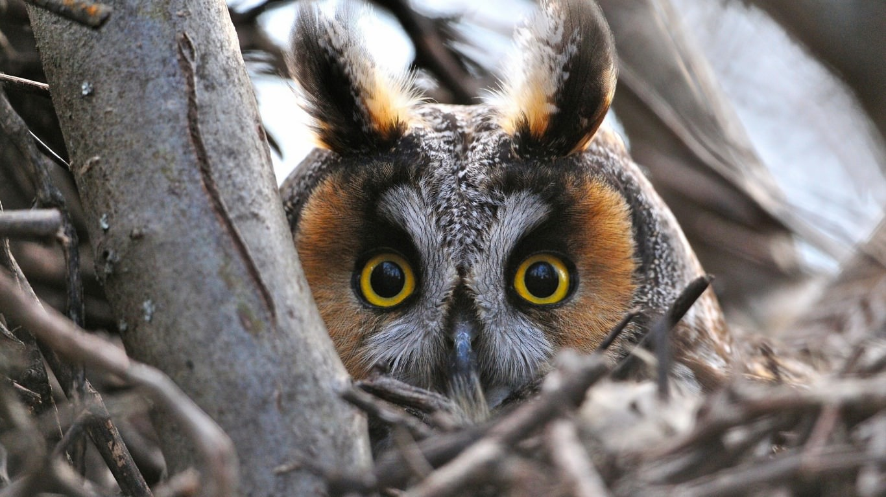

Slide 11
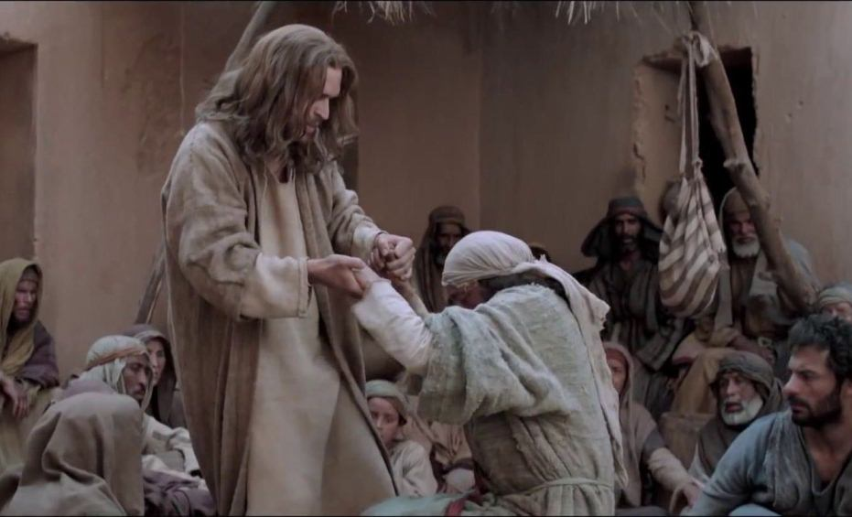

Slide 13
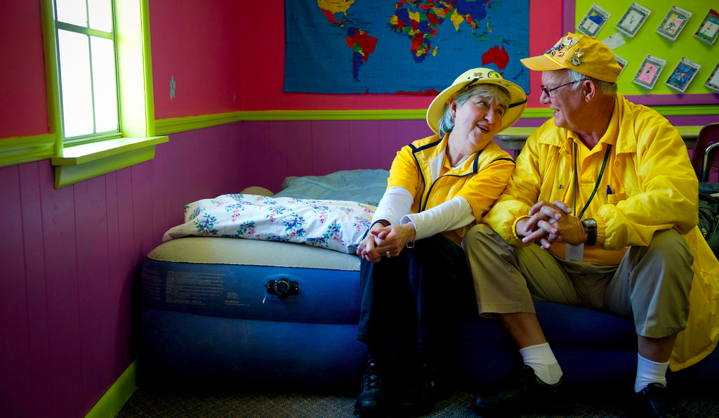
Marteen and Wiley Blankenship of Decatur, Ala., spent their 48th anniversary last week volunteering with the Southern Baptist Convention's disaster relief effort helping tornado victims in Rainsville.
Credit Rich Addicks for The New York Times

Slide 14
Watchful Eyes
Table Assignments
Dinner Invitations

Slide 15
⁸ “When someone invites you to a wedding feast, do not take the place of honor, for a person more distinguished than you may have been invited. . . .
¹¹ For all those who exalt themselves will be humbled, and those who humble themselves will be exalted.”

Slide 16
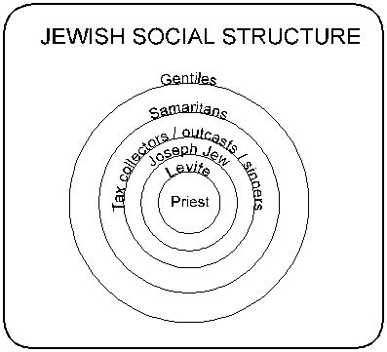

Slide 19
Watchful Eyes
Table Assignments
Dinner Invitations

Slide 20
¹³ But when you give a banquet, invite the poor, the crippled, the lame, the blind, ¹⁴ and you will be blessed. Although they cannot repay you, you will be repaid at the resurrection of the righteous.”

Slide 21
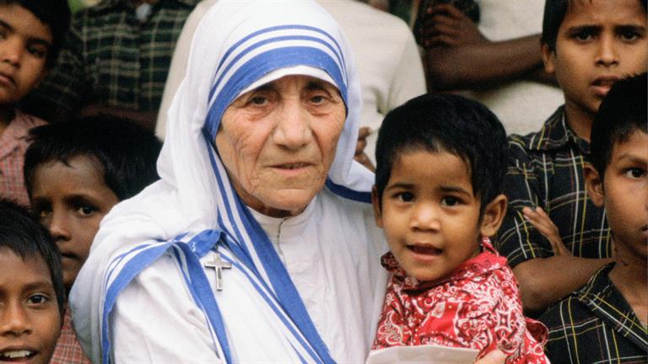

Slide 22
An American cameraman in India stood by in awe as he watched Mother Teresa lovingly clean the infected wounds of a horribly disfigured leper, “Sister,” he commented, “I wouldn’t do that for a million dollars!” Her response, “Neither would I, brother. Neither would I.”

Slide 23
Lessons for Disciples

Slide 24
Be Christ’s example by living humbly.

