Slide 1
Easter
An Empty Tomb

Slide 2
Secularization
Commercialization
Accommodation

Slide 4
Rejoice and share the Good News

Slide 5
¹ After the Sabbath, at dawn on the first day of the week, Mary Magdalene and the other Mary went to look at the tomb.
² There was a violent earthquake, for an angel of the Lord came down from heaven and, going to the tomb, rolled back the stone and sat on it. ³ His appearance was like lightning, and his clothes were white as snow. ⁴ The guards were so afraid of him that they shook and became like dead men.

Slide 6
⁵ The angel said to the women, “Do not be afraid, for I know that you are looking for Jesus, who was crucified. ⁶ He is not here; he has risen, just as he said. Come and see the place where he lay. ⁷ Then go quickly and tell his disciples: ‘He has risen from the dead and is going ahead of you into Galilee. There you will see him.’ Now I have told you.”

Slide 7
⁸ So the women hurried away from the tomb, afraid yet filled with joy, and ran to tell his disciples. ⁹ Suddenly Jesus met them. “Greetings,” he said. They came to him, clasped his feet and worshiped him. ¹⁰ Then Jesus said to them, “Do not be afraid. Go and tell my brothers to go to Galilee; there they will see me.”
Matthew 28:1-10

Slide 8
A Visit to the Tomb

Slide 9
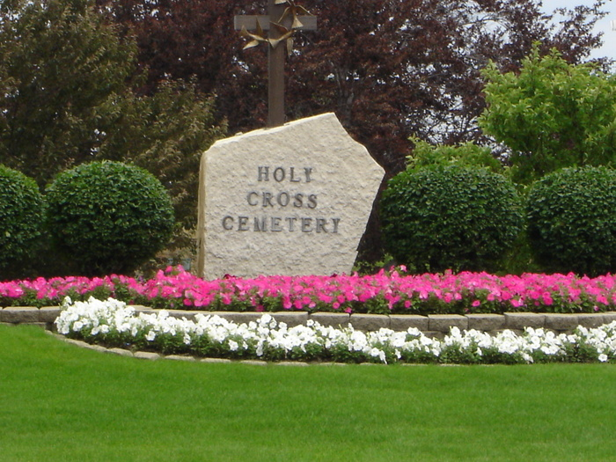

Slide 10
¹ After the Sabbath, at dawn on the first day of the week, Mary Magdalene and the other Mary went to look at the tomb.

Slide 11
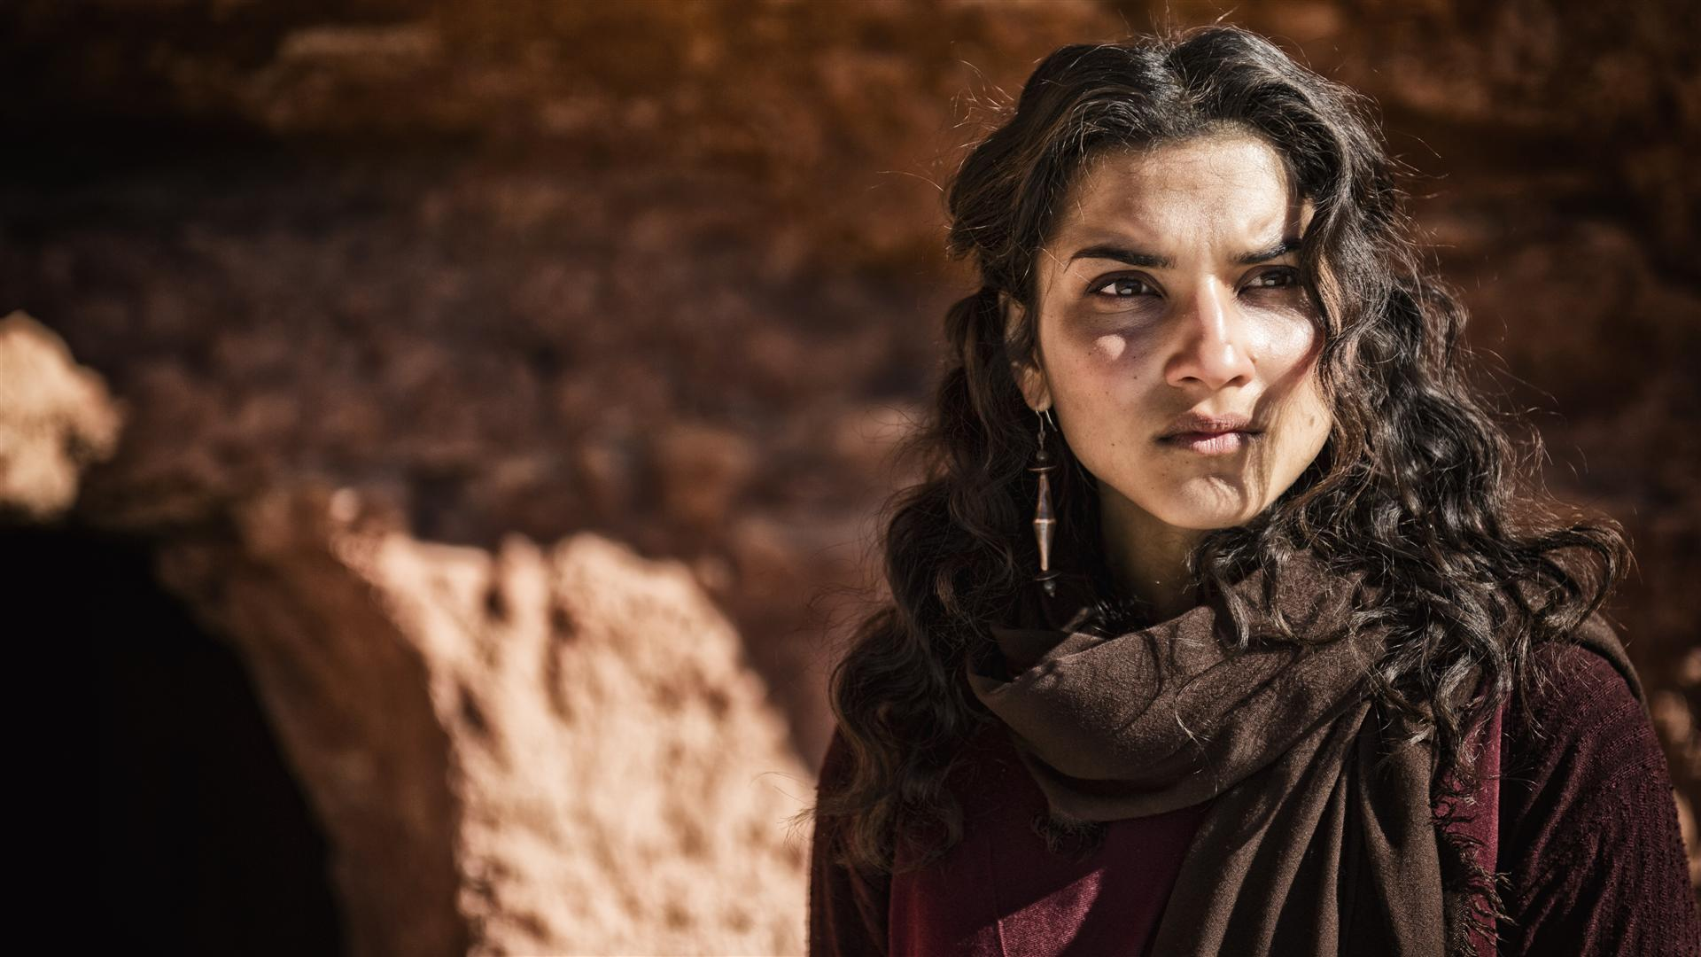
Mary Magdalene

Slide 12
The Twelve were with him [Jesus], and also some women who had been cured of evil spirits and diseases: Mary (called Magdalene) from whom seven demons had come out; Joanna the wife of Chuza, the manager of Herod’s household; Susanna; and many others. These women were helping to support them out of their own means.
Luke 8:1-3

Slide 13
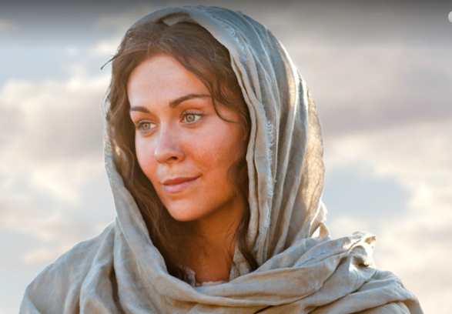
Mary, Mother of James and Joseph

Slide 14
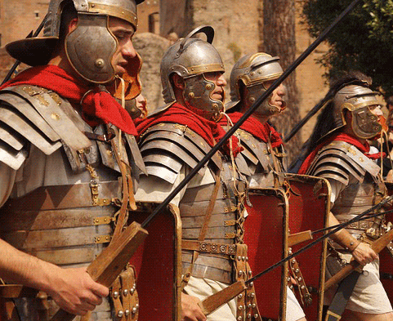

Slide 15
An Angel Appears

Slide 16
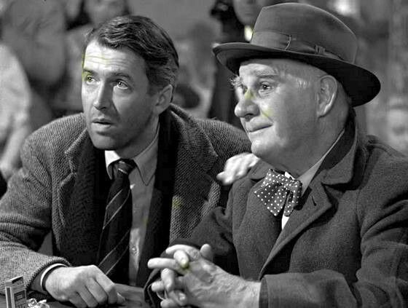
Clarence Odbody, Angel 2nd Class

Slide 17
² There was a violent earthquake, for an angel of the Lord came down from heaven and, going to the tomb, rolled back the stone and sat on it. ³ His appearance was like lightning, and his clothes were white as snow. ⁴ The guards were so afraid of him that they shook and became like dead men.

Slide 18
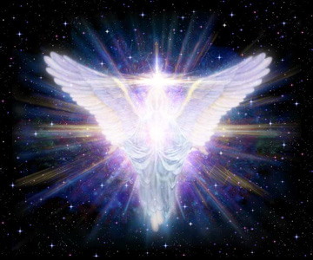

Slide 19
Angel:
Superhuman or heavenly being who serves as God's messenger. . . These beings also act decisively in fulfilling God's will in the world. "Angels" are mentioned almost three hundred times in Scripture. . .
From the beginning, angels were part of the divine hierarchy. . . By nature they were spiritual entities, and thus not subject to the limitations of human flesh.
Baker Evangelical Dictionary of Biblical Theology

Slide 20
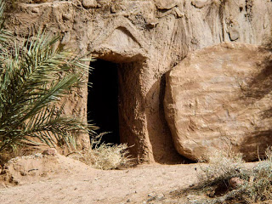

Slide 21
⁵ The angel said to the women, “Do not be afraid, for I know that you are looking for Jesus, who was crucified. ⁶ He is not here; he has risen, just as he said. Come and see the place where he lay. ⁷ Then go quickly and tell his disciples: ‘He has risen from the dead and is going ahead of you into Galilee. There you will see him.’ Now I have told you.”

Slide 22
Meeting Jesus

Slide 23
⁸ So the women hurried away from the tomb, afraid yet filled with joy, and ran to tell his disciples. ⁹ Suddenly Jesus met them. “Greetings,” he said. They came to him, clasped his feet and worshiped him. ¹⁰ Then Jesus said to them, “Do not be afraid. Go and tell my brothers to go to Galilee; there they will see me.”
Matthew 28:1-10

Slide 24
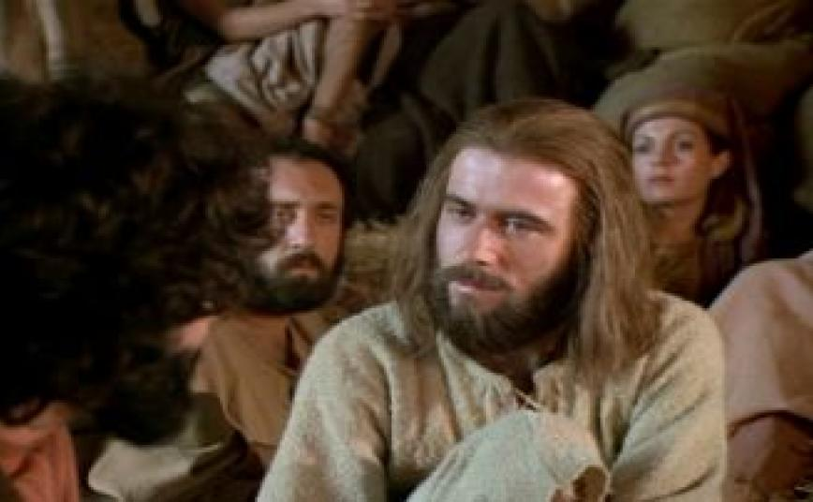

Slide 25
He replied to him, “Who is my mother, and who are my brothers?” Pointing to his disciples, he said, “Here are my mother and my brothers. For whoever does the will of my Father in heaven is my brother and sister and mother.”
Matthew 12:48-50

Slide 26
Lessons for Disciples

