Slide 1
Means of Spiritual Growth
Prayer Purposes

Slide 5
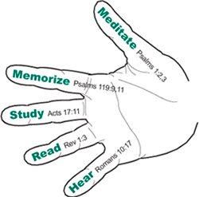

Slide 6
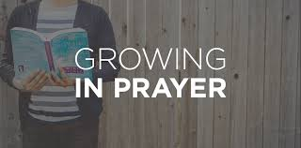

Slide 7
The great people of the earth today are the people who pray, (not) those who talk about prayer…but I mean those who take time and pray. S.D. Gordon

Slide 8
And pray in the Spirit on all occasions with all kinds of prayers and requests.
Ephesians 6:18

Slide 9
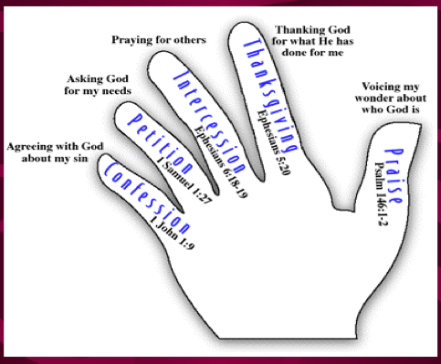

Slide 10
Confession
If we confess our sins, he is faithful and just to forgive us our sins and to cleanse us from all unrighteousness.
1 John 1:9 ESV

Slide 11
¹ Blessed is the one whose transgression is forgiven,
whose sin is covered.
³ For when I kept silent, my bones wasted away
through my groaning all day long. . .
⁴ For day and night your hand was heavy upon me;
my strength was dried up as by the heat of summer.
Psalm 32

Slide 14
Petition
For this child I prayed, and the Lord has granted me my petition that I made to him.
1 Samuel 1:27

Slide 17
Intercession
Praying at all times in the Spirit, with all prayer and supplication. To that end keep alert with all perseverance, making supplication for all the saints, and also for me, that words may be given to me in opening my mouth boldly to proclaim the mystery of the gospel . . .
Ephesians 6:18-19

Slide 19
Thanksgiving
¹⁸ And do not get drunk with wine, for that is debauchery, but be filled with the Spirit, ¹⁹ addressing one another in psalms and hymns and spiritual songs, singing and making melody to the Lord with your heart, ²⁰ giving thanks always and for everything to God the Father in the name of our Lord Jesus Christ, ²¹ submitting to one another out of reverence for Christ.
Ephesians 5

Slide 23
Praise
¹ Praise the Lord! Praise the Lord, O my soul! ² I will praise the Lord as long as I live; I will sing praises to my God while I have my being.
Psalm 146

Slide 26
