Slide 1
The Christian Life
Give Thanks

Slide 2
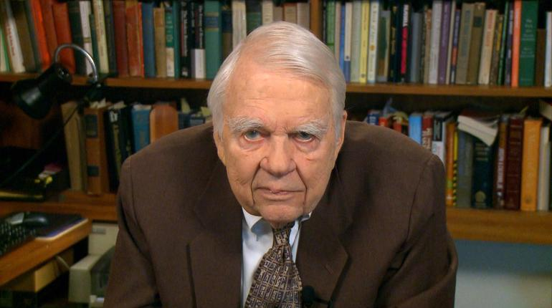
Curmudgeon: a bad-tempered, difficult, complaining person.

Slide 3
¹¹ Now on his way to Jerusalem, Jesus traveled along the border between Samaria and Galilee. ¹² As he was going into a village, ten men who had leprosy met him. They stood at a distance ¹³ and called out in a loud voice, “Jesus, Master, have pity on us!”
¹⁴ When he saw them, he said, “Go, show yourselves to the priests.” And as they went, they were cleansed.

Slide 4
¹⁵ One of them, when he saw he was healed, came back, praising God in a loud voice. ¹⁶ He threw himself at Jesus’ feet and thanked him—and he was a Samaritan.
¹⁷ Jesus asked, “Were not all ten cleansed? Where are the other nine? ¹⁸ Has no one returned to give praise to God except this foreigner?” ¹⁹ Then he said to him, “Rise and go; your faith has made you well.”
Luke 17:11-19

Slide 5
Context

Slide 6
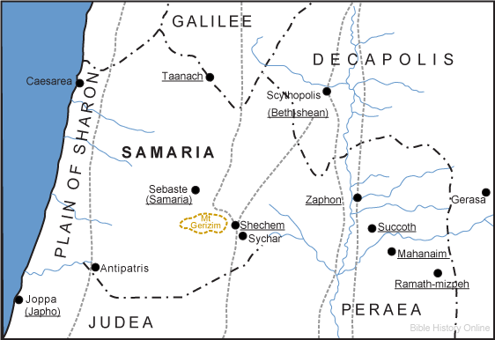

Slide 9
Give thanks, get up and go

Slide 10
A cry for help
Outsiders included
Get up and go!

Slide 11
¹² As he was going into a village, ten men who had leprosy met him. They stood at a distance ¹³ and called out in a loud voice, “Jesus, Master, have pity on us!”
¹⁴ When he saw them, he said, “Go, show yourselves to the priests.” And as they went, they were cleansed.

Slide 12
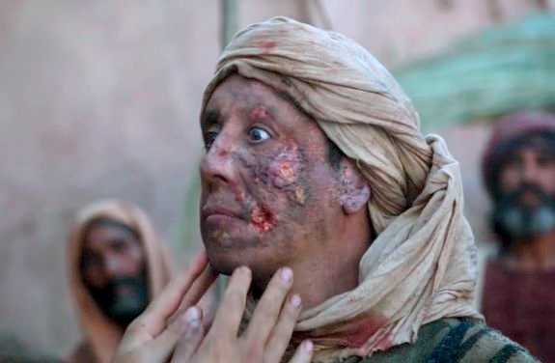
¹² As he was going into a village, ten men who had leprosy met him. They stood at a distance ¹³ and called out in a loud voice, “Jesus, Master, have pity on us!”
¹⁴ When he saw them, he said, “Go, show yourselves to the priests.” And as they went, they were cleansed.

Slide 14
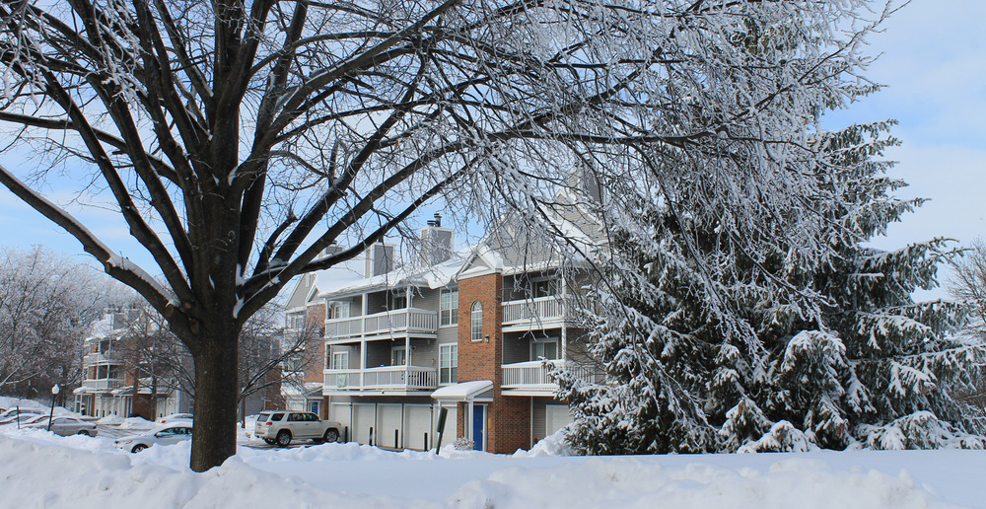

Slide 15
A cry for help
Outsiders included
Get up and go!

Slide 16
¹⁵ One of them, when he saw he was healed, came back, praising God in a loud voice. ¹⁶ He threw himself at Jesus’ feet and thanked him—and he was a Samaritan.
¹⁷ Jesus asked, “Were not all ten cleansed? Where are the other nine? ¹⁸ Has no one returned to give praise to God except this foreigner?”

Slide 17
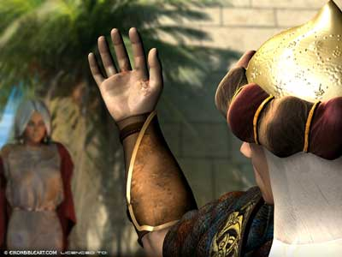

Slide 18
A cry for help
Outsiders included
Get up and go!

Slide 19
¹⁹ Then he said to him, “Rise and go; your faith has made you well.”
Luke 17:19

Slide 20
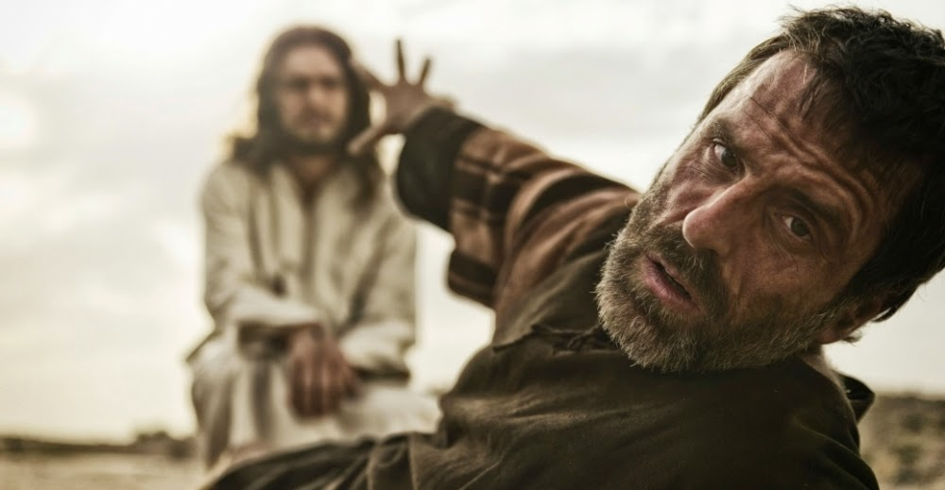

Slide 21
In Luke-Acts the phrase “get up and go,” suggests that a significant (even wondrous) change is about to occur. After the annunciation, for example, Mary “gets up and goes” to Elizabeth (Luke 1:39). The prodigal son decides to “get up and go” back to his father (Luke 15:18), and God tells Paul to “get up and go” to Damascus (Acts 22:10; cf. Acts 9:11; 10:20).
Dr. Audrey West

Slide 22
Lessons for Disciples

Slide 23
Give thanks, get up and go

