Slide 1
Lent
Give

Slide 2
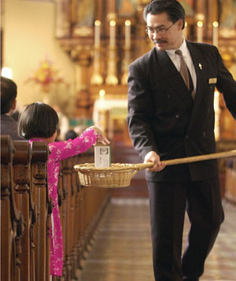

Slide 4
Give joyfully to various aspects of God’s kingdom.

Slide 5
Tithing

Slide 6
¹ When you have entered the land the Lord your God is giving you as an inheritance and have taken possession of it and settled in it, ² take some of the firstfruits of all that you produce from the soil of the land the Lord your God is giving you and put them in a basket. . . ¹² When you have finished setting aside a tenth of all your produce in the third year, the year of the tithe . . .
Deuteronomy 26:1-2, 12

Slide 8
The Old Testament Law required multiple tithes—one for the Levites, one for the use of the temple and the feasts, and one for the poor of the land—which would have pushed the total to around 23.3 percent. Some understand the Old Testament tithe as a method of taxation to provide for the needs of the priests and Levites in the sacrificial system.
GotQuestions.org

Slide 9
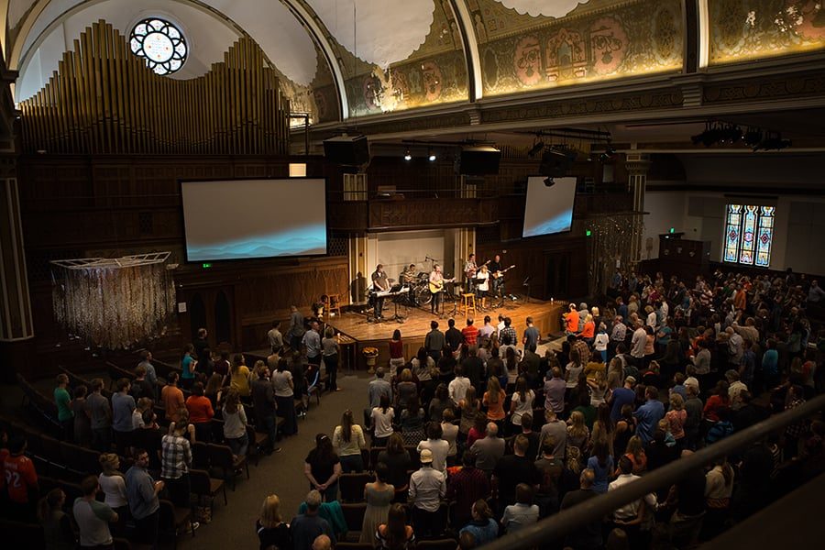

Slide 10
Giving

Slide 11
⁶ Remember this: Whoever sows sparingly will also reap sparingly, and whoever sows generously will also reap generously. ⁷ Each of you should give what you have decided in your heart to give, not reluctantly or under compulsion, for God loves a cheerful giver. ⁸ And God is able to bless you abundantly, so that in all things at all times, having all that you need, you will abound in every good work.
2 Corinthians 9:6-8

Slide 13
Giving to the Poor

Slide 14
There were no needy persons among them. For from time to time those who owned land or houses sold them, brought the money from the sales and put it at the apostles’ feet, and it was distributed to anyone who had need.
Acts 4:34-35
Give to the one who asks you, and do not turn away from the one who wants to borrow from you.
Matthew 5:42

Slide 16
Missions Giving

Slide 17
¹⁵ Moreover, as you Philippians know, in the early days of your acquaintance with the gospel, when I set out from Macedonia, not one church shared with me in the matter of giving and receiving, except you only. ¹⁶ for even when I was in Thessalonica, you sent me aid more than once when I was in need. ¹⁷ Not that I desire your gifts; what I desire is that more be credited to your account.
Philippians 4:15-17

Slide 19
Special Needs

Slide 20
Now about the collection for the Lord’s people: Do what I told the Galatian churches to do. On the first day of every week, each one of you should set aside a sum of money in keeping with your income, saving it up, so that when I come no collections will have to be made. Then, when I arrive, I will give letters of introduction to the men you approve and send them with your gift to Jerusalem.
1 Corinthians 16:1-3

Slide 21
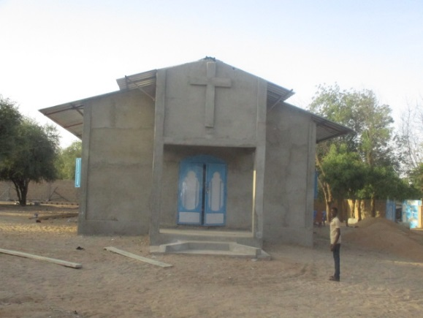

Slide 22
Giving. . .

Slide 23
Regularly
Generously
Joyfully

Slide 24
Give joyfully to various aspects of God’s kingdom.

