Slide 1
Lent
Behold the Glory

Slide 2
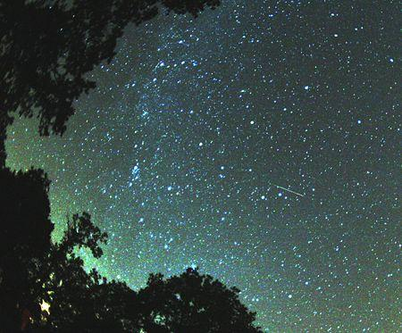

Slide 4
²⁸ About eight days after Jesus said this, he took Peter, John and James with him and went up onto a mountain to pray. ²⁹ As he was praying, the appearance of his face changed, and his clothes became as bright as a flash of lightning. ³⁰ Two men, Moses and Elijah, appeared in glorious splendor, talking with Jesus. ³¹ They spoke about his departure, which he was about to bring to fulfillment at Jerusalem.

Slide 5
³² Peter and his companions were very sleepy, but when they became fully awake, they saw his glory and the two men standing with him. ³³ As the men were leaving Jesus, Peter said to him, “Master, it is good for us to be here. Let us put up three shelters—one for you, one for Moses and one for Elijah.” (He did not know what he was saying.)

Slide 6
³⁴ While he was speaking, a cloud appeared and covered them, and they were afraid as they entered the cloud. ³⁵ A voice came from the cloud, saying, “This is my Son, whom I have chosen; listen to him.” ³⁶ When the voice had spoken, they found that Jesus was alone. The disciples kept this to themselves and did not tell anyone at that time what they had seen.
Luke 9:8-36

Slide 7
An Awe-Inspiring Sight

Slide 8
²⁸ About eight days after Jesus said this, he took Peter, John and James with him and went up onto a mountain to pray. ²⁹ As he was praying, the appearance of his face changed, and his clothes became as bright as a flash of lightning. ³⁰ Two men, Moses and Elijah, appeared in glorious splendor, talking with Jesus. ³¹ They spoke about his departure, which he was about to bring to fulfillment at Jerusalem.

Slide 9
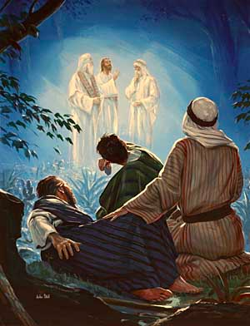

Slide 10
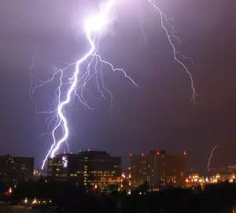

Slide 11
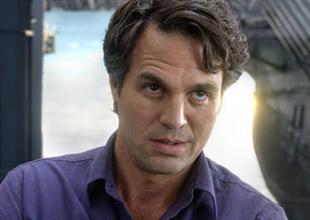
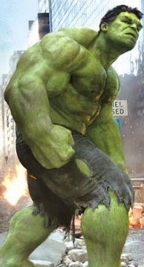
Bruce Banner = Incredible Hulk

Slide 12
Do not think that I have come to abolish the Law or the Prophets; I have not come to abolish them but to fulfill them.
Matthew 5:17

Slide 13
³³ As the men were leaving Jesus, Peter said to him, “Master, it is good for us to be here. Let us put up three shelters—one for you, one for Moses and one for Elijah.” (He did not know what he was saying.)

Slide 15
A Voice From Heaven

Slide 17
³⁴ While he was speaking, a cloud appeared and covered them, and they were afraid as they entered the cloud. ³⁵ A voice came from the cloud, saying, “This is my Son, whom I have chosen; listen to him.”

Slide 19
Strange Silence

Slide 20
When the voice had spoken, they found that Jesus was alone. The disciples kept this to themselves and did not tell anyone at that time what they had seen.

Slide 22
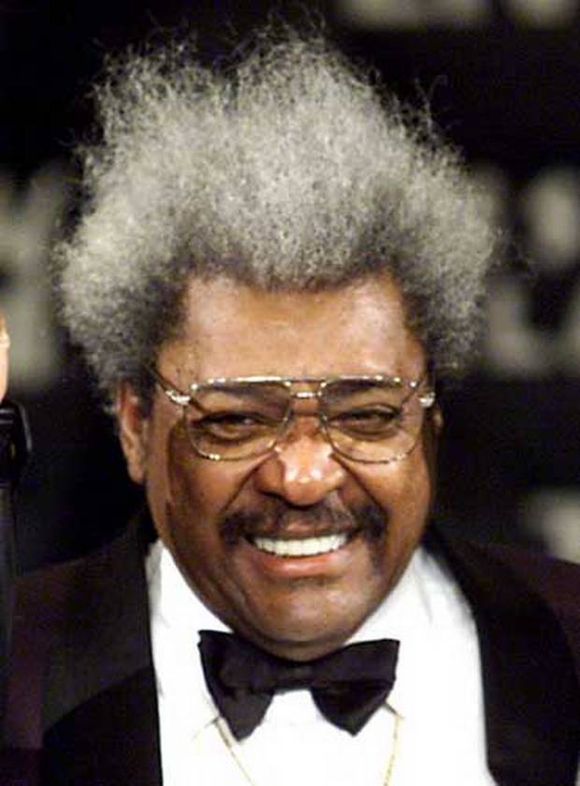

Slide 23
Apply to Our Lives

Slide 25
