Slide 1
Marks of a Christian
Godly Relationships

Slide 4
¹³ Share with the Lord’s people who are in need. Practice hospitality.
¹⁴ Bless those who persecute you; bless and do not curse. ¹⁵ Rejoice with those who rejoice; mourn with those who mourn. ¹⁶ Live in harmony with one another. Do not be proud, but be willing to associate with people of low position. Do not be conceited.
Romans 12:13-16

Slide 6
Generous

Slide 7
¹³ Share with the Lord’s people who are in need. Practice hospitality.

Slide 11
Forgiving

Slide 12
¹⁴ Bless those who persecute you; bless and do not curse.

Slide 14
Open Doors USA

Slide 15
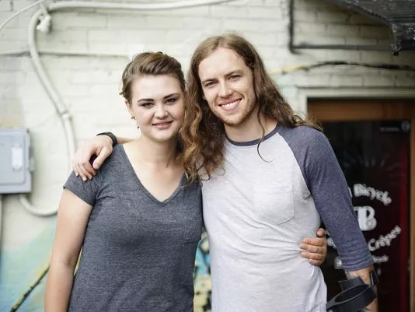
David Francisco poses with Freya Markowski at a Nashville coffee shop where the two met about a year after Markowski ran into Francisco with her car, leaving him unable to use his legs without aids.
(Photo: Dylan Snowden)

Slide 16
Empathetic

Slide 17
¹⁵ Rejoice with those who rejoice; mourn with those who mourn.

Slide 18
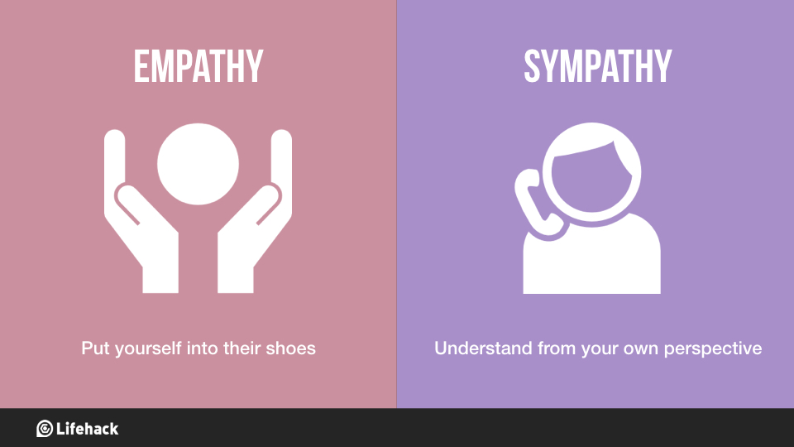

Slide 19
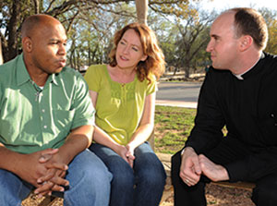

Slide 20
Humble

Slide 21
¹⁶ Live in harmony with one another. Do not be proud, but be willing to associate with people of low position. Do not be conceited.

Slide 23
