Slide 1
The Christian Life
God’s Grace

Slide 2
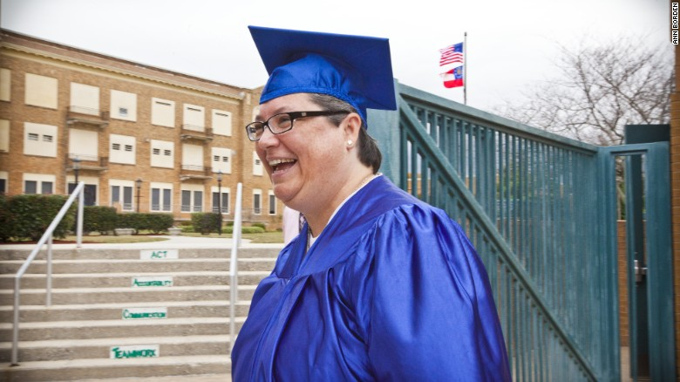
Kelly Gissendaner

Slide 3
³³ When they came to the place called the Skull, they crucified him there, along with the criminals—one on his right, the other on his left. ³⁴ Jesus said, “Father, forgive them, for they do not know what they are doing.” And they divided up his clothes by casting lots.
³⁵ The people stood watching, and the rulers even sneered at him. They said, “He saved others; let him save himself if he is God’s Messiah, the Chosen One.”

Slide 4
³⁶ The soldiers also came up and mocked him. They offered him wine vinegar ³⁷ and said, “If you are the king of the Jews, save yourself.”
³⁸ There was a written notice above him, which read: this is the king of the Jews.
³⁹ One of the criminals who hung there hurled insults at him: “Aren’t you the Messiah? Save yourself and us!”

Slide 5
⁴⁰ But the other criminal rebuked him. “Don’t you fear God,” he said, “since you are under the same sentence? ⁴¹ We are punished justly, for we are getting what our deeds deserve. But this man has done nothing wrong.”
⁴² Then he said, “Jesus, remember me when you come into your kingdom.”
⁴³ Jesus answered him, “Truly I tell you, today you will be with me in paradise.”

Slide 6
God’s grace is truly amazing.

Slide 7
³³ When they came to the place called the Skull, they crucified him there, along with the criminals—one on his right, the other on his left.

Slide 8
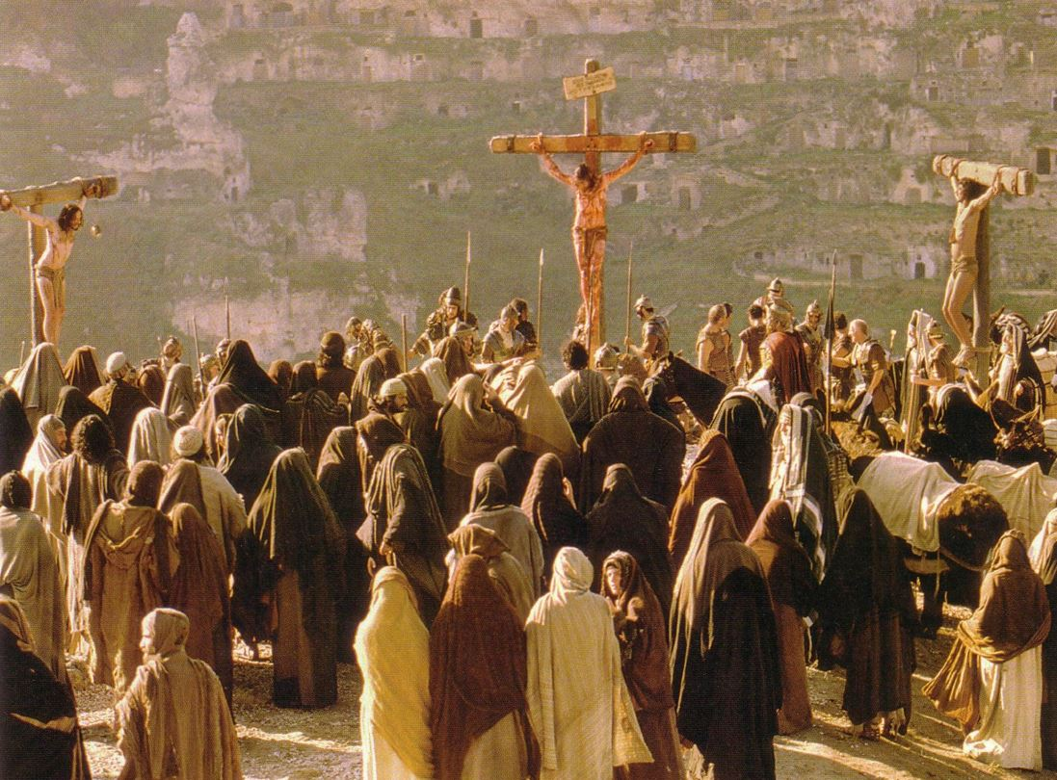

Slide 9
Jesus mocked
Jesus correctly identified
Jesus extends mercy

Slide 10
³⁵ The people stood watching, and the rulers even sneered at him. They said, “He saved others; let him save himself if he is God’s Messiah, the Chosen One.”
³⁶ The soldiers also came up and mocked him. They offered him wine vinegar ³⁷ and said, “If you are the king of the Jews, save yourself. . .”
³⁹ One of the criminals who hung there hurled insults at him: “Aren’t you the Messiah? Save yourself and us!”

Slide 11
Mock: to tease or laugh at in a scornful or contemptuous manner.
Sneer: a contemptuous or mocking smile, remark, or tone.
Insult: speak to or treat with disrespect or scornful abuse.
Contemptuous - showing or expressing contempt or disdain; scornful; disrespectful.
Disdain: the feeling that someone or something is unworthy of one's consideration or respect; contempt.
Scorn: the feeling or belief that someone or something is worthless or despicable

Slide 12
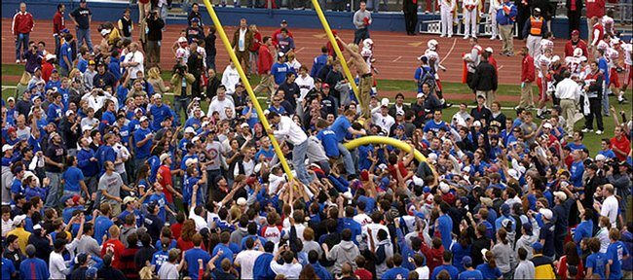

Slide 13
Rulers: “He saved others; let him save himself if he is God’s Messiah, the Chosen One.”
Soldiers: “If you are the king of the Jews, save yourself.”
Criminals: “Aren’t you the Messiah? Save yourself and us!”

Slide 14
Jesus mocked
Jesus correctly identified
Jesus extends mercy

Slide 15
Rulers: “He saved others; let him save himself if he is God’s Messiah, the Chosen One.”
Soldiers: “If you are the king of the Jews, save yourself.”
Criminals: “Aren’t you the Messiah? Save yourself and us!”
Written Notice: This is the king of the Jews.

Slide 17
Jesus mocked
Jesus correctly identified
Jesus extends mercy

Slide 18
⁴¹ We are punished justly, for we are getting what our deeds deserve. But this man has done nothing wrong.”
⁴² Then he said, “Jesus, remember me when you come into your kingdom.”

Slide 19
The Second Criminal:
Acknowledged Jesus’ innocence
Addressed Jesus respectfully
Accepts the reality that Christ is King
Ask to be remembered

Slide 20
⁴³ Jesus answered him, “Truly I tell you, today you will be with me in paradise.”

Slide 22
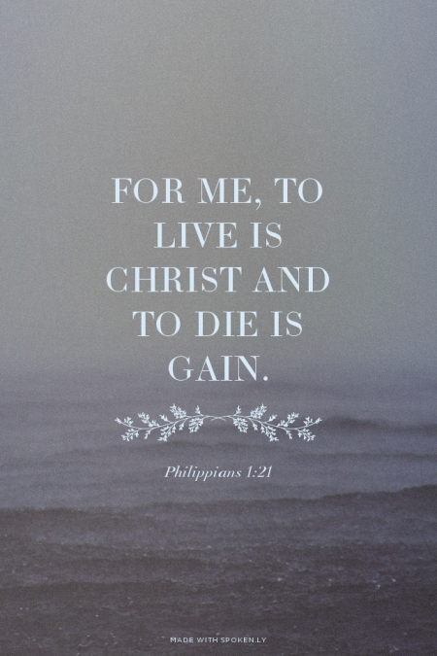

Slide 23
Jesus uses his power as “King” to dispense mercy in a boundlessly gracious fashion that far exceeds what is asked of him. As the Church Father Ambrose put it, “More abundant is the favor shown than the request made.”
Dr. Gilberto Ruiz

Slide 24
God’s grace is truly amazing.

Slide 25
