Slide 2
Amazed by the Universe When I was a Little Child

Slide 3
Search for the Truth

Slide 4
Search for the Truth

Slide 5
The Wonder of Mathematics

Slide 8
Irrational Numbers

Slide 11
Irrational Numbers

Slide 12
Buffon’s Needle (1707-1788)

Slide 15
Golden Ratio

Slide 18
Geometry

Slide 20
Geometry

Slide 21
Logarithmic Curve

Slide 23
Leonardo Fibonacci (1170-1250)

Slide 24
德国 Wittenberg 学生营会

Slide 25
Fibionacci Sequence

Slide 26
Golden Triangle

Slide 27
Daisy

Slide 28
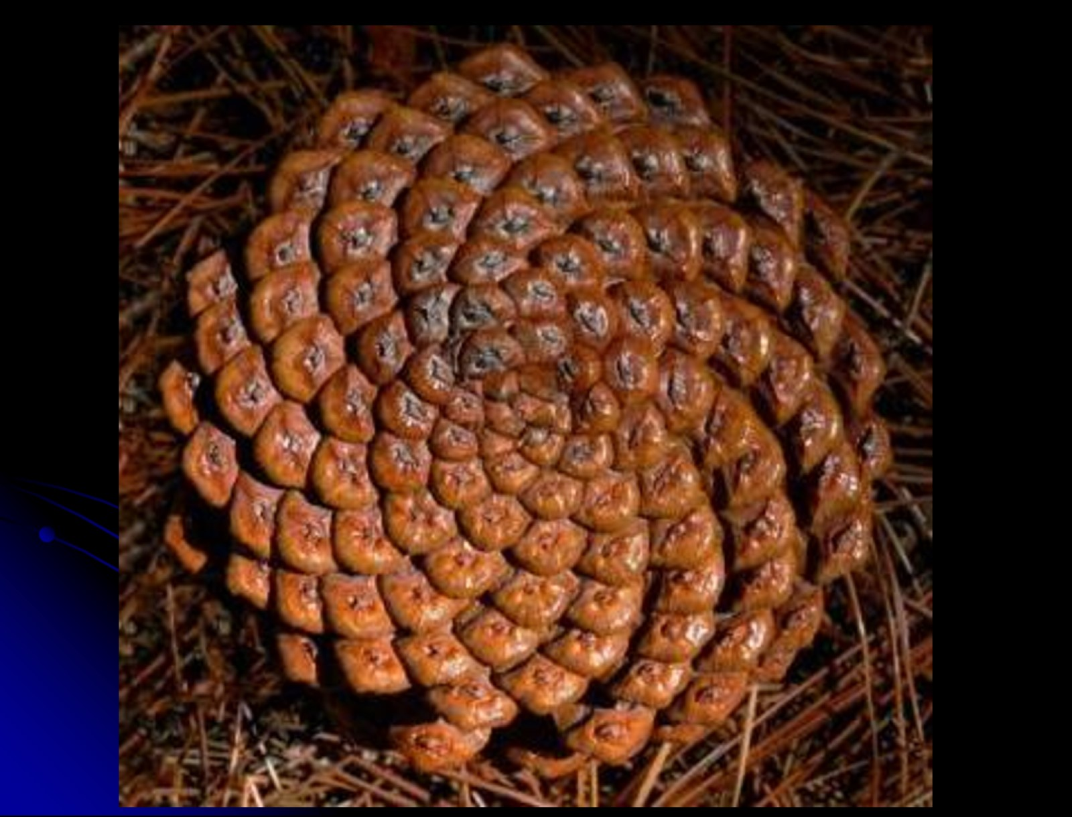

Slide 29
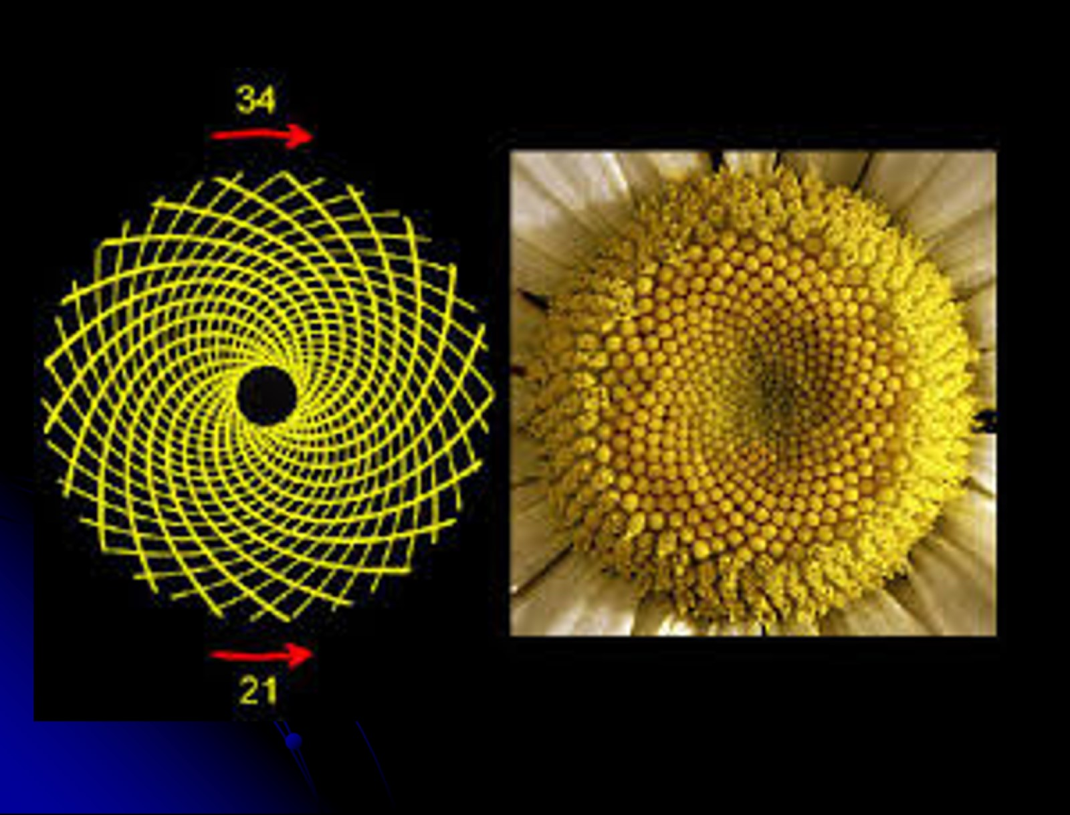

Slide 32
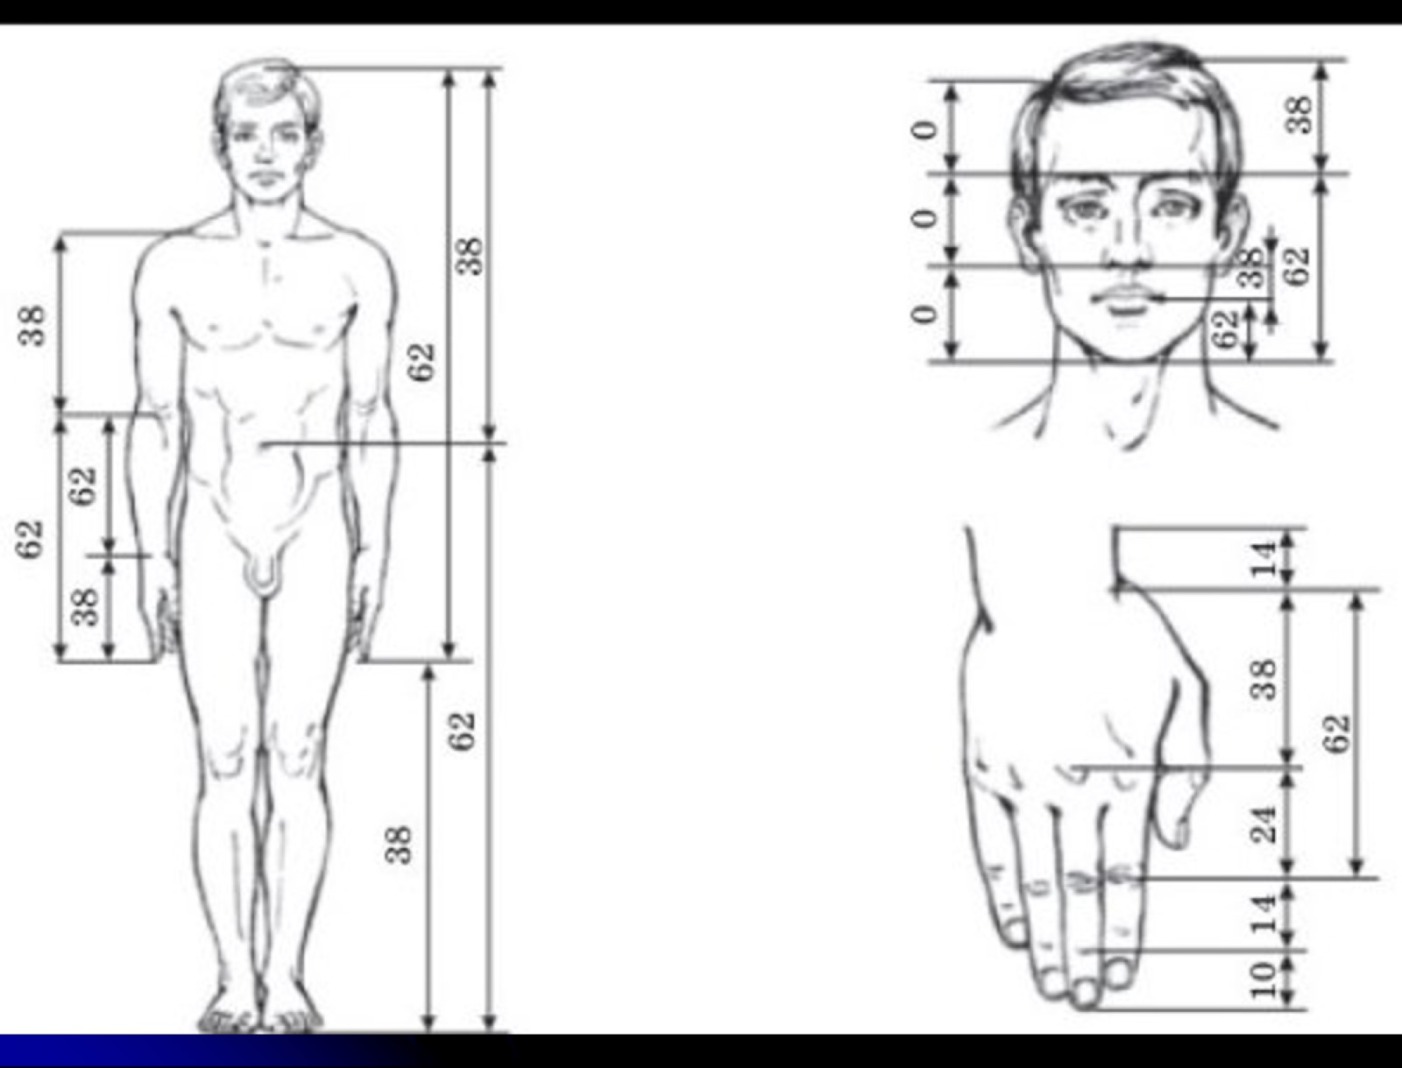

Slide 34
Golden Ratio and Fibonacci Sequence

Slide 36
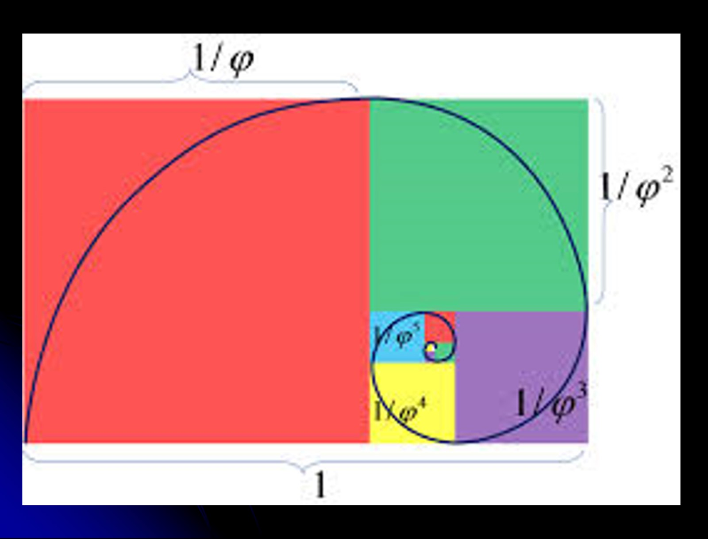

Slide 38
Logarithmic Curve

Slide 39
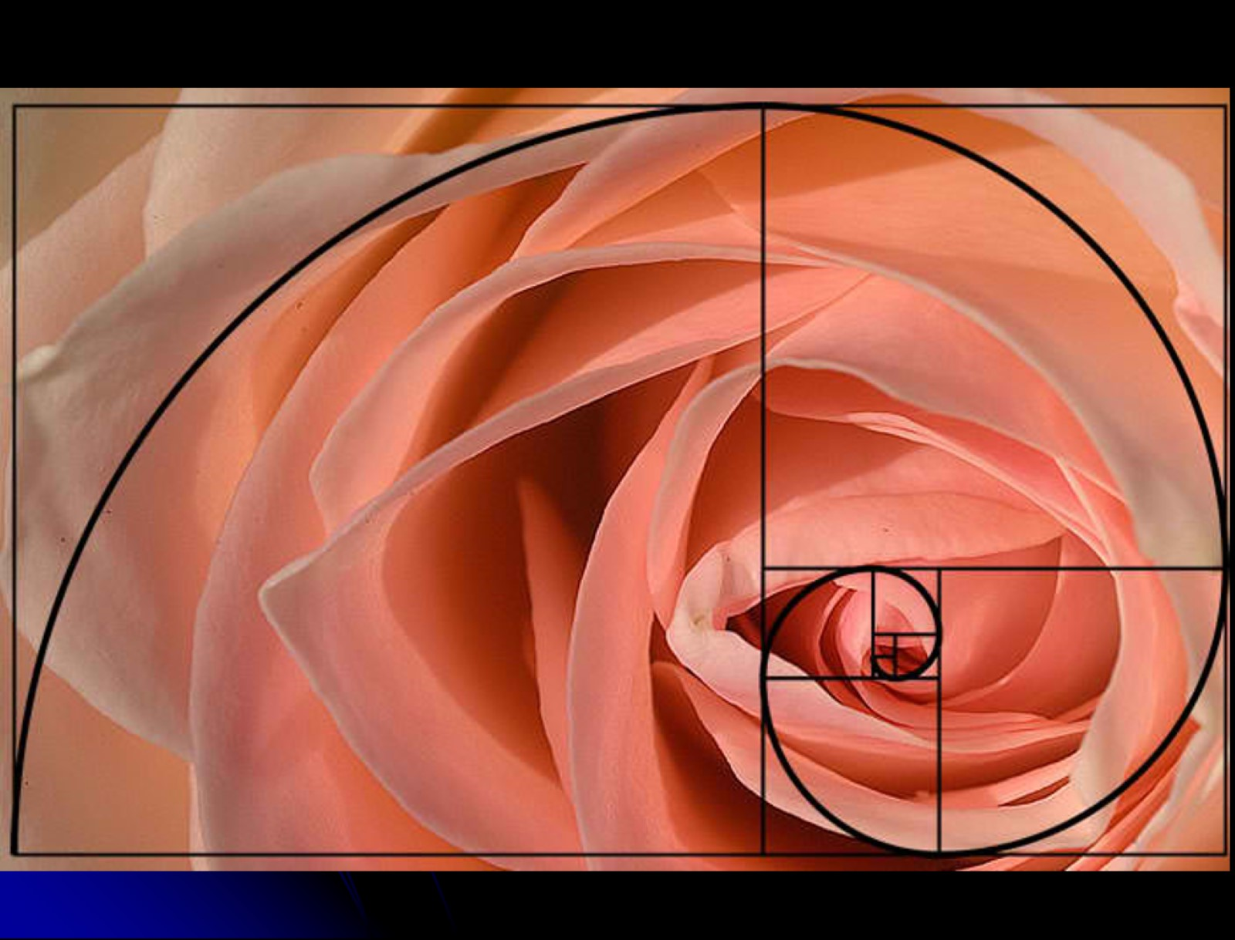

Slide 41
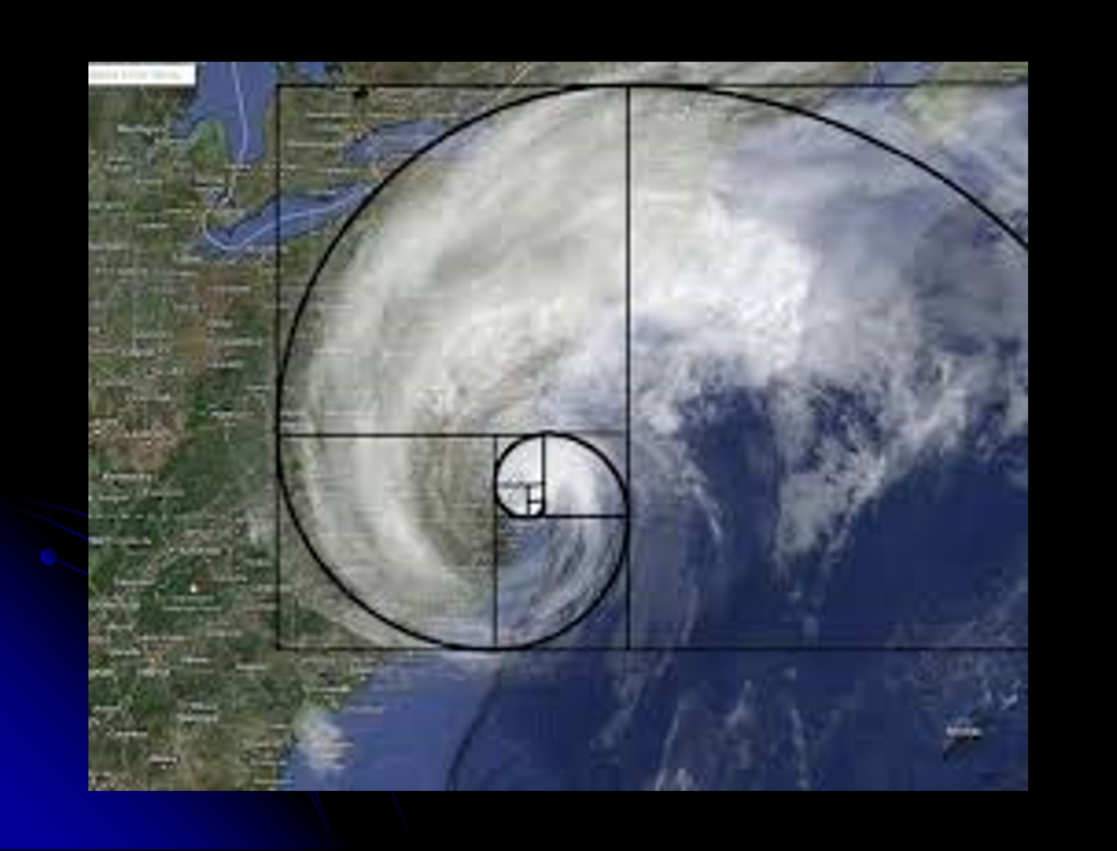

Slide 42
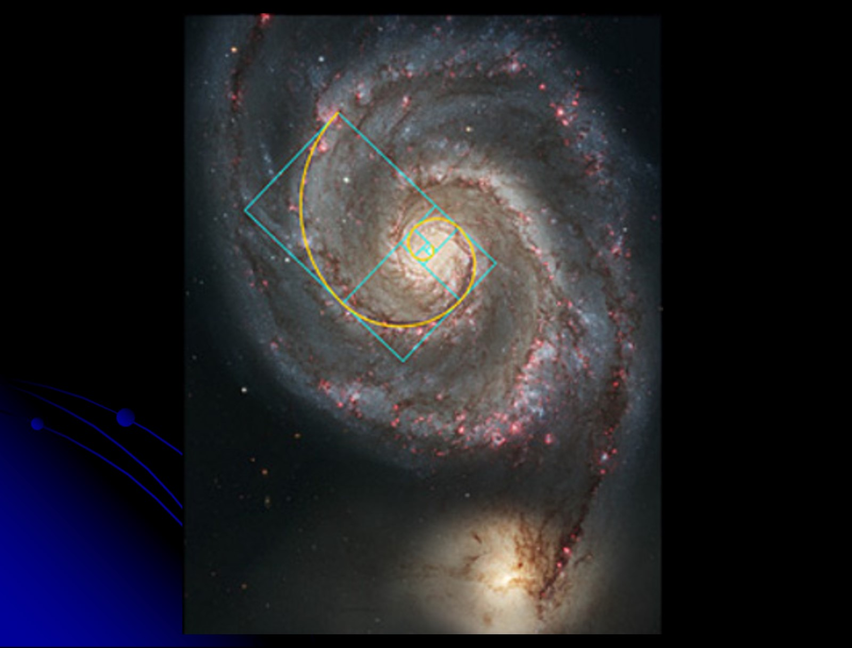

Slide 48
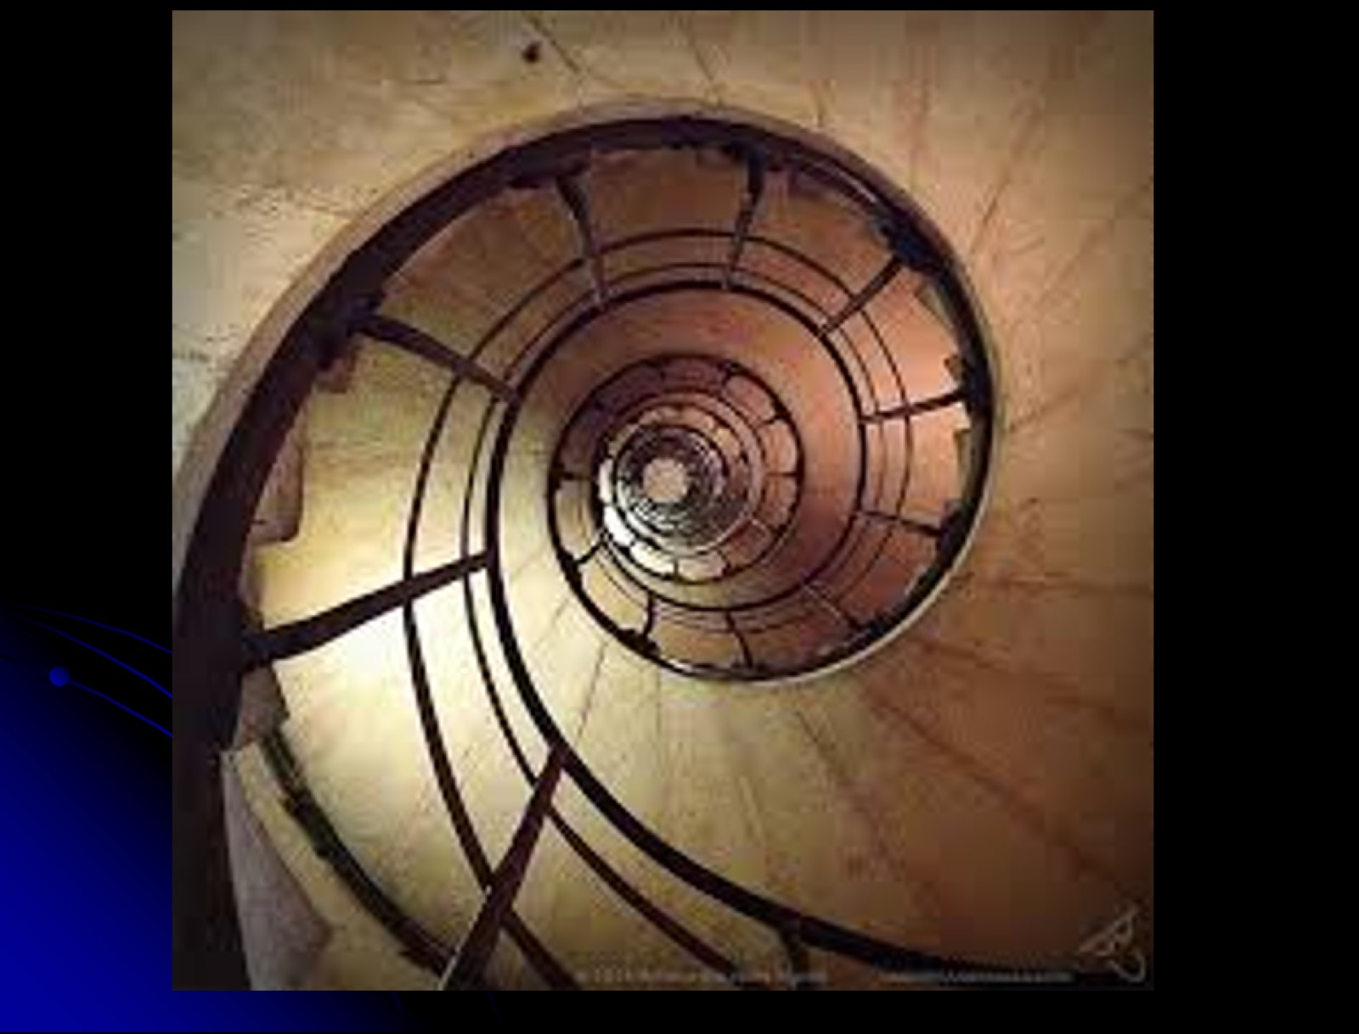

Slide 51
A Few Points of View

Slide 53
Psalm 19:1-4

Slide 54
John 1:1-5,11-14

Slide 56
Reflections on the Golden Ratio

