Slide 1
Joy of the Resurrection
Gone Fishing

Slide 2
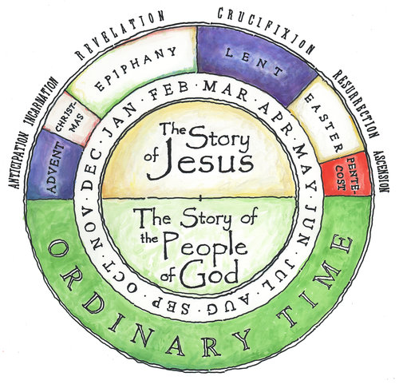

Slide 3
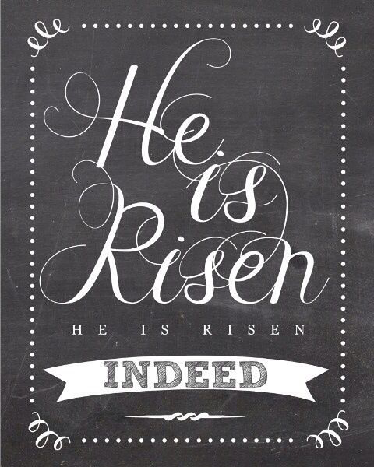

Slide 4
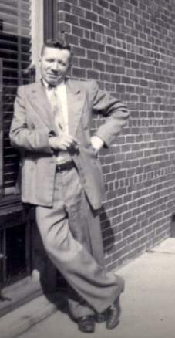

Slide 6
Context

Slide 7
¹ Afterward Jesus appeared again to his disciples, by the Sea of Galilee. It happened this way: ² Simon Peter, Thomas (also known as Didymus), Nathanael from Cana in Galilee, the sons of Zebedee, and two other disciples were together. ³ “I’m going out to fish,” Simon Peter told them, and they said, “We’ll go with you.” So they went out and got into the boat, but that night they caught nothing.
John 21

Slide 8
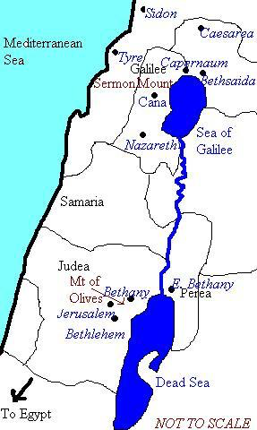

Slide 9
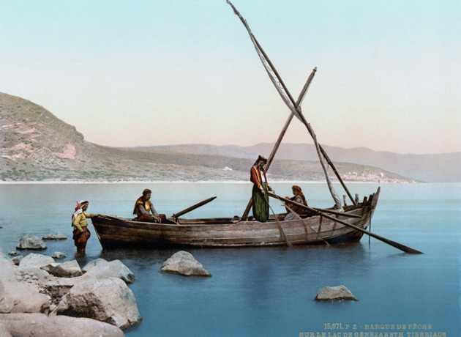

Slide 10
Fishing with Jesus. . .

Slide 11
⁴ Early in the morning, Jesus stood on the shore, but the disciples did not realize that it was Jesus.
⁵ He called out to them, “Friends, haven’t you any fish?”
“No,” they answered.
⁶ He said, “Throw your net on the right side of the boat and you will find some.” When they did, they were unable to haul the net in because of the large number of fish.
⁷ Then the disciple whom Jesus loved said to Peter, “It is the Lord!” As soon as Simon Peter heard him say, “It is the Lord,” he wrapped his outer garment around him (for he had taken it off) and jumped into the water.

Slide 12
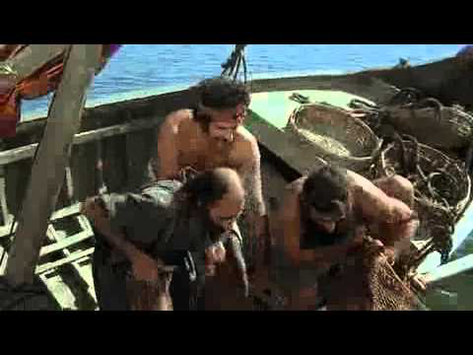

Slide 14
Eating with Jesus. . .

Slide 15
⁸ The other disciples followed in the boat, towing the net full of fish, for they were not far from shore, about a hundred yards. ⁹ When they landed, they saw a fire of burning coals there with fish on it, and some bread.
¹⁰ Jesus said to them, “Bring some of the fish you have just caught.” ¹¹ So Simon Peter climbed back into the boat and dragged the net ashore. It was full of large fish, 153, but even with so many the net was not torn.

Slide 16
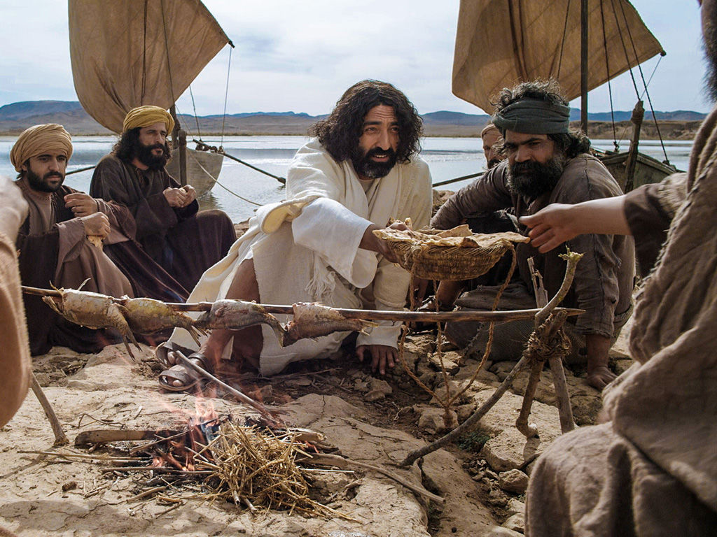

Slide 17
¹² Jesus said to them, “Come and have breakfast.” None of the disciples dared ask him, “Who are you?” They knew it was the Lord. ¹³ Jesus came, took the bread and gave it to them, and did the same with the fish. ¹⁴ This was now the third time Jesus appeared to his disciples after he was raised from the dead.

Slide 18
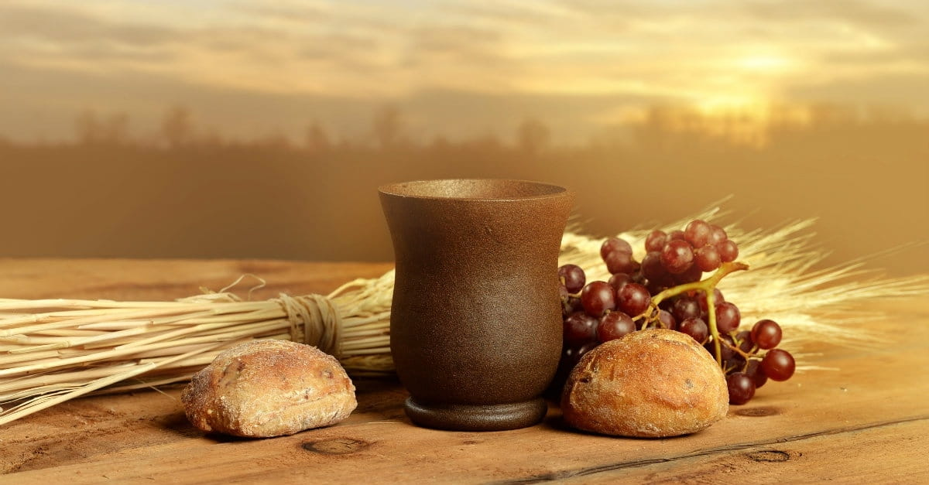

Slide 20
Interacting with Jesus. . .

Slide 21
¹⁵ When they had finished eating, Jesus said to Simon Peter, “Simon son of John, do you love me more than these?”
“Yes, Lord,” he said, “you know that I love you.”
Jesus said, “Feed my lambs.”
¹⁶ Again Jesus said, “Simon son of John, do you love me?”
He answered, “Yes, Lord, you know that I love you.”
Jesus said, “Take care of my sheep.”
¹⁷ The third time he said to him, “Simon son of John, do you love me?”
Peter was hurt because Jesus asked him the third time, “Do you love me?” He said, “Lord, you know all things; you know that I love you.”
Jesus said, “Feed my sheep.

Slide 22
Jesus:
Reaches out to Peter
Restores Peter
Commissions Peter

Slide 24
Lesson for disciples

Slide 25
Resurrection hope enables us to trust and obey.

