Slide 1
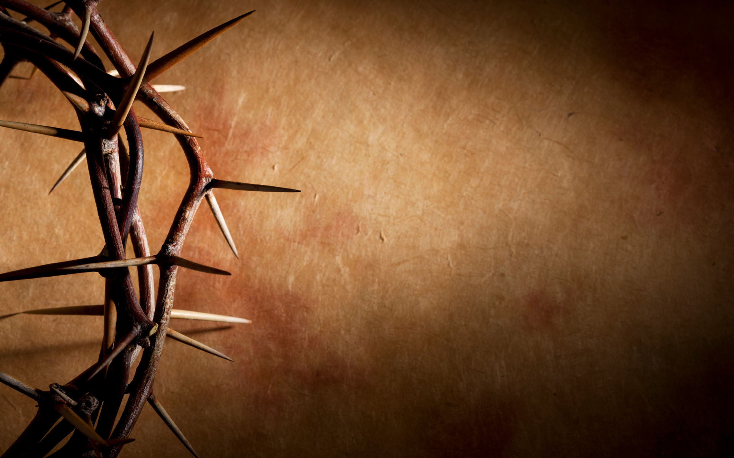
Chinese Christian Church of Columbia
哥伦比亚华人教会
Good Friday
耶稣受难日

Slide 2
Welcome & Greeting
欢迎问候

Slide 3
Prelude
前奏曲

Slide 4
Scripture Reading
-Grace & Jane-
读经

Slide 5

路加福音 23:32-38
32 另外有两个犯人也被带来和耶稣一同处死。33 到了一个地方，名叫髑髅地，他们就在那里把耶稣钉在十字架上，又钉了两个犯人：一个在右边，一个在左边。
Luke 23:32-38 (NIV)
32 Two other men, both criminals, were also led out with him to be executed. 33 When they came to the place called the Skull, they crucified him there, along with the criminals—one on his right, the other on his left.

Slide 6
34 这时，耶稣说：“父啊！赦免他们，因为他们所做的，他们不知道。”士兵就抽签分他的衣服。35 百姓站在那里观看。官长也嘲笑他，说：“他救了别人，他若是基督，是 神所拣选的，救救他自己吧！”
34 Jesus said, “Father, forgive them, for they do not know what they are doing.” And they divided up his clothes by casting lots.
35 The people stood watching, and the rulers even sneered at him. They said, “He saved others; let him save himself if he is God’s Messiah, the Chosen One.”

Slide 7
36 士兵也戏弄他，上前拿醋送给他喝，37 说：“你若是犹太人的王，救救你自己吧！”38 在耶稣上方有一个牌子写着：“这是犹太人的王。”
36 The soldiers also came up and mocked him. They offered him wine vinegar 37 and said, “If you are the king of the Jews, save yourself.” 38 There was a written notice above him, which read: this is the king of the Jews.

Slide 8

JESUS PAID IT ALL
主替我舍身

Slide 9
我听救主说道 你的力量微小
应当儆醒祈祷 因我作你中保
I HEAR THE SAVIOR SAY
THY STRENGTH INDEED IS SMALL
CHILD OF WEAKNESS WATCH AND PRAY
FIND IN ME THINE ALL IN ALL

Slide 10
我无嘉言善行 可藉此得救恩
唯主所流宝血 能洗一切罪痕
FOR NOTHING GOOD HAVE I
WHEREBY THY GRACE TO CLAIM
I WILL WASH MY GARMENTS WHITE
IN THE BLOOD OF CALV’RY’S LAMB

Slide 11
主为我舍身 罪债全还清
无数罪孽污秽心 主洗比雪更白
JESUS PAID IT ALL
ALL TO HIM I OWE
SIN HAD LEFT A CRIMSON STAIN
HE WASHED IT WHITE AS SNOW

Slide 12
主为我舍身 罪债全还清
无数罪孽污秽心 主洗比雪更白
Jesus paid it all
All to Him I owe
Sin had left a crimson stain
He washed it white as snow

Slide 13
将来身体得赎 荣耀站主面前
我口仍要歌唱 主赐救恩完全
And when before the throne
I stand in Him complete
Jesus died my soul to save
My lips shall still repeat

Slide 14
主为我舍身 罪债全还清
无数罪孽污秽心 主洗比雪更白
Jesus paid it all
All to Him I owe
Sin had left a crimson stain
He washed it white as snow

Slide 15
主为我舍身 罪债全还清
无数罪孽污秽心 主洗比雪更白
Jesus paid it all
All to Him I owe
Sin had left a crimson stain
He washed it white as snow

Slide 16
Scripture Reading
-Chuck & Shirley-
读经

Slide 17
路加福音 23:39-43
39 同钉的犯人中有一个讥笑他，说：“你不是基督吗？救救你自己和我们吧！” 40 另一个就应声责备他，说：“你是一样受刑的，还不怕 神吗？ 41 我们是应得的，因为我们是自作自受，但这个人没有做过一件不对的事。”
Luke 23:39-43 (NIV)
39 One of the criminals who hung there hurled insults at him: “Aren’t you the Messiah? Save yourself and us!”40 But the other criminal rebuked him. “Don’t you fear God,” he said, “since you are under the same sentence? 41 We are punished justly, for we are getting what our deeds deserve. But this man has done nothing wrong.”

Slide 18
42 他对耶稣说：“耶稣啊，你进入你国的时候，求你记念我。” 43 耶稣对他说：“我实在告诉你，今日你要同我在乐园里了。”
42 Then he said, “Jesus, remember me when you come into your kingdom.” 43 Jesus answered him, “Truly I tell you, today you will be with me in paradise.”

Slide 19

Via dolorosa

Slide 20
Down the Via Dolorosa in Jerusalem that day
The soldiers tried to clear the narrow street

Slide 21
But the crowd pressed into see
A man condemned to die on Calvary

Slide 22
He was bleeding from a beating there were stripes upon His back
And He wore a crown upon his head

Slide 23
And He bore with every step
The scorn of those who cried out for his death

Slide 24
Down the Via Dolorosa called the way of suffering
Like a lamb came the Messiah
Christ the King

Slide 25
and He chose to walk that road out of His love for you and me
Down the Via Dolorosa all the way to Calvary

Slide 26
The blood that will cleanse the souls of all men made its way to the heart of jerusalem

Slide 27
The blood that will cleanse the souls of all men made its way to the heart of jerusalem

Slide 28
Down the Via Dolorosa called the way of suffering
Like a lamb came the Messiah
Christ the King

Slide 29
Down the Via Dolorosa called the way of suffering
Like a lamb came the Messiah
Christ the King

Slide 30
and He chose to walk that road out of His love for you and me
Down the Via Dolorosa all the way to Calvary

Slide 31
Scripture Reading
-Louck Family-
读经

Slide 32
路加福音 23:44-49
44 那时大约是正午，全地都黑暗了，直到下午三点钟，45 太阳变黑了，殿的幔子从当中裂为两半。 46 耶稣大声喊着说：“父啊，我将我的灵交在你手里！”他说了这话，气就断了。
Luke 23:44-49 (NIV)
44 It was now about noon, and darkness came over the whole land until three in the afternoon, 45 for the sun stopped shining. And the curtain of the temple was torn in two. 46 Jesus called out with a loud voice, “Father, into your hands I commit my spirit.” When he had said this, he breathed his last.

Slide 33
47 百夫长看见所发生的事，就归荣耀给 神，说：“这人真是个义人！” 48 聚集观看这事的众人，见了所发生的事，都捶着胸回去了。 49 所有与耶稣熟悉的人，和从加利利跟着他来的妇女们，都远远地站着，看这些事。
47 The centurion, seeing what had happened, praised God and said, “Surely this was a righteous man.” 48 When all the people who had gathered to witness this sight saw what took place, they beat their breasts and went away. 49 But all those who knew him, including the women who had followed him from Galilee, stood at a distance, watching these things.

Slide 34
Message
“Final Words of Jesus”
信息
“耶稣的遗言”

Slide 35
Confession at the Cross
十架上的忏悔

Slide 36

是你牵着我的手

Slide 37
耶稣的心意 我现在才回应
尊贵的生命 为了我们舍去
前面的道路 我不会觉得苦
有你在看顾 让我明白你如何引领我

Slide 38
耶稣的心意 我现在才回应
尊贵的生命 为了我们舍去
前面的道路 我不会觉得苦
有你在看顾 让我明白你如何引领我

Slide 39
是你牵着我的手 陪我流泪到最后
所有的担忧 不需要停留
因有你的手

Slide 40
是你牵着我的手 创造平凡的笑容
不需要理由 你一定守候
耶稣钉痕的手 牵着我

Slide 41
耶稣的心意 我现在才回应
尊贵的生命 为了我们舍去
前面的道路 我不会觉得苦
有你在看顾 让我明白你如何引领我

Slide 42
是你牵着我的手 陪我流泪到最后
所有的担忧 不需要停留
因有你的手

Slide 43
是你牵着我的手 创造平凡的笑容
不需要理由 你一定守候
耶稣钉痕的手 牵着我

Slide 44
我心有深刻的感受
因知道你陪我走
你重视我每一分钟
你为我停留

Slide 45
是你牵着我的手 陪我流泪到最后
所有的担忧 不需要停留
因有你的手

Slide 46
是你牵着我的手 创造平凡的笑容
不需要理由 你一定守候
耶稣钉痕的手 牵着我

Slide 47
不需要理由 你一定守候
耶稣钉痕的手 牵着我

Slide 48

Amazing grace
(My chains are gone)
奇异恩典(不再有捆绑)

Slide 49
Amazing grace how sweet the sound
That saved a wretch like me
I once was lost but now I'm found
Was blind but now I see
奇异恩典 何等甘甜 我罪已得赦免
前我失丧 今被寻回 瞎眼今得看见

Slide 50
如此恩典 使我敬畏 使我心得安慰
初信之时 即蒙恩惠 真是何等宝贵
'Twas grace that taught my heart to fear
And grace my fears relieved
How precious did that grace appear
The hour I first believed

Slide 51
不再有捆绑 我已得释放 我救主耶穌 已付代价
丰富恩典 今充满我 永恆的爱 奇异恩典
My chains are gone I've been set free
My God my Savior has ransomed me
And like a flood His mercy reigns
Unending love amazing grace

Slide 52
The Lord has promised good to me
His word my hope secures
He will my shield and portion be
As long as life endures
我主应许 美好无比 盼望永不失去
有主做為 盾牌福分 我心不再畏惧

Slide 53
不再有捆绑 我已得释放
我救主耶穌 已付代价
丰富恩典 今充满我
永恆的爱 奇异恩典
My chains are gone I've been set free
My God my Savior has ransomed me
And like a flood His mercy reigns
Unending love amazing grace

Slide 54
不再有捆绑 我已得释放
我救主耶穌 已付代价
丰富恩典 今充满我
永恆的爱 奇异恩典
My chains are gone I've been set free
My God my Savior has ransomed me
And like a flood His mercy reigns
Unending love amazing grace

Slide 55
天地都会 渐渐废去 但我主永长存
我的生命 有主看顾
我永远属于祢 x3
The earth shall soon dissolve like snow
The sun forbear to shine
But God Who called me here below
Will be forever mine x3

Slide 56
Benediction
祝福

Slide 57
Chinese Christian Church of Columbia
哥伦比亚华人教会
Good Friday
耶稣受难日

