Slide 1
Grace to You
Grace Alone

Slide 2
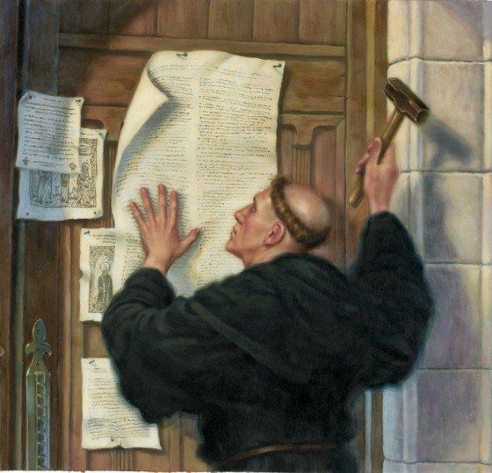

Slide 4
⁸ For it is by grace you have been saved, through faith—and this is not from yourselves, it is the gift of God— ⁹ not by works, so that no one can boast.
Ephesian 2:8-9

Slide 5
Grace

Slide 6
⁸ For it is by grace you have been saved, through faith—and this is not from yourselves, it is the gift of God— ⁹ not by works, so that no one can boast.

Slide 10
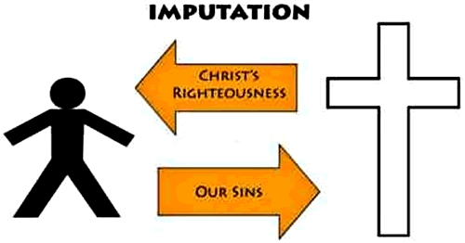

Slide 11
Saved

Slide 12
⁸ For it is by grace you have been saved, through faith—and this is not from yourselves, it is the gift of God— ⁹ not by works, so that no one can boast.

Slide 16
Faith

Slide 17
⁸ For it is by grace you have been saved, through faith—and this is not from yourselves, it is the gift of God— ⁹ not by works, so that no one can boast.
Ephesian 2:8-9

Slide 21
Apply

Slide 22
Receive Grace

Slide 23
Receive Grace
Appreciate Grace

Slide 24
Receive Grace
Appreciate Grace
Share Grace

