Slide 1
Church
Healthy Characteristics

Slide 2
National Community Church

Slide 4
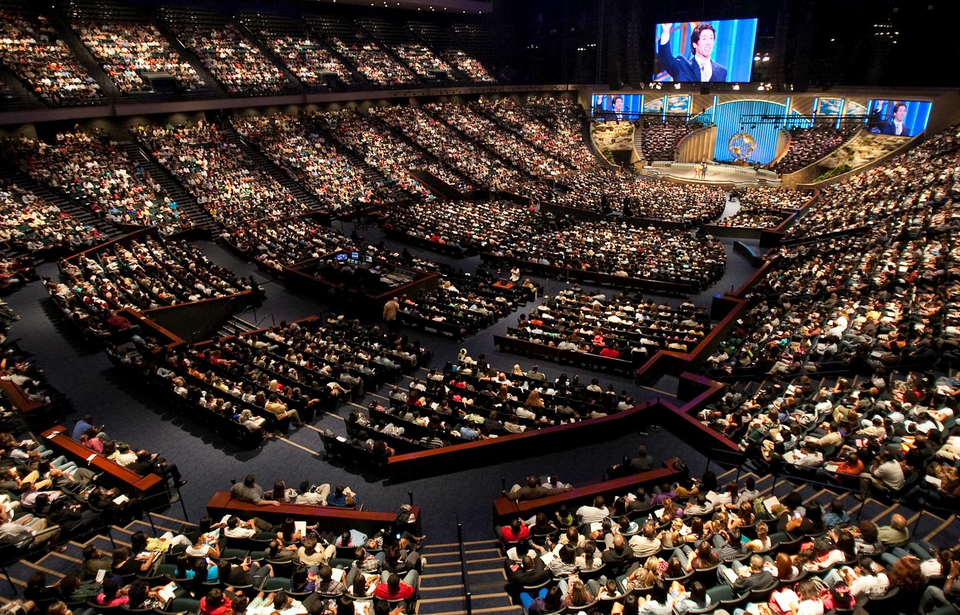

Slide 5
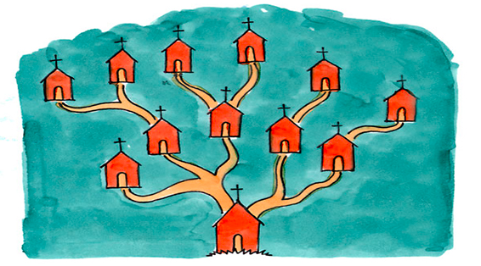

Slide 6
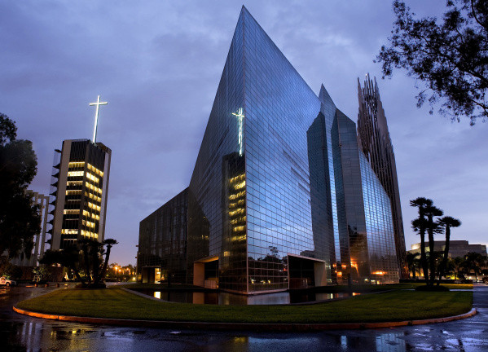

Slide 7
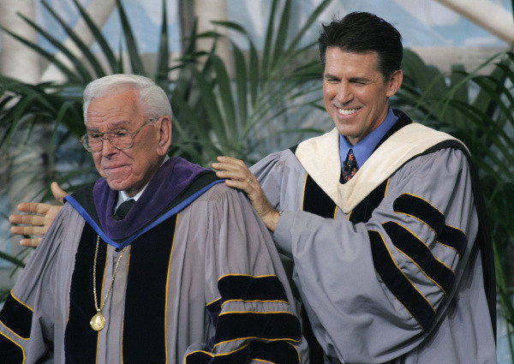

Slide 8
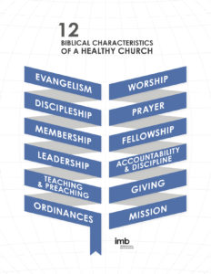

Slide 9
Biblical Evangelism

Slide 10
¹⁴ How, then, can they call on the one they have not believed in? And how can they believe in the one of whom they have not heard? And how can they hear without someone preaching to them? ¹⁵ And how can anyone preach unless they are sent? As it is written: “How beautiful are the feet of those who bring good news!”
Romans 10:14-15

Slide 11
“The stats tell us that ten smaller churches of 100 people will accomplish much more than one church of 1000.”
Neil Cole

Slide 14
Biblical Discipleship

Slide 15
¹⁸ Then Jesus came to them and said, “All authority in heaven and on earth has been given to me. ¹⁹ Therefore go and make disciples of all nations, baptizing them in the name of the Father and of the Son and of the Holy Spirit, ²⁰ and teaching them to obey everything I have commanded you. And surely I am with you always, to the very end of the age.”
Matthew 28:18-20

Slide 17
Chinese Christian Church of Columbia’s vision is to be a Christ-centered community that seeks to make disciples who learn, grow, and serve in the Lord.”

Slide 19
Biblical Membership

Slide 20
They devoted themselves to the apostles’ teaching and to fellowship, to the breaking of bread and to prayer.
Acts 2:42

Slide 21
Research . . . suggests high-commitment churches grow much faster than low-commitment churches. Quite intuitively, research also shows that high-commitment churches are healthier, more involved with their community and demonstrate a stronger commitment to missions and outreach.
Faith Autopsy

Slide 23
Lessons for Disciples

Slide 24
