Slide 1
Church
Healthy Characteristics: Ordinances & Worship

Slide 2
National Community Church

Slide 4
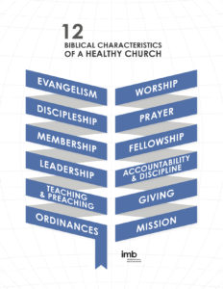

Slide 5
Evangelism – Beautiful feet (Rm. 10:15)
Discipleship – Learn, Grow & Serve
Membership – Devoted themselves:
Apostles’ teaching
Breaking of bread
Fellowship &
Prayer (Acts 2:42)

Slide 6
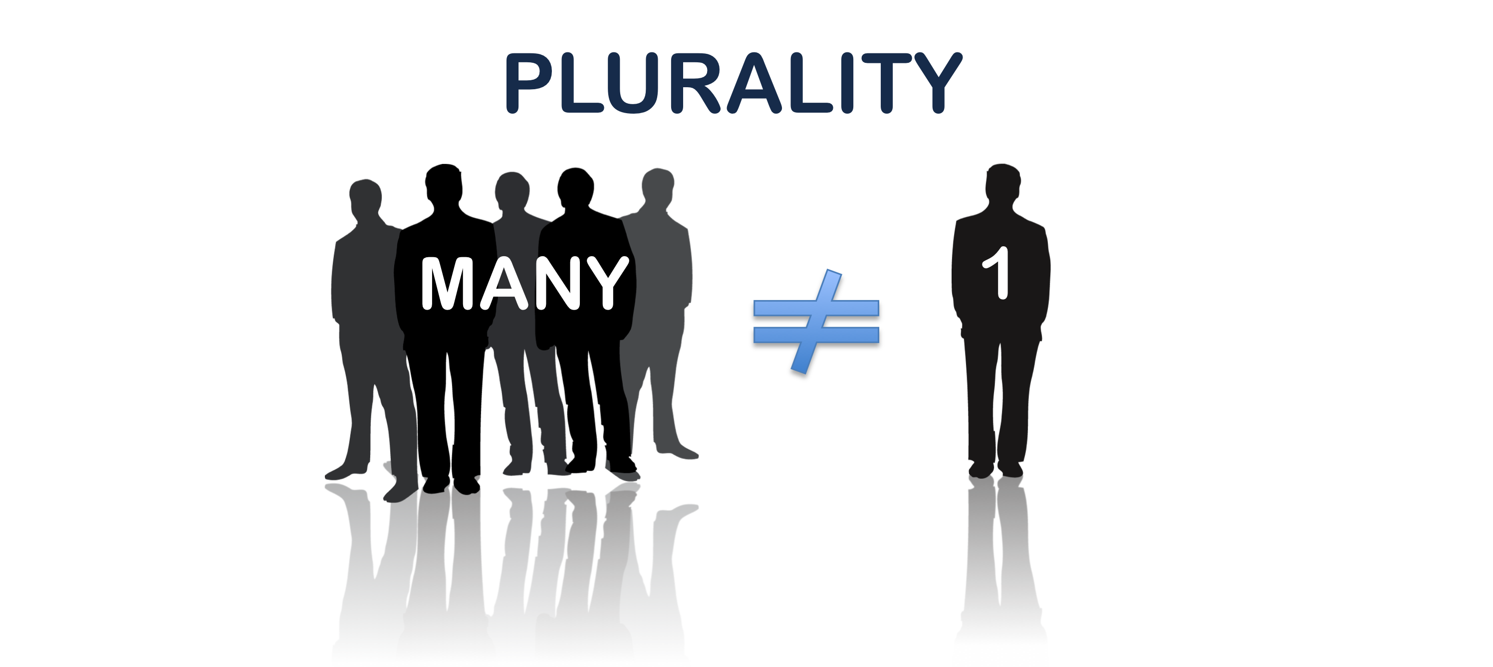
Biblical Leadership

Slide 8
Biblical Teaching & Preaching

Slide 9
Biblical Ordinances

Slide 10
An ordinance is a "prescribed practice." It is something that has been (1) prescribed and instituted by Jesus Christ, (2) taught by the Apostles, and (3) practiced by the Church.
An ordinance is something that the Church practices because Jesus Christ has told her to do so.

Slide 11
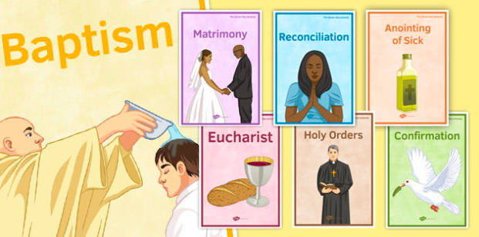

Slide 13
¹⁹ Therefore go and make disciples of all nations, baptizing them in the name of the Father and of the Son and of the Holy Spirit, ²⁰ and teaching them to obey everything I have commanded you. And surely I am with you always, to the very end of the age.”
Matthew 28:19-20

Slide 14
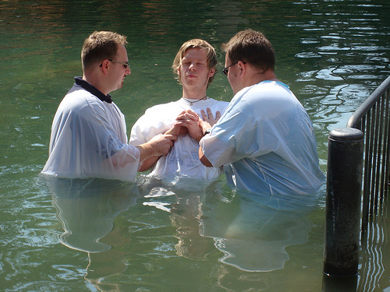

Slide 16
²⁶ Jesus took bread, and when he had given thanks, he broke it and gave it to his disciples, saying, “Take and eat; this is my body.”
²⁷ Then he took a cup, and when he had given thanks, he gave it to them, saying, “Drink from it, all of you. ²⁸ This is my blood of the covenant, which is poured out for many for the forgiveness of sins.
Matthew 26:26-28

Slide 17
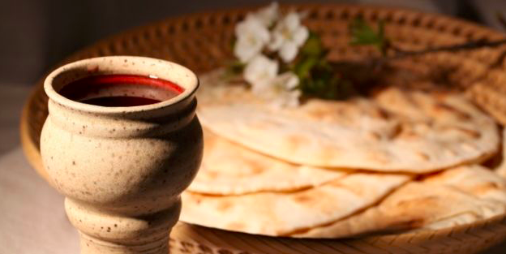

Slide 18
Biblical Worship

Slide 19
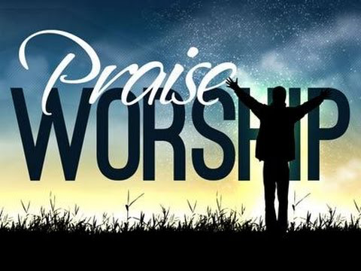

Slide 20
The local churches come together to exalt God, sing, share testimonies of God’s grace, spur one another on toward Christ and his Word, and send one another out into service. As long as its members are following the Bible’s instructions for worship a healthy church is free to enjoy a wide range of variety, diversity, and creativity in their worship together.
International Missions Board, SBC

Slide 21
God is spirit, and his worshipers must worship in the Spirit and in truth.
John 4:24

Slide 24
Lessons for Disciples

Slide 25
Partake in the ordinances
Prioritize corporate worship
Practice life-changing worship

