Slide 1
Church
Healthy Characteristics: Worship

Slide 2
National Community Church

Slide 3
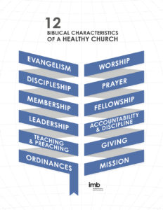

Slide 4
An ordinance is a "prescribed practice." It is something that has been:
Prescribed and instituted by Jesus Christ,
Taught by the Apostles, and
Practiced by the Church.

Slide 5
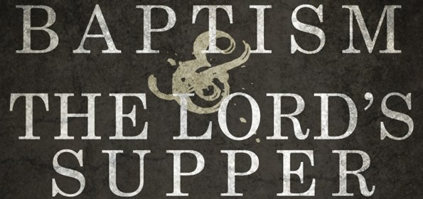

Slide 6
Biblical Worship

Slide 7
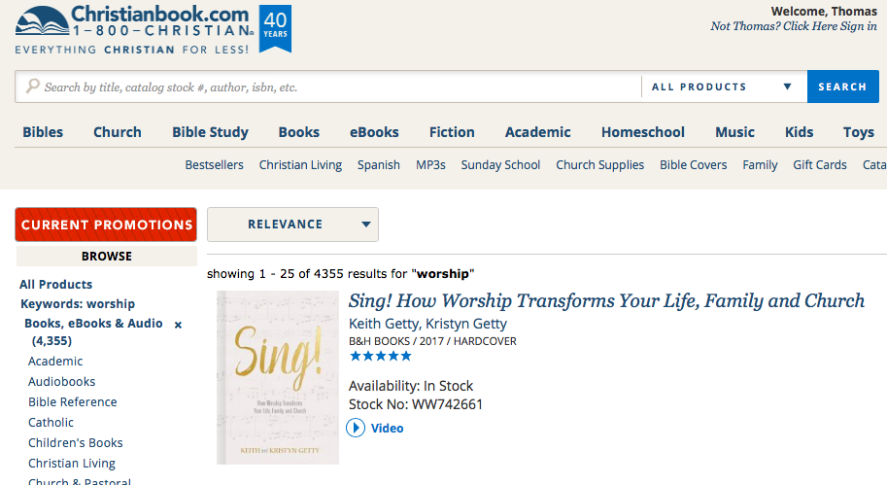

Slide 8
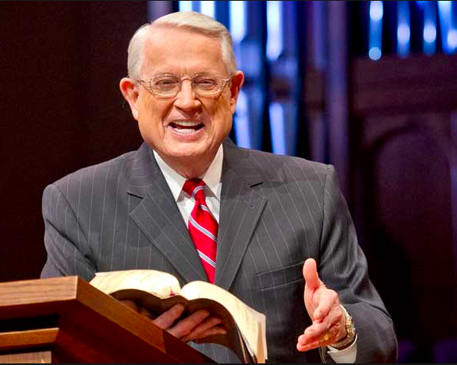

Slide 9
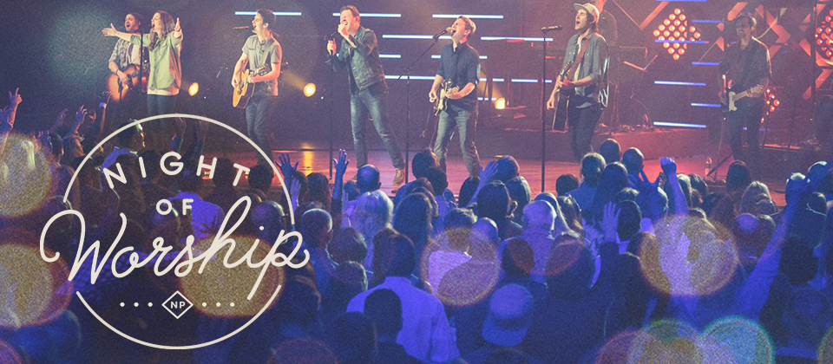

Slide 10
¹⁹ “Sir,” the woman said, “I can see that you are a prophet. ²⁰ Our ancestors worshiped on this mountain, but you Jews claim that the place where we must worship is in Jerusalem.”
²¹ “Woman,” Jesus replied, “believe me, a time is coming when you will worship the Father neither on this mountain nor in Jerusalem. ²² You Samaritans worship what you do not know; we worship what we do know, for salvation is from the Jews.

Slide 11
²³ Yet a time is coming and has now come when the true worshipers will worship the Father in the Spirit and in truth, for they are the kind of worshipers the Father seeks. ²⁴ God is spirit, and his worshipers must worship in the Spirit and in truth.”
John 4:19-24

Slide 12
An Encounter with Jesus

Slide 13
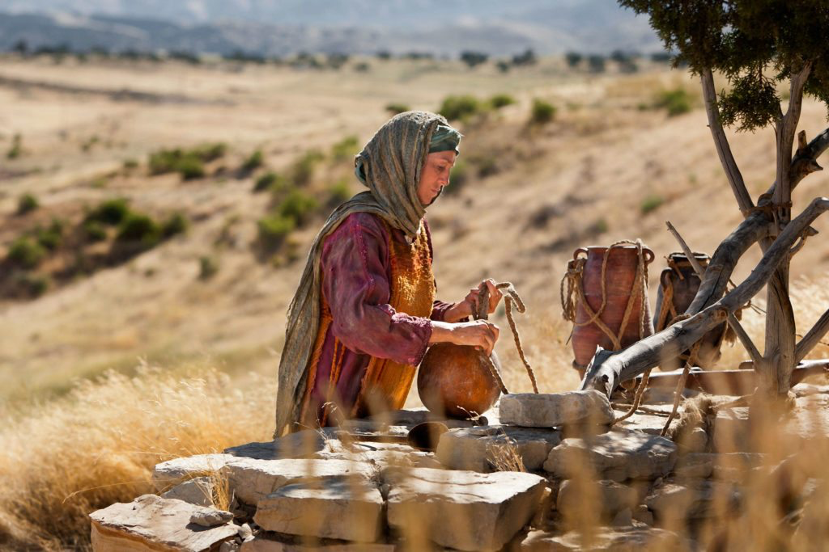

Slide 14
¹⁹ “Sir,” the woman said, “I can see that you are a prophet. ²⁰ Our ancestors worshiped on this mountain, but you Jews claim that the place where we must worship is in Jerusalem.”

Slide 15
A Theological Exchange

Slide 16
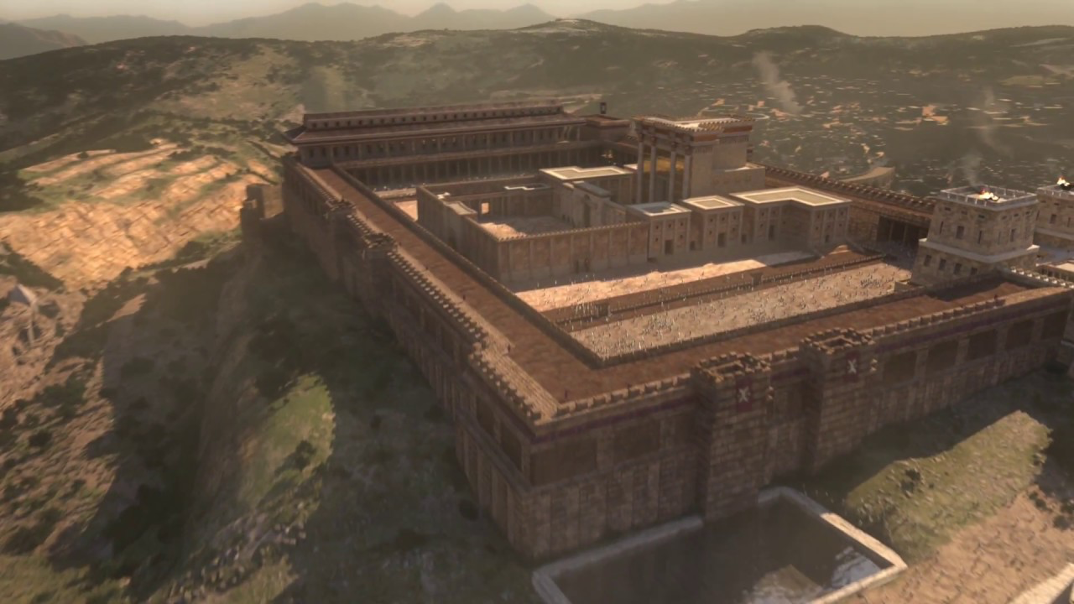

Slide 17
²⁰ Our ancestors worshiped on this mountain, but you Jews claim that the place where we must worship is in Jerusalem.”
²¹ “Woman,” Jesus replied, “believe me, a time is coming when you will worship the Father neither on this mountain nor in Jerusalem. ²² You Samaritans worship what you do not know; we worship what we do know, for salvation is from the Jews.

Slide 18
True Worship

Slide 19
²³ Yet a time is coming and has now come when the true worshipers will worship the Father in the Spirit and in truth, for they are the kind of worshipers the Father seeks. ²⁴ God is spirit, and his worshipers must worship in the Spirit and in truth.”

Slide 21
The local churches come together to exalt God, sing, share testimonies of God’s grace, spur one another on toward Christ and his Word, and send one another out into service. As long as its members are following the Bible’s instructions for worship a healthy church is free to enjoy a wide range of variety, diversity, and creativity in their worship together.
International Missions Board, SBC

Slide 22
Lessons for Disciples

Slide 23
Prioritize corporate worship
Practice personal worship
Experience life-changing worship

