Slide 1
Healthy Church
Sharing Responsibility

Slide 2
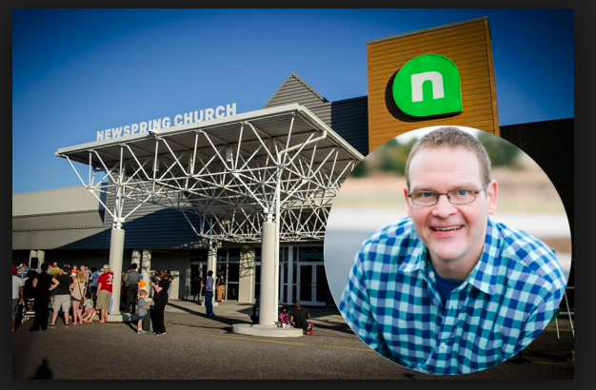

Slide 3
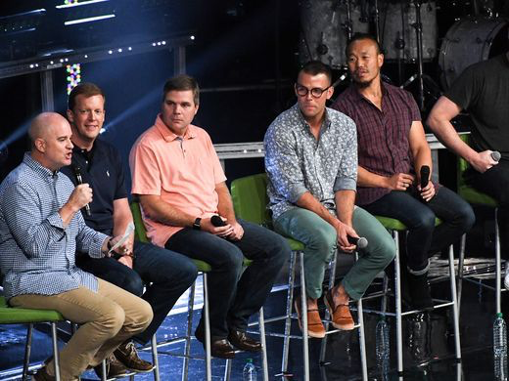

Slide 5
I WILL SHARE THE RESPONSIBILITY OF MY CHURCH
By praying for its growth and health (1 Thess. 1:2)
By inviting the unchurched to attend (Luke 14:23)
By warmly welcoming those who visit (Rom. 15:7)
By supporting our global missions efforts (Acts 1:8)

Slide 6
Praying for growth and health

Slide 7
² We always thank God for all of you and continually mention you in our prayers.
³ We remember before our God and Father your work produced by faith, your labor prompted by love, and your endurance inspired by hope in our Lord Jesus Christ.
1 Thessalonians 1:2-3

Slide 8
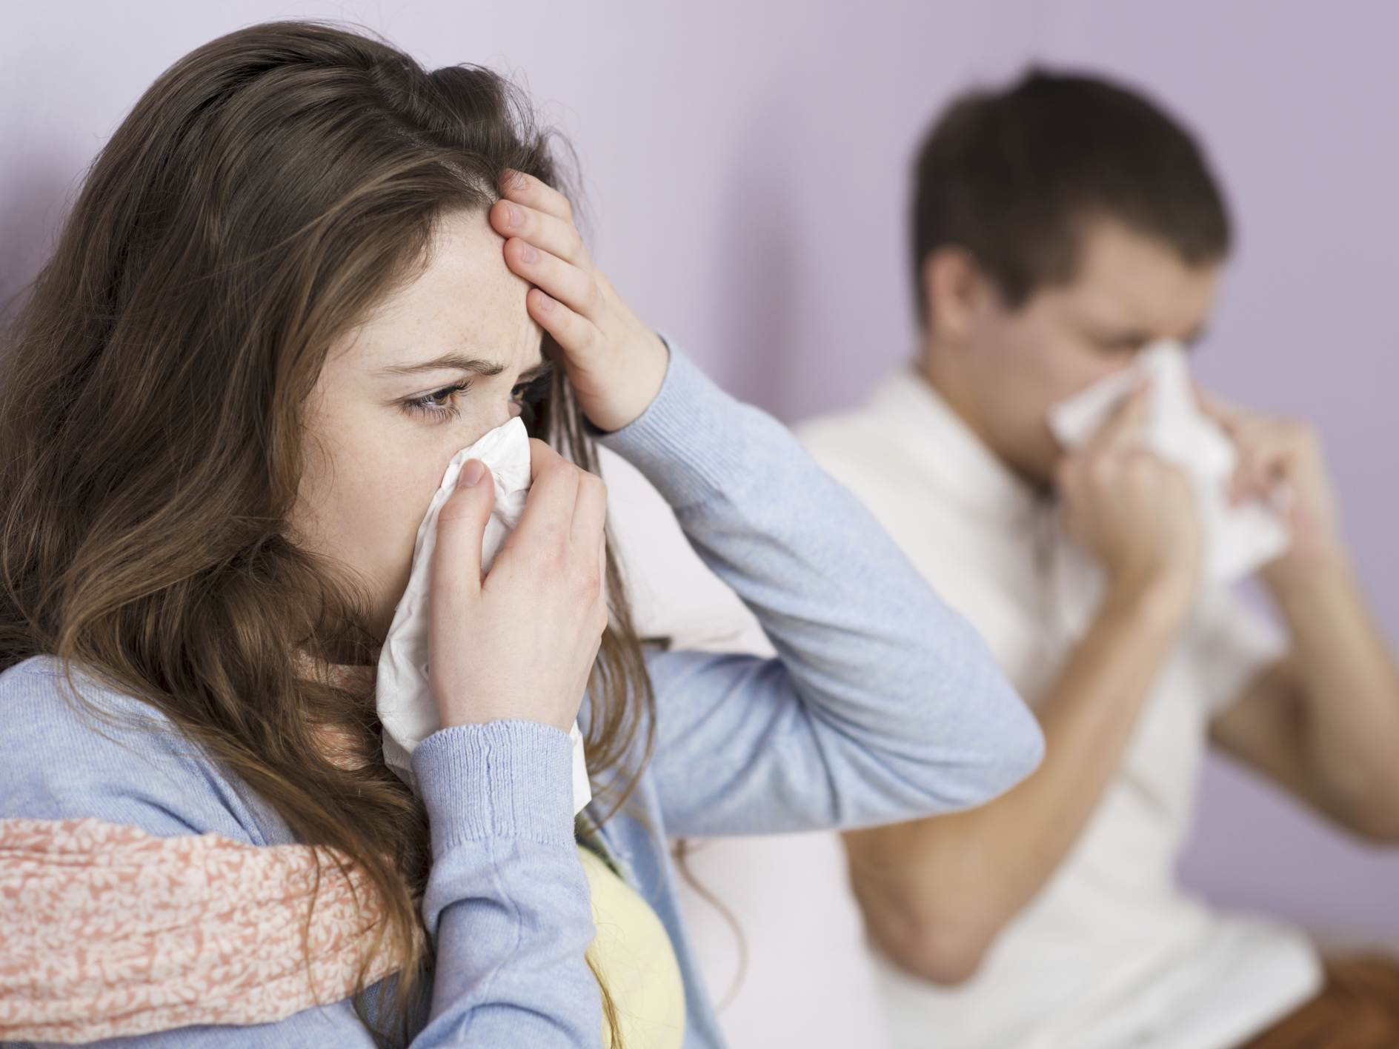

Slide 9
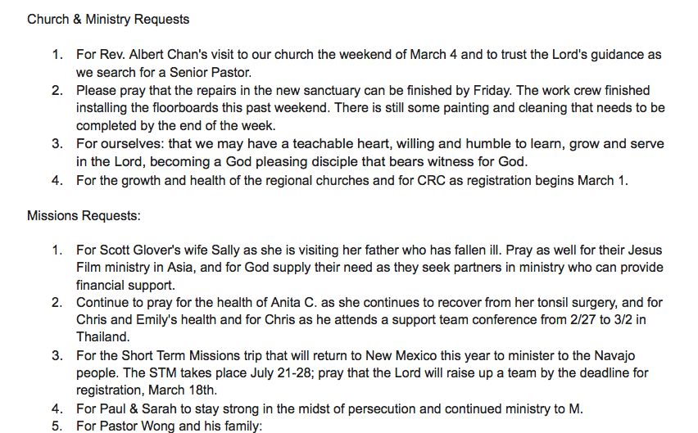

Slide 10
By inviting the unchurched to attend

Slide 12
²¹ “The servant came back and reported this to his master. Then the owner of the house became angry and ordered his servant, ‘Go out quickly into the streets and alleys of the town and bring in the poor, the crippled, the blind and the lame.’
²² “‘Sir,’ the servant said, ‘what you ordered has been done, but there is still room.’
²³ “Then the master told his servant, ‘Go out to the roads and country lanes and compel them to come in, so that my house will be full. ²⁴ I tell you, not one of those who were invited will get a taste of my banquet.’”
Luke 14

Slide 13
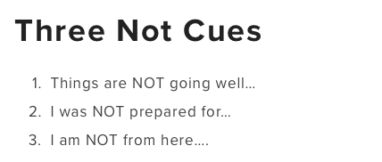

Slide 15
By warmly welcoming those who visit

Slide 16
Do not neglect to show hospitality to strangers, for thereby some have entertained angels unawares.
Hebrews 13:2

Slide 19
By supporting our global missions efforts

Slide 20
But you will receive power when the Holy Spirit comes on you; and you will be my witnesses in Jerusalem, and in all Judea and Samaria, and to the ends of the earth.”
Acts 1:8

Slide 22
Living it Out

