Slide 1
Healthy Church
Unity

Slide 4
Chinese Christian Church of Columbia’s vision is to be a Christ-centered community that seeks to make disciples who learn, grow, and serve in the Lord.

Slide 5
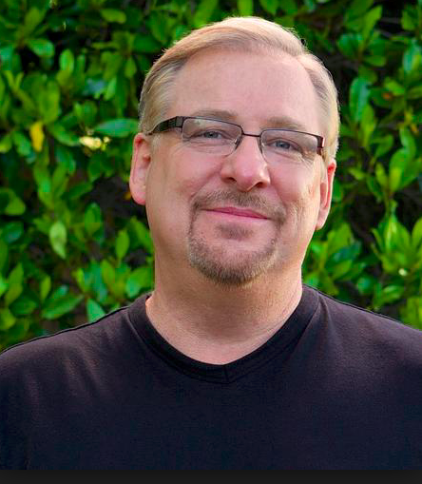
"In churches, membership is often reduced to simply adding your name to a roll, with no requirements or expectations."

Slide 6
I WILL PROTECT THE UNITY OF MY CHURCH
By acting in love toward other members (1 Peter 1:22)
By building one another up (Eph. 4:29)
By forgiving and seeking reconciliation if necessary (Matt. 5:23-24)
By following the leaders (Heb.13:17)

Slide 7
Love one another

Slide 8
Now that you have purified yourselves by obeying the truth so that you have sincere love for each other, love one another deeply, from the heart.
1 Peter 1:22

Slide 13
Build up one another

Slide 14
Do not let any unwholesome talk come out of your mouths, but only what is helpful for building others up according to their needs, that it may benefit those who listen.
Ephesians 4:29

Slide 15
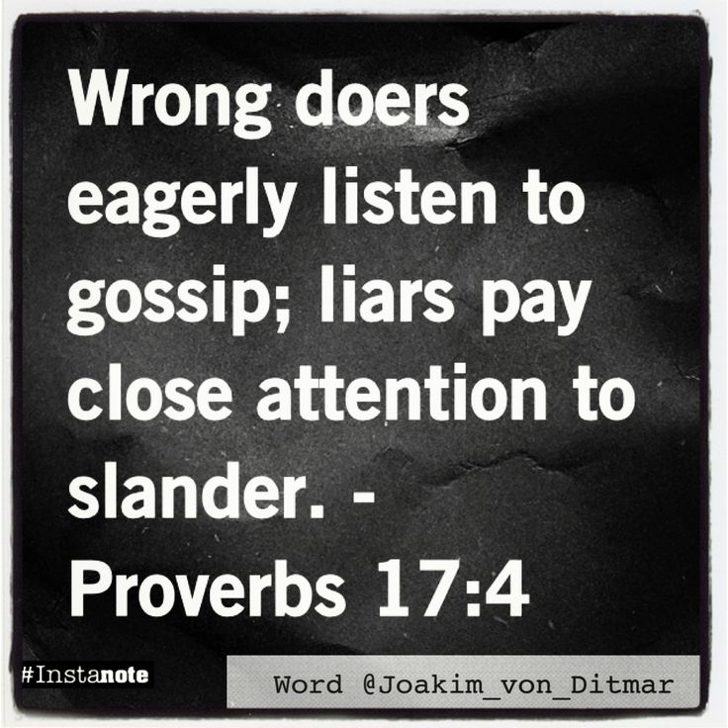

Slide 17
Here’s the basic rule: If the person were in the room with you, and you were talking about them to their face, how would you say it? If it doesn’t encourage or challenge them to grow in a positive way, then it isn’t wholesome.
Ted Ward, Relevant

Slide 18
Forgive one another

Slide 19
²³ “Therefore, if you are offering your gift at the altar and there remember that your brother or sister has something against you, ²⁴ leave your gift there in front of the altar. First go and be reconciled to them; then come and offer your gift.
Matthew 5:23-24

Slide 22
Living it Out

Slide 23
Love one another

Slide 24
Build up one another

Slide 25
Forgive one another

