Slide 1
Romans
His Peace

Slide 2
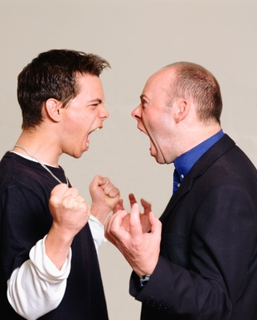
Strife. . .

Slide 3
Therefore, since we have been justified through faith, we have peace with God through our Lord Jesus Christ.
Romans 5:1 NIV

Slide 4
Translation
English: peace
Greek: eirene
Hebrew: shalom

Slide 5
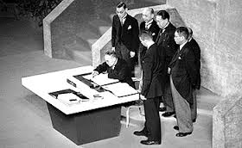
Peace - Reconciliatory

Slide 6
Peace - Judicial

Slide 8
Peace - Experiential
“Let the peace of Christ rule in your hearts.” Colossians 3:15
“And the peace of God, which transcends all understanding, will guard your hearts and your minds in Christ Jesus.”
Philippians 4:7

Slide 9
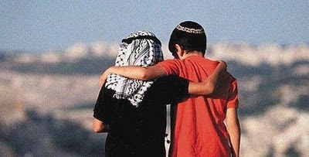
Peace - Relational

Slide 10
Peace – Communal

Slide 11
Seek Shalom in your relationship with God and in your relationships with others.

Slide 12
Seek Shalom by:
Spending time God
Confessing your sins
Reconciling with others
Encouraging brothers and sisters
Being His Hands & His Feet

Slide 13
Peace. . .

