Slide 1
Romans
His Gift

Slide 2
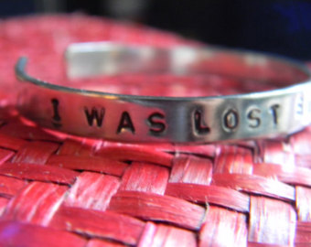

Slide 3
Corinne Ganther

Slide 4
²⁰ For when you were slaves of sin, you were free in regard to righteousness.²¹ But what fruit were you getting at that time from the things of which you are now ashamed? For the end of those things is death. ²² But now that you have been set free from sin and have become slaves of God, the fruit you get leads to sanctification and its end, eternal life. ²³ For the wages of sin is death, but the free gift of God is eternal life in Christ Jesus our Lord.
Romans 6:20-23 ESV

Slide 5
Before We Were Christians (v. 21)
Status: slaves of sin, free from righteousness
Result: fruit bearing shame
Outcome: death

Slide 6
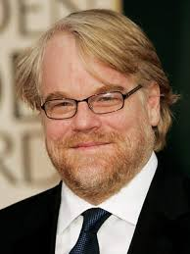
Academy Award:
Best Actor 2005
Film: Capote
Philip Seymour Hoffman

Slide 7
Now that we are Christians (v. 22)
Status: free from sin, slave to God
Result: fruit bringing sanctification
Outcome: life

Slide 10
How should we respond?
Receive Christ
With Gratitude

Slide 11
What draws us to obedience and righteousness is not duty but love. It is gratitude.
R.C. Sproul

