Slide 1
Romans
His Love

Slide 2
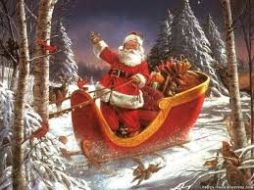

Slide 3
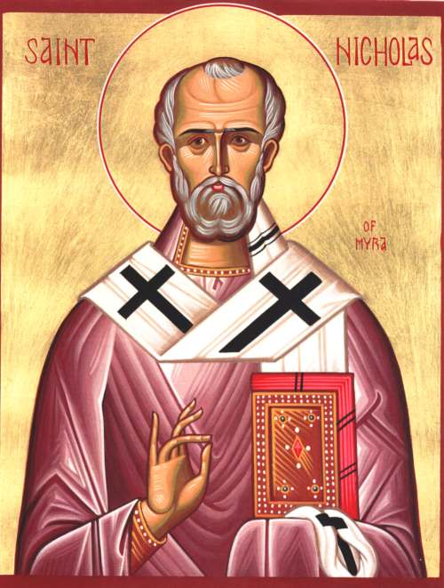

Slide 4
You see, at just the right time, when we were still powerless, Christ died for the ungodly. Very rarely will anyone die for a righteous person, though for a good person someone might possibly dare to die. But God demonstrates his own love for us in this: While we were still sinners, Christ died for us.
Romans 5:6-8 NIV

Slide 5
The Right Time
Powerless
God’s Love

Slide 6
Realize God is in Control
Give Thanks and Praise
Experience a Renewed Spirit

