Slide 1
Disciple
Hope Eternal

Slide 3
Disciple Defined

Slide 4
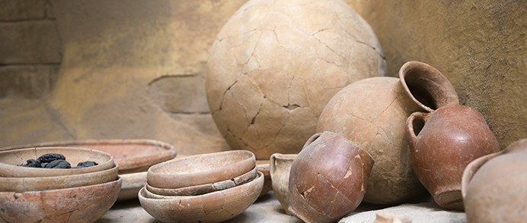

Slide 5
⁷ But we have this treasure in jars of clay to show that this all-surpassing power is from God and not from us.
2 Corinthians 4 (NIV)

Slide 7
¹³ It is written: “I believed; therefore I have spoken.” Since we have that same spirit of faith, we also believe and therefore speak, ¹⁴ because we know that the one who raised the Lord Jesus from the dead will also raise us with Jesus and present us with you to himself. ¹⁵ All this is for your benefit, so that the grace that is reaching more and more people may cause thanksgiving to overflow to the glory of God.
2 Corinthians 4

Slide 8
¹⁶ Therefore we do not lose heart. Though outwardly we are wasting away, yet inwardly we are being renewed day by day. ¹⁷ For our light and momentary troubles are achieving for us an eternal glory that far outweighs them all. ¹⁸ So we fix our eyes not on what is seen, but on what is unseen, since what is seen is temporary, but what is unseen is eternal.
2 Corinthians 4:13-18 (NIV)

Slide 9
Context

Slide 10
¹³ It is written: “I believed; therefore I have spoken.” Since we have that same spirit of faith, we also believe and therefore speak. . .
2 Corinthians 4

Slide 11
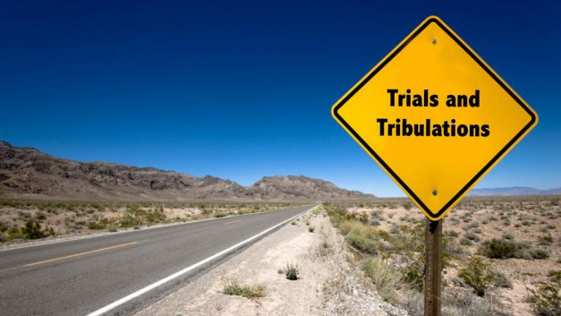

Slide 12
I believed, even when I spoke:
“I am greatly afflicted”;
Psalm 116:10 (ESV)

Slide 13
⁸ We are hard pressed on every side, but not crushed; perplexed, but not in despair; ⁹ persecuted, but not abandoned; struck down, but not destroyed.
2 Corinthians 4 (NIV)

Slide 14
Hope in the Resurrection

Slide 15
¹⁴ because we know that the one who raised the Lord Jesus from the dead will also raise us with Jesus and present us with you to himself. ¹⁵ All this is for your benefit, so that the grace that is reaching more and more people may cause thanksgiving to overflow to the glory of God.
2 Corinthians 4

Slide 16
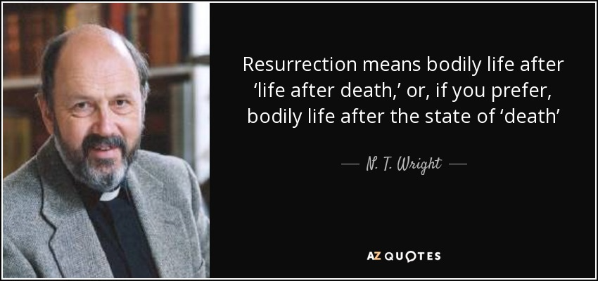

Slide 17
Hope Through Afflictions

Slide 18
¹⁶ Therefore we do not lose heart. Though outwardly we are wasting away, yet inwardly we are being renewed day by day. ¹⁷ For our light and momentary troubles are achieving for us an eternal glory that far outweighs them all.
2 Corinthians 4

Slide 19
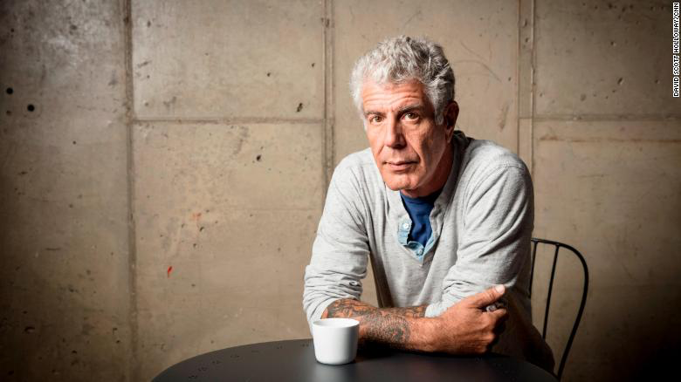

Slide 20
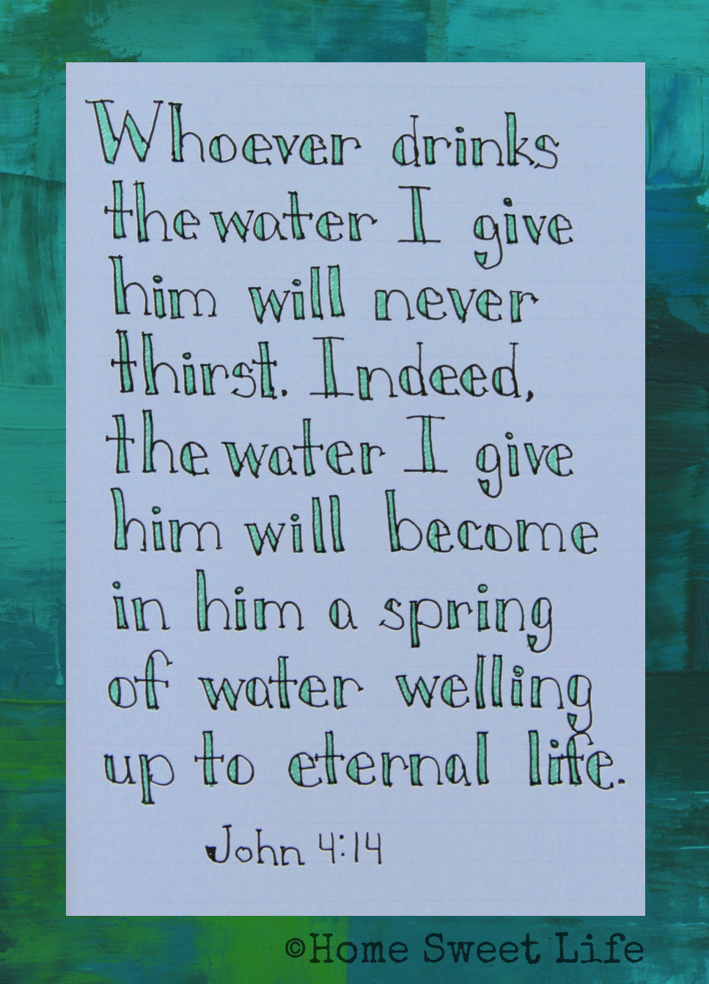

Slide 21
Hope in Jesus

Slide 22
¹⁸ So we fix our eyes not on what is seen, but on what is unseen, since what is seen is temporary, but what is unseen is eternal.
2 Corinthians 4:18 (NIV)

Slide 23
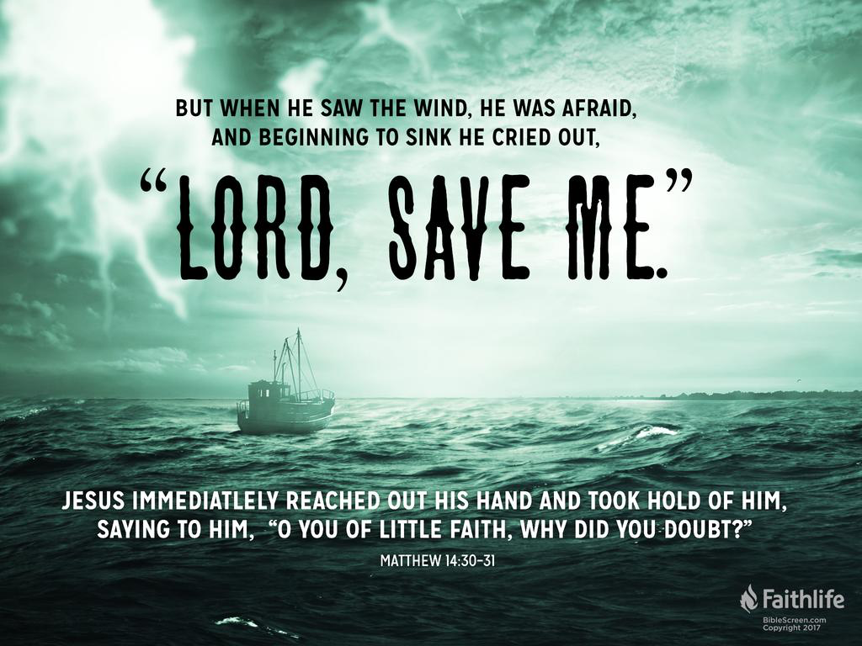

Slide 24
Lessons for Disciples

