Slide 1
Advent
Refiner’s Fire

Slide 3
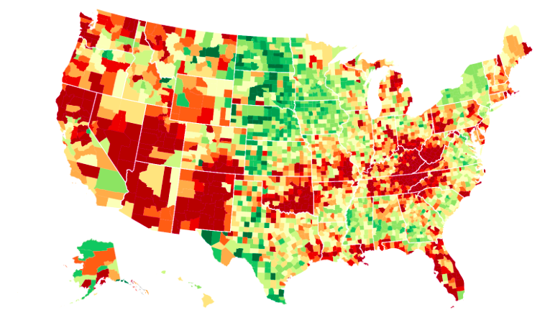

Slide 4
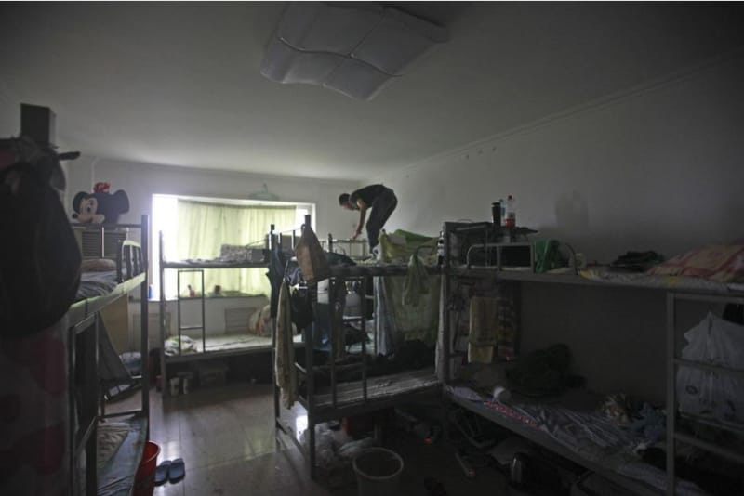

Slide 5
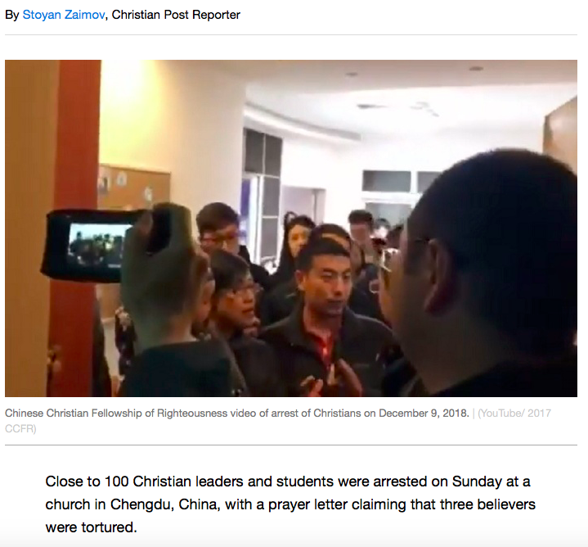

Slide 6
¹ Marshal your troops now, city of troops, for a siege is laid against us. They will strike Israel’s ruler on the cheek with a rod.
² “But you, Bethlehem Ephrathah, though you are small among the clans of Judah, out of you will come for me one who will be ruler over Israel, whose origins are from of old, from ancient times.”

Slide 7
³ Therefore Israel will be abandoned until the time when she who is in labor bears a son, and the rest of his brothers return to join the Israelites.
⁴ He will stand and shepherd his flock in the strength of the Lord, in the majesty of the name of the Lord his God. And they will live securely, for then his greatness will reach to the ends of the earth.
⁵ And he will be our peace.
Micah 5:1-5a

Slide 8
A difficult situation

Slide 9
Micah – Prophesied 737 to 696 B.C.
Prophesied the destruction of Jerusalem
Babylonian Captivity – 587 B.C.

Slide 10
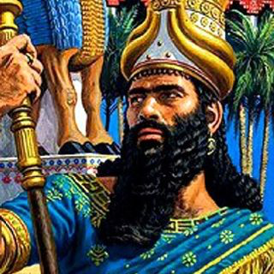

Slide 11
¹ Marshal your troops now, city of troops, for a siege is laid against us. They will strike Israel’s ruler on the cheek with a rod.

Slide 12
Why does God allow suffering?
The Fall
Consequences of Sin/Disobedience
God’s Intervention
Persecution

Slide 14
The hope of a Savior

Slide 15
² “But you, Bethlehem Ephrathah, though you are small among the clans of Judah, out of you will come for me one who will be ruler over Israel, whose origins are from of old, from ancient times.”
³ Therefore Israel will be abandoned until the time when she who is in labor bears a son, and the rest of his brothers return to join the Israelites.

Slide 17
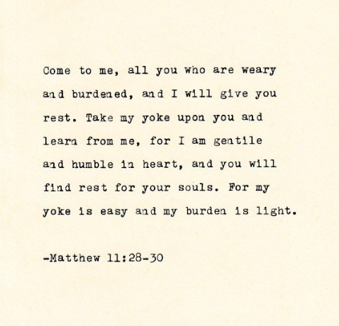

Slide 18
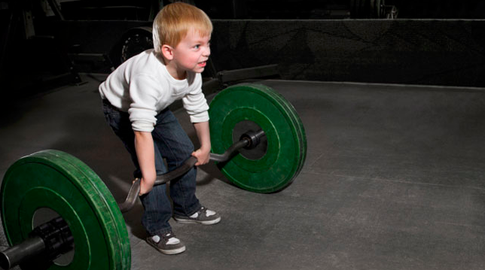

Slide 19
Our Future Hope

Slide 20
⁴ He will stand and shepherd his flock in the strength of the Lord, in the majesty of the name of the Lord his God. And they will live securely, for then his greatness will reach to the ends of the earth.
⁵ And he will be our peace.

Slide 21
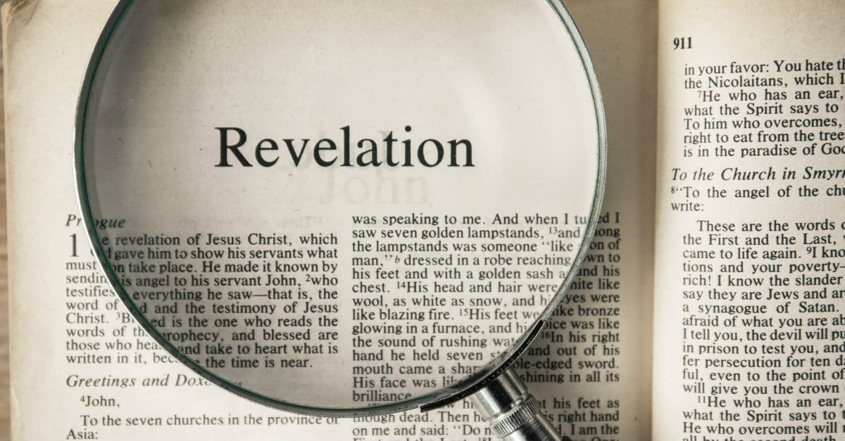

Slide 23
Lessons for disciples

Slide 24
Be comforted by the truth of God’s word
Draw close to Jesus in prayer
Anticipate His second coming

Slide 25
