Slide 1
The Christian Life
Humility

Slide 2
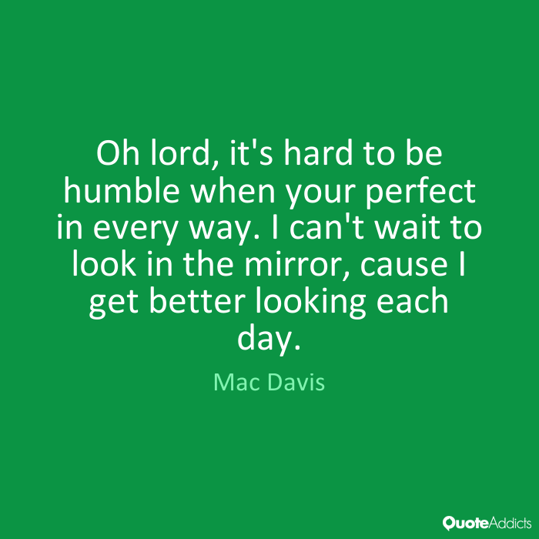

Slide 3
⁹ To some who were confident of their own righteousness and looked down on everyone else, Jesus told this parable: ¹⁰ “Two men went up to the temple to pray, one a Pharisee and the other a tax collector. ¹¹ The Pharisee stood by himself and prayed: ‘God, I thank you that I am not like other people—robbers, evildoers, adulterers—or even like this tax collector. ¹² I fast twice a week and give a tenth of all I get.’

Slide 4
¹³ “But the tax collector stood at a distance. He would not even look up to heaven, but beat his breast and said, ‘God, have mercy on me, a sinner.’
¹⁴ “I tell you that this man, rather than the other, went home justified before God. For all those who exalt themselves will be humbled, and those who humble themselves will be exalted.”
Luke 18:9-14

Slide 5
Respond in humility to God’s undeserved mercy.

Slide 6
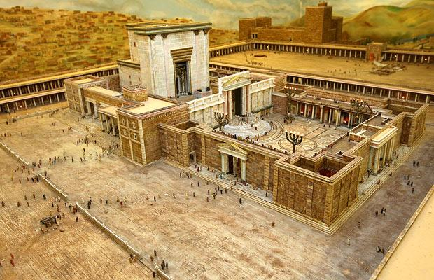

Slide 7
⁹ To some who were confident of their own righteousness and looked down on everyone else, Jesus told this parable:

Slide 8
A misplaced focus
A plea for mercy
Going home justified

Slide 9
¹⁰ “Two men went up to the temple to pray, one a Pharisee and the other a tax collector. ¹¹ The Pharisee stood by himself and prayed: ‘God, I thank you that I am not like other people—robbers, evildoers, adulterers—or even like this tax collector. ¹² I fast twice a week and give a tenth of all I get.’

Slide 10
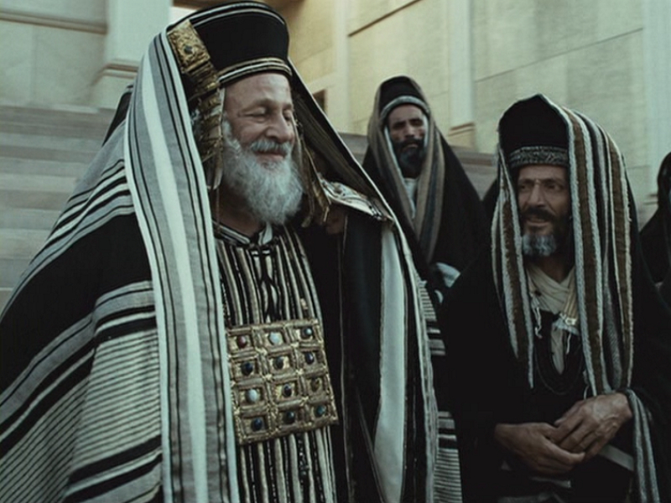

Slide 12
It isn't that the Pharisee is speaking falsely, but rather that the Pharisee misses the true nature of his blessing. As Luke states in his introductory sentence, he has trusted in himself. His prayer of gratitude may be spoken to the Lord, but it is really about himself. He locates his righteousness entirely in his own actions and being.
Dr. David Lose

Slide 14
A misplaced focus
A plea for mercy
Going home justified

Slide 15
¹³ “But the tax collector stood at a distance. He would not even look up to heaven, but beat his breast and said, ‘God, have mercy on me, a sinner.’

Slide 16
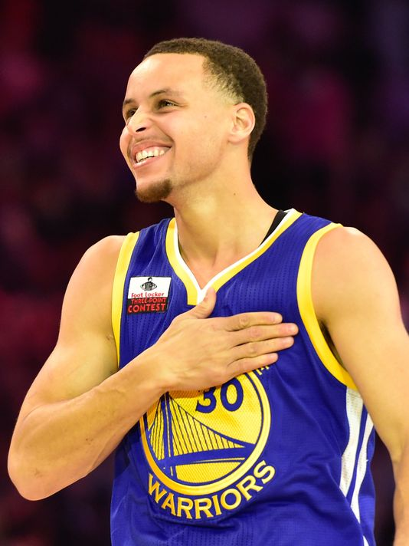

Slide 17
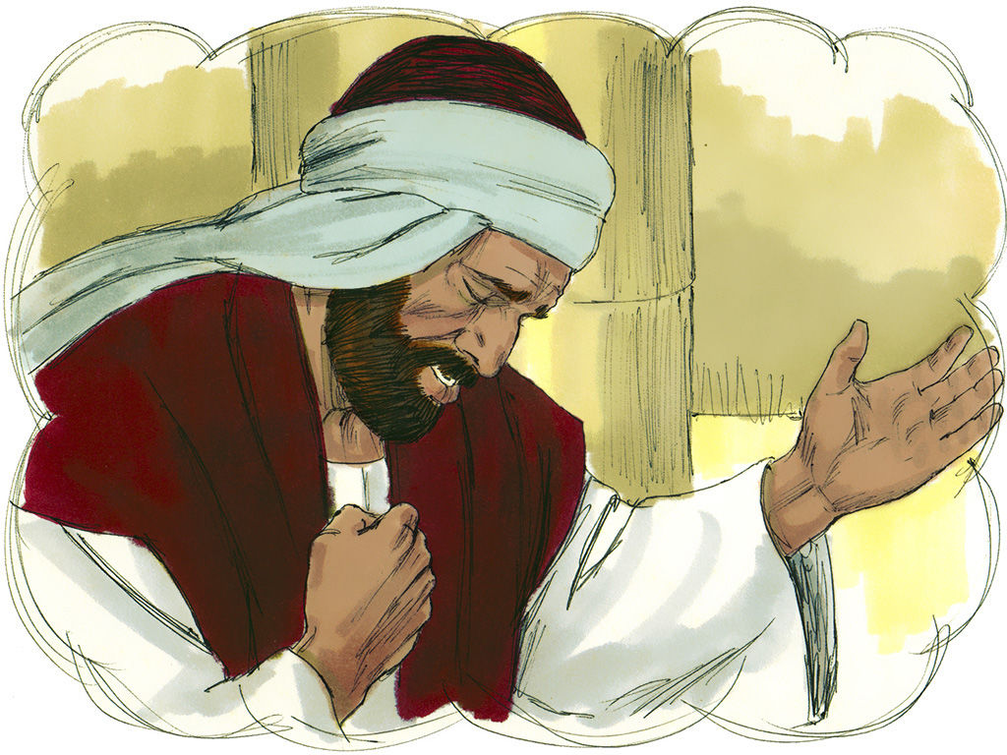

Slide 18
Most holy and merciful Father:
I confess to you and to others . . .
that I have sinned by my own fault
in thought, word, and deed;
by what I have done, and by what I have left undone.
I have not loved you with my whole heart, and mind, and strength. I have not loved my neighbors as myself. I have not forgiven others, as I have been forgiven.
Have mercy on me, Lord.
I have been deaf to your call to serve, as Christ served me. I have not been true to the mind of Christ. I have grieved your Holy Spirit.
Have mercy on me, Lord.

Slide 19
I confess to you, Lord, all my past unfaithfulness: the pride, hypocrisy, and impatience of my life,
I confess to you, Lord.
My self-indulgent appetites and ways, and my exploitation of other people,
I confess to you, Lord.
My anger at my own frustration, and my envy of those more fortunate than myself,
I confess to you, Lord. . .
My negligence in prayer and worship, and my failure to commend the faith that is in me,
I confess to you, Lord.

Slide 20
A misplaced focus
A plea for mercy
Going home justified

Slide 21
¹⁴ “I tell you that this man, rather than the other, went home justified before God. For all those who exalt themselves will be humbled, and those who humble themselves will be exalted.”
Luke 18:9-14

Slide 22
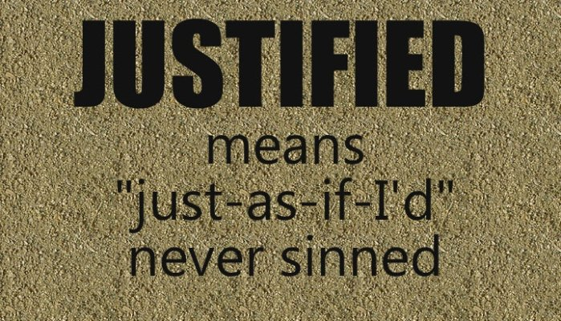

Slide 23
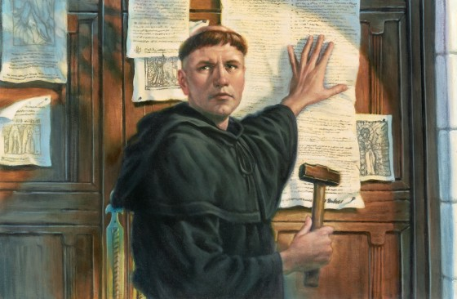

Slide 24
We find ourselves, yet again, with nothing to claim but our dependence on God's mercy. When this happens and we forget if only for a moment our human-constructed divisions and stand before God aware only of our need, then we, too, are justified by the God of Jesus and invited to return to our homes in mercy, grace, and gratitude.
Dr. David Lose

Slide 25
Respond in humility to God’s undeserved mercy.

Slide 26
