Slide 1
Jesus
His Identity

Slide 2
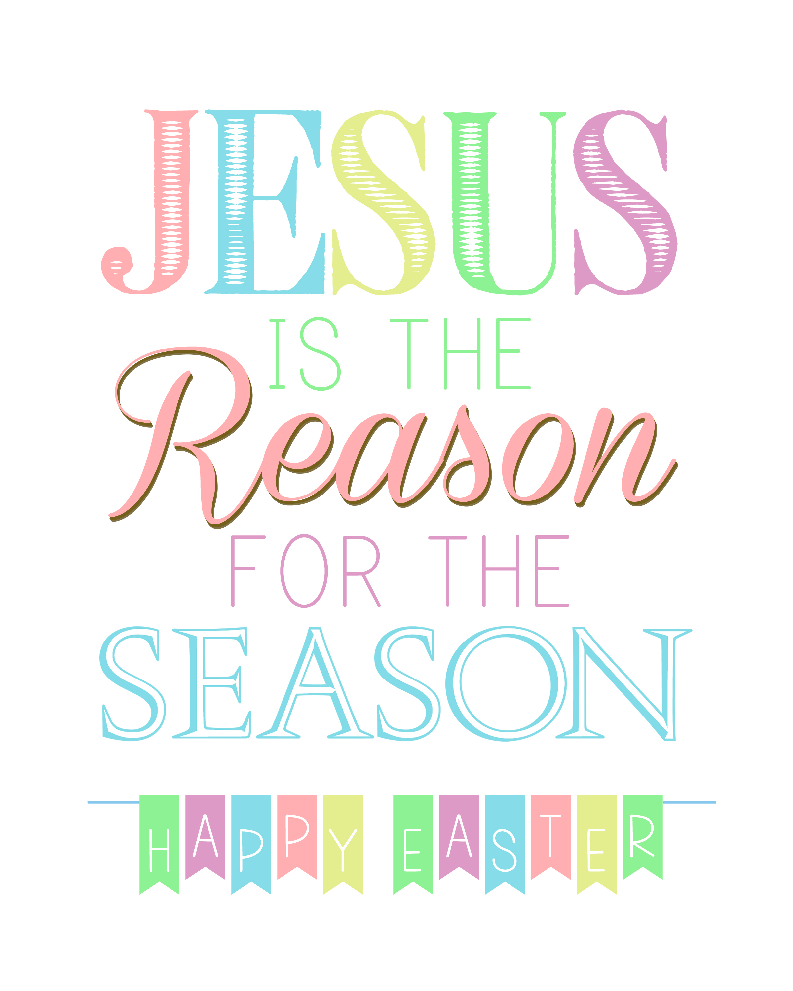

Slide 5
²² Then came the Festival of Dedication at Jerusalem. It was winter, ²³ and Jesus was in the temple courts walking in Solomon’s Colonnade. ²⁴ The Jews who were there gathered around him, saying, “How long will you keep us in suspense? If you are the Messiah, tell us plainly.”

Slide 6
²⁵ Jesus answered, “I did tell you, but you do not believe. The works I do in my Father’s name testify about me, ²⁶ but you do not believe because you are not my sheep. ²⁷ My sheep listen to my voice; I know them, and they follow me. ²⁸ I give them eternal life, and they shall never perish; no one will snatch them out of my hand. ²⁹ My Father, who has given them to me, is greater than all; no one can snatch them out of my Father’s hand. ³⁰ I and the Father are one.”

Slide 7
Context

Slide 8
²² Then came the Festival of Dedication at Jerusalem. It was winter, ²³ and Jesus was in the temple courts walking in Solomon’s Colonnade.

Slide 10
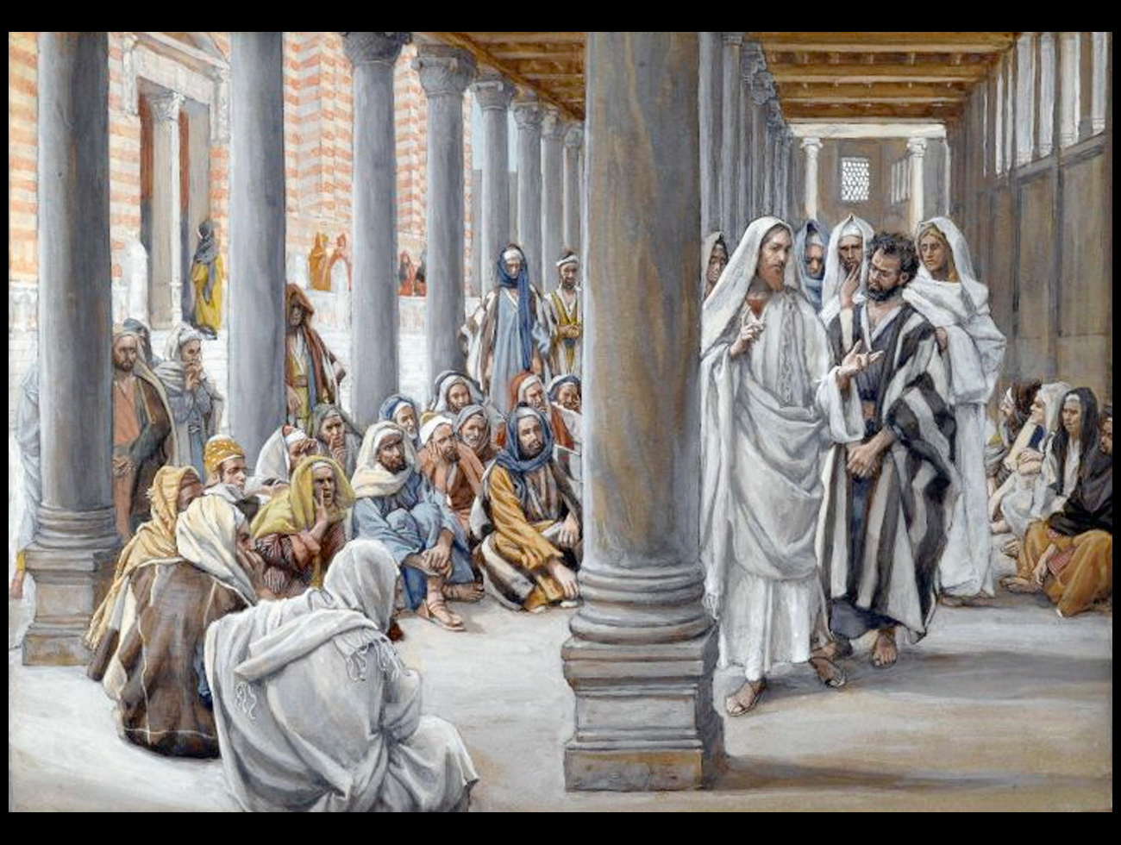

Slide 11
Question & Answer

Slide 12
²⁴ The Jews who were there gathered around him, saying, “How long will you keep us in suspense? If you are the Messiah, tell us plainly.”

Slide 13
Two disciples: Rabbi and Messiah (1:37-41)
Nathanael: Rabbi, Son of God, and King of Israel (1:49)
Nicodemus: Rabbi and teacher come from God (3:2)
Samaritan woman: Prophet and Messiah (4:19, 29)
Samaritan People: Savior of the world (4:42)
Feeding of the 5,000: Prophet" and King (6:14-15)
Peter: the Holy One of God (6:66-69)
Crowds: good man (7:12), prophet (7:40), Messiah (7:41-43)
Man born blind: Jesus (9:11), prophet (9:17), Lord (9:38)

Slide 14
Authorities: "Jesus, son of Joseph (6:42)
Crowds: deceiver (7:12); demon-possessed (7:20), deny his being Messiah (7:41-43)
Authorities: demon-possessed Samaritan (8:48, 52), blasphemer (8:57-59).
Authorities questioning blind man: a Sabbath-breaking sinner (9:16, 24).

Slide 16
²⁵ Jesus answered, “I did tell you, but you do not believe. The works I do in my Father’s name testify about me, ²⁶ but you do not believe because you are not my sheep.

Slide 17
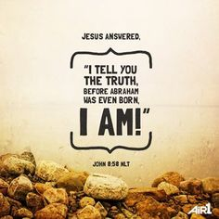

Slide 18
²⁵ Jesus answered, “I did tell you, but you do not believe. The works I do in my Father’s name testify about me, ²⁶ but you do not believe because you are not my sheep.

Slide 19
Shepherd & Sheep

Slide 20
²⁷ My sheep listen to my voice; I know them, and they follow me.

Slide 22
²⁸ I give them eternal life, and they shall never perish; no one will snatch them out of my hand. ²⁹ My Father, who has given them to me, is greater than all; no one can snatch them out of my Father’s hand.

Slide 23
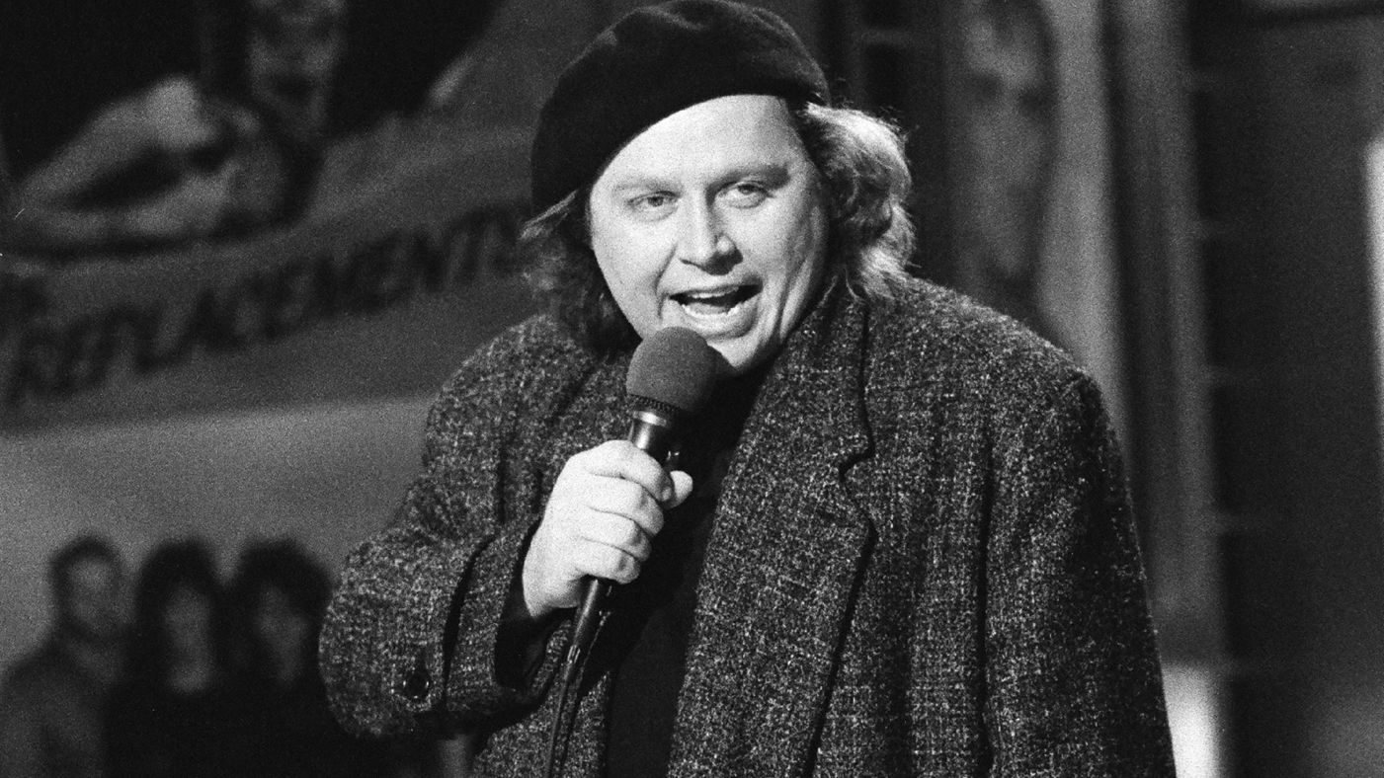

Slide 24
Savior & God

Slide 25
²⁸ I give them eternal life, and they shall never perish; no one will snatch them out of my hand. ²⁹ My Father, who has given them to me, is greater than all; no one can snatch them out of my Father’s hand. ³⁰ I and the Father are one.”

Slide 26
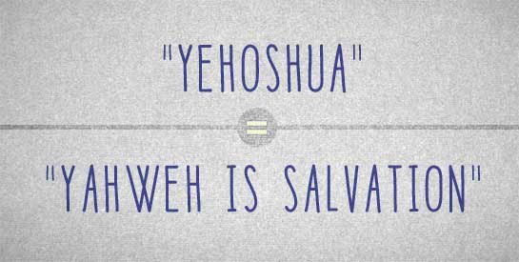

Slide 27
Lessons for Disciples

Slide 28
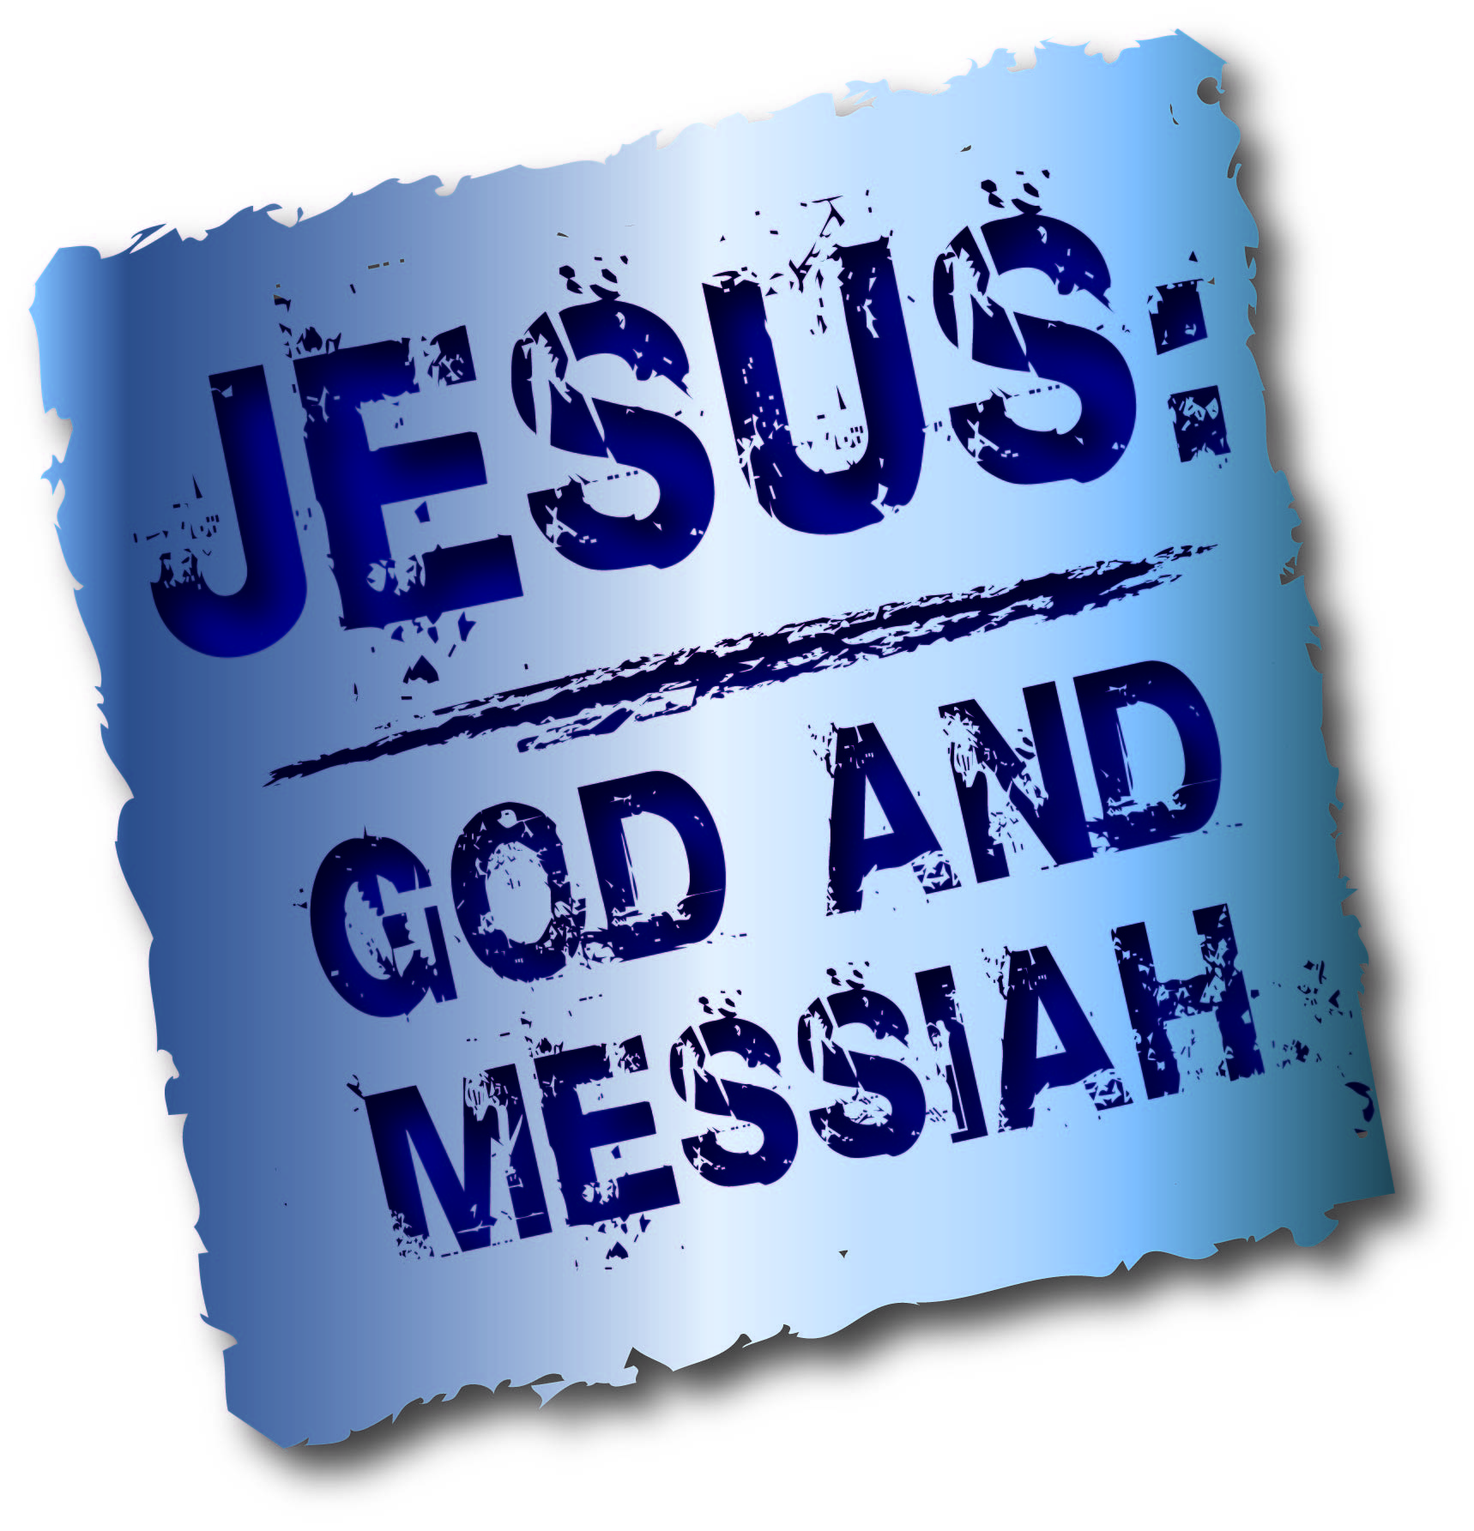

Slide 29
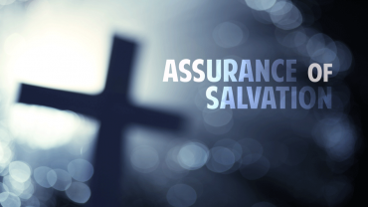

Slide 30
