Slide 1
Journey to the Cross
Jesus’ Longing

Slide 4
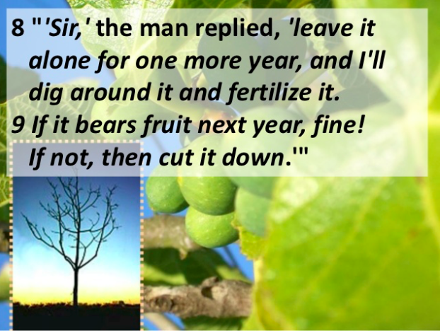

Slide 6
³¹ At that time some Pharisees came to Jesus and said to him, “Leave this place and go somewhere else. Herod wants to kill you.”
³² He replied, “Go tell that fox, ‘I will keep on driving out demons and healing people today and tomorrow, and on the third day I will reach my goal.’ ³³ In any case, I must press on today and tomorrow and the next day—for surely no prophet can die outside Jerusalem!

Slide 7
³⁴ “Jerusalem, Jerusalem, you who kill the prophets and stone those sent to you, how often I have longed to gather your children together, as a hen gathers her chicks under her wings, and you were not willing. ³⁵ Look, your house is left to you desolate. I tell you, you will not see me again until you say, ‘Blessed is he who comes in the name of the Lord.’”
Luke 13:31-35

Slide 8
Renew our desire for friends to know Jesus.

Slide 9
Context

Slide 10
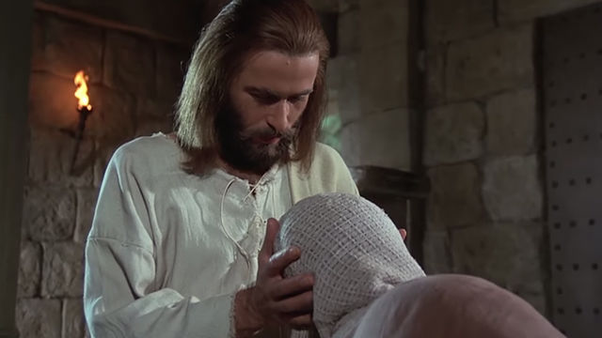

Slide 11
A stern warning

Slide 12
³¹ At that time some Pharisees came to Jesus and said to him, “Leave this place and go somewhere else. Herod wants to kill you.”

Slide 13
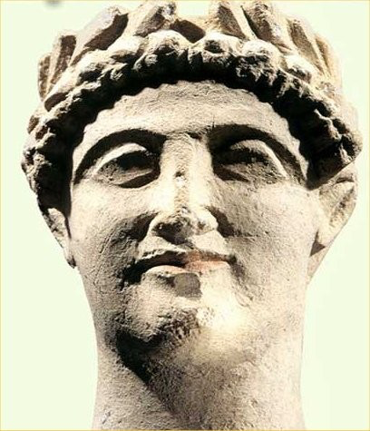

Slide 14
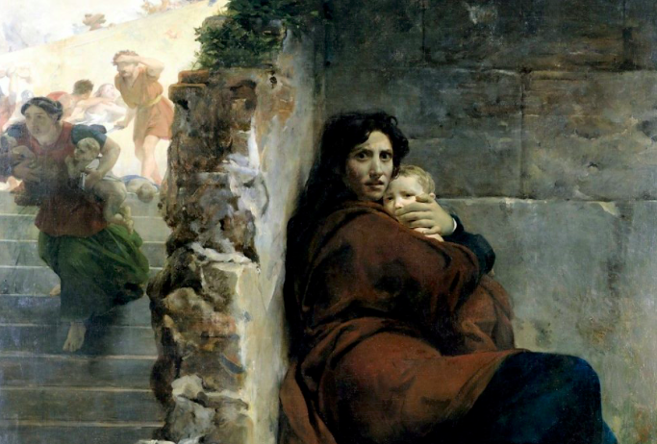

Slide 15
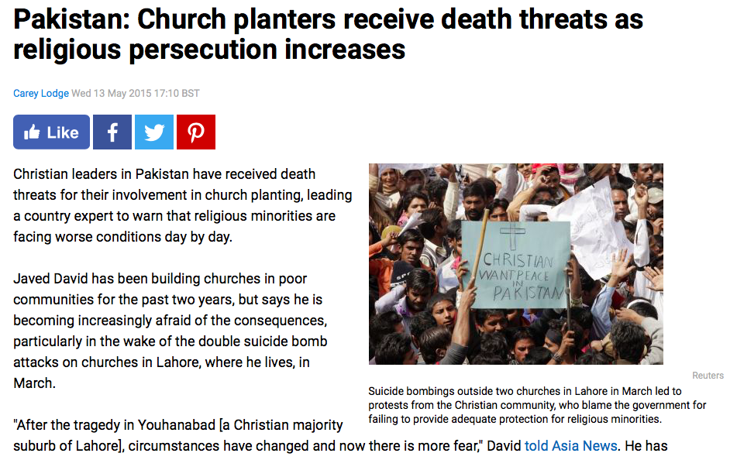

Slide 17
About God’s business. . .

Slide 18
³² He replied, “Go tell that fox, ‘I will keep on driving out demons and healing people today and tomorrow, and on the third day I will reach my goal.’ ³³ In any case, I must press on today and tomorrow and the next day—for surely no prophet can die outside Jerusalem!

Slide 20
An unfulfilled desire

Slide 21
³⁴ “Jerusalem, Jerusalem, you who kill the prophets and stone those sent to you, how often I have longed to gather your children together, as a hen gathers her chicks under her wings, and you were not willing. ³⁵ Look, your house is left to you desolate. I tell you, you will not see me again until you say, ‘Blessed is he who comes in the name of the Lord.’”
Luke 13:31-35

Slide 23
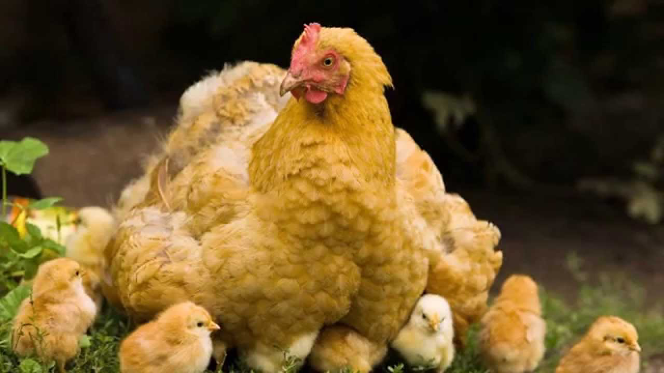

Slide 24
Lesson for disciples

Slide 25
Renew our desire for friends to know Jesus.

