Slide 1
Empowered
Jesus’ Witnesses

Slide 3
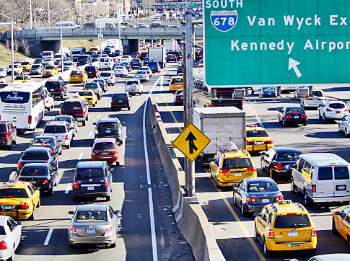

Slide 4
We are empowered by the Holy Spirit to be Jesus’ witnesses to the world.

Slide 5
¹ In my former book, Theophilus, I wrote about all that Jesus began to do and to teach ² until the day he was taken up to heaven, after giving instructions through the Holy Spirit to the apostles he had chosen. ³ After his suffering, he presented himself to them and gave many convincing proofs that he was alive. He appeared to them over a period of forty days and spoke about the kingdom of God. ⁴ On one occasion, while he was eating with them, he gave them this command: “Do not leave Jerusalem, but wait for the gift my Father promised, which you have heard me speak about. ⁵ For John baptized with water, but in a few days you will be baptized with the Holy Spirit.”

Slide 6
⁶ Then they gathered around him and asked him, “Lord, are you at this time going to restore the kingdom to Israel?”
⁷ He said to them: “It is not for you to know the times or dates the Father has set by his own authority. ⁸ But you will receive power when the Holy Spirit comes on you; and you will be my witnesses in Jerusalem, and in all Judea and Samaria, and to the ends of the earth.”
⁹ After he said this, he was taken up before their very eyes, and a cloud hid him from their sight.
Acts 1:1-9

Slide 7
Context

Slide 8
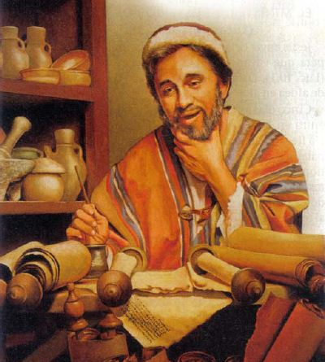

Slide 9
¹ In my former book, Theophilus, I wrote about all that Jesus began to do and to teach ² until the day he was taken up to heaven, after giving instructions through the Holy Spirit to the apostles he had chosen. ³ After his suffering, he presented himself to them and gave many convincing proofs that he was alive. He appeared to them over a period of forty days and spoke about the kingdom of God. ⁴ On one occasion, while he was eating with them, he gave them this command: “Do not leave Jerusalem, but wait for the gift my Father promised, which you have heard me speak about. ⁵ For John baptized with water, but in a few days you will be baptized with the Holy Spirit.”
⁹ After he said this, he was taken up before their very eyes, and a cloud hid him from their sight.

Slide 10
Empowered by the Spirit. . .

Slide 12
⁷ He said to them: “It is not for you to know the times or dates the Father has set by his own authority. ⁸ But you will receive power when the Holy Spirit comes on you; and you will be my witnesses in Jerusalem, and in all Judea and Samaria, and to the ends of the earth.”

Slide 13
you will receive. . .
“predictive future tense” -- indicates something will certainly take place or come to pass.

Slide 14
power when the Holy Spirit comes on you. . .
Political - “Lord, are you at this time going to restore the kingdom to Israel?”
or
Individual – “when the Holy Spirit comes on you. . .”

Slide 17
Jesus’ Witnesses. . .

Slide 18
⁸ But you will receive power when the Holy Spirit comes on you; and you will be my witnesses in Jerusalem, and in all Judea and Samaria, and to the ends of the earth.”

Slide 19
Each of us is called to be a witness of:
Jesus’ life and character
Jesus’ work on the cross
Jesus’ Gospel of Hope

Slide 20
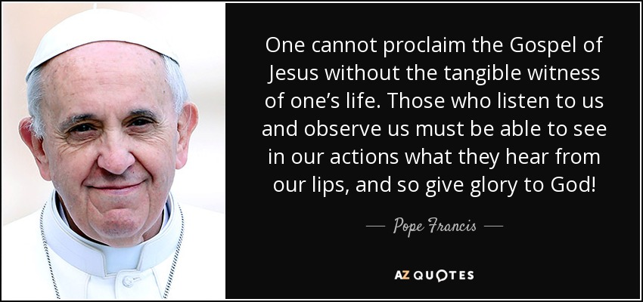

Slide 21
To the world. . .

Slide 22
⁸ But you will receive power when the Holy Spirit comes on you; and you will be my witnesses in Jerusalem, and in all Judea and Samaria, and to the ends of the earth.”

Slide 23
Seek to be a witness through simplified missional living:
Eat with non-Christians
Walk, don’t drive
Be a regular
Hobby with Non-Christians
Talk to your co-workers
Volunteer with non-profits
Participate in city events
Serve your neighbors

Slide 25
We are empowered by the Holy Spirit to be Jesus’ witnesses to the world.

Slide 26
