Slide 1
Christmas Reflection
The Word, Our Word

Slide 2
www.zazzle .com

Slide 4
In the beginning was the Word, and the Word was with God, and the Word was God. He was with God in the beginning. Through him all things were made; without him nothing was made that has been made. In him was life, and that life was the light of all mankind. The light shines in the darkness, and the darkness has not overcome it.

Slide 5
There was a man sent from God whose name was John. He came as a witness to testify concerning that light, so that through him all might believe. He himself was not the light; he came only as a witness to the light.

Slide 6
The true light that gives light to everyone was coming into the world. He was in the world, and though the world was made through him, the world did not recognize him. He came to that which was his own, but his own did not receive him.

Slide 7
Yet to all who did receive him, to those who believed in his name, he gave the right to become children of God— children born not of natural descent, nor of human decision or a husband’s will, but born of God.

Slide 8
The Word became flesh and made his dwelling among us. We have seen his glory, the glory of the one and only Son, who came from the Father, full of grace and truth.

Slide 9
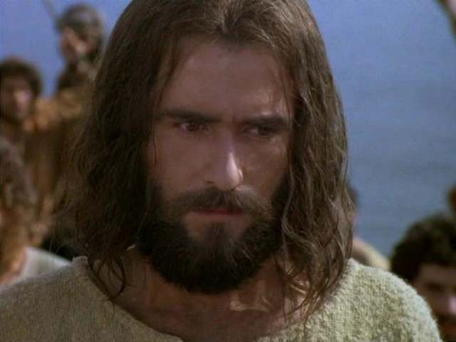
Who is Jesus?
The Jesus Film

Slide 10
¹In the beginning was the Word, and the Word was with God, and the Word was God. ²He was with God in the beginning. ³Through him all things were made; without him nothing was made that has been made.

Slide 11
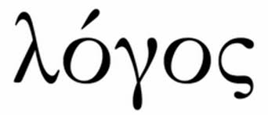

Slide 12
In the mind of the ancient Jews, the phrase "the word of God" could be used to refer to God Himself.
Exodus 19:17: "Moses brought the people out of the camp to meet the word of God. "

Slide 13
The Greek philosophers saw the logos as the power which puts sense into the world, making the world orderly instead of chaotic. . . They saw the logos as the "Ultimate Reason" that controlled all things.

Slide 16
What did He do?

Slide 17
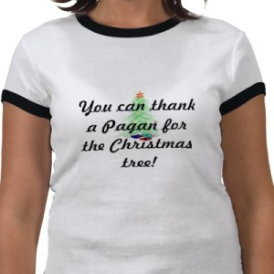

Slide 18
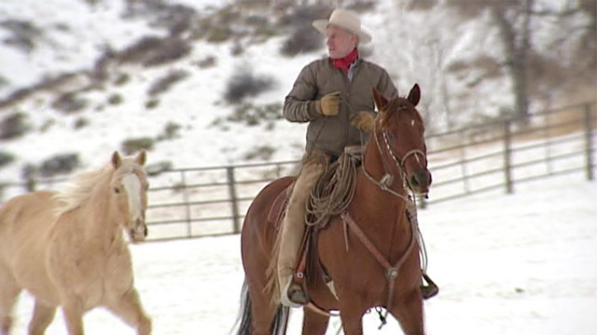
Buck Brannaman

Slide 19
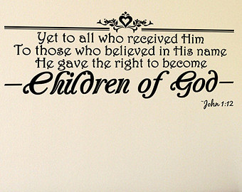
How should we respond?
Etsy

Slide 20
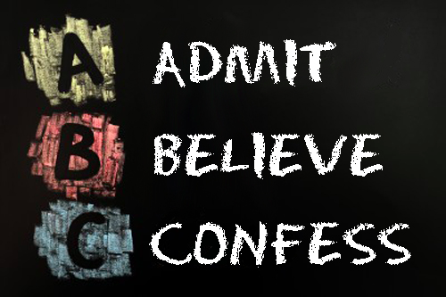

Slide 21
